Slide 1

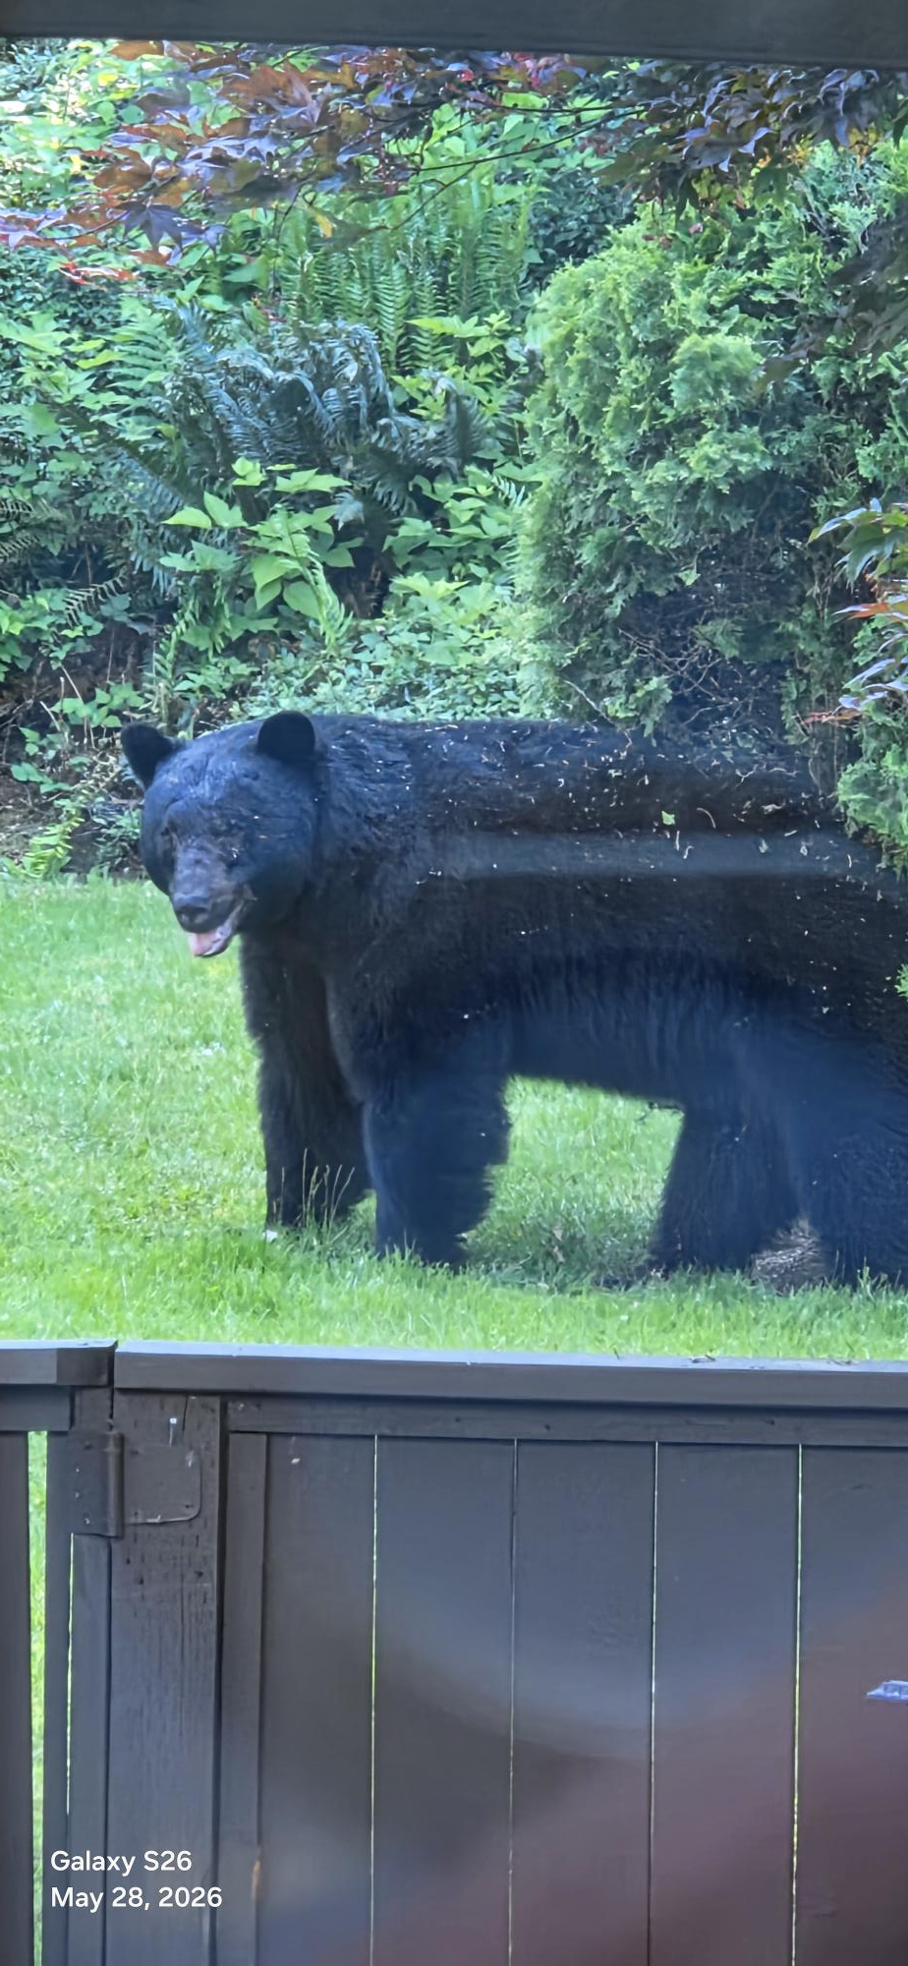
SCHOLARSHIP MEETING #1
WELCOME!

Slide 2
Quick survery
Who uses Instagram?
Who uses Teams?
If I created a team would you join?

Slide 3

New Centennial Career Centre Website
Download:
- How to Apply to Post Secondary
-Scholarship Mtg 1 Handout (info & list of scholarships)
UNDER CONSTRUCTION!

Slide 4
Scholarship eligibility:
*Graduating students*Canadian Citizenship, PR or Landed Immigrant Status, Protected persons/Refugees will fulfill most requirements and criteria.
**International Students do not meet this requirement.
There are a few sources of funding for International students via government agencies, post-secondary institutions and other independent donors
------------------------------------------------------------------------------------------------------------------------------------
INTRODUCTION & updates
DEFINITIONS
DEFINING NEED-
APPLICATION STRATEGIES
POST SECONDARY timelines
Mark you calendars!
Scholarship Meeting #2 in the library on
February 18 2027
Local Scholarship form & SD43 Scholarship form due:
April 15 2027

Slide 5
Fall updates to note:
SFU does not require self reporting.
SFU has one approved course list. More holistic approach to admission. AP level course = approved course.
2nd year of SFU-EXETER NEW ACCELERATED LAW (6yr dual degree) program. Accelerated Law (SFU-Exeter) - Faculty of Arts and Social Sciences - Simon Fraser University
Grade 11 science req’s have expanded for the Faculty of Science. (two of chem 11, life sci 11 or physics 11)
New* Have a minimum grade of 70% or higher in a senior level English (11/12)
Medical School had its first cohort last year.

Slide 6
SFU – Grade ranges from low 90’s to low 80’s
Applied Sciences (Engineering)
Canadian and permanent residents: high 80s to low 90s
Students studying on a student visa: high 80s to low 90s
Beedie School of Business
Minimum grades in the 80s and supplemental application
Arts and Social Sciences
Canadian and permanent residents: low 80s
Students studying on a student visa: mid 80s
Environment
Canadian and permanent residents: low 80s
Students studying on a student visa: low 80s
Health Sciences
Canadian and permanent residents: mid 80s
Students studying on a student visa: high 80s
Science
Canadian and permanent residents: mid 80s
Students studying on a student visa: high 80s

Slide 7
UBC Updates
UBC no longer has an ‘early admission deadline’. The deadline to apply by Dec 1st is only for selected major scholarships.
Now using first review process to assess students early. Top students can apply earlier to be assessed earlier.
UBC Admission averages continue to increase across all faculties. UBCO New BCom program (re-brand in 2025) Aligns with Sauder UBCVan.

Slide 8
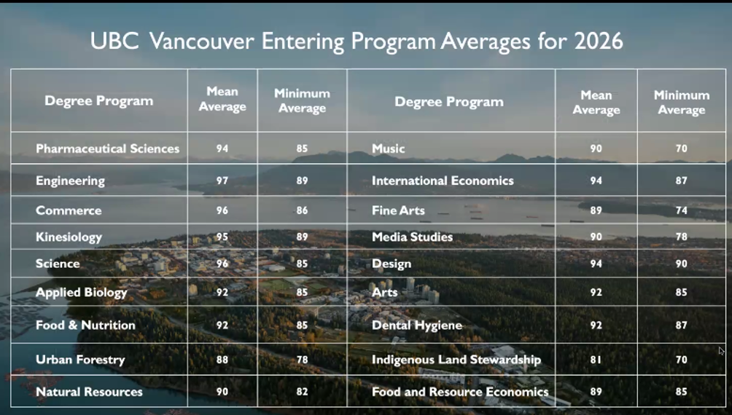

Slide 9
OTHER
Douglas College. Nursing Foundations closes Oct 16. Volunteer hours waived for most programs except SW.
Apply early for Limited Entry programs.
TRADES many waitlisted 2 years plus (Electrical, Hvac, Piping). Apply EARLY in grade 12. *VCC added Electrical in Jan 2026.
BCIT Apply Early for popular programs – spots fill. Upload DVR when applying. (see counsellor) On campus housing.
KPU now offers an Engineering diploma (2yr) for Transfer.
UVIC No supplemental for BCom. Deadline Jan 31 most programs.
If you meet criteria - APPLY FOR ENTRANCE AWARDS! THEY HAVE FUNDS AVAILABLE only FOR HIGH SCHOOL GRADS!!

Slide 10
Scholarships open and close during the year.
WHEN should I apply for scholarships?
Start NOW for Entrance Scholarships and National/Major Awards
Most scholarship deadlines occur within the months of February-May

Slide 11



Post-Secondary Funding options:
Student Aid BC (re-payment)
For student loans there is an expectation that YOU and your parents will contribute some funds to your education! Talk to your parents about this.
Do research on the website http://www.studentaidbc.ca
Bank Loans (re-payment)
Savings from part-time and/or summer employment
REF (Registered Education Fund) or money from family
Scholarships
Awards
Bursaries (based on financial need/family income)

Slide 12
SCHOLARSHIPS, BURSARIES & AWARDS - AN OVERVIEW
Financial aid is not the same as Financial need
Financial Aid:
Refers to general monetary support as a loan or scholarship, that is used to pay for school, especially higher education:
“I don’t qualify for need-based financial aid, so I’ll apply for merit-based achievement, community service and/or leadership awards.”
Financial Need:
The difference between the cost of an educational program and what the student can afford to pay. One's financial need may qualify one for grants, scholarships, low-interest loans or bursaries and/or student aid.
PAYING FOR POST-SECONDARY CAN BE A COMBINATION OF VARIOUS SOURCES OF FUNDING!!

Slide 13
Student Aid BC - Explore the website EARLY IN 2027- BUT
YOU CAN’T APPLY UNTIL JUNE 2027
Parental & student annual income is considered for students applying for Student Aid BC for both low- and median-income households. You and your parents are expected to contribute to your education costs.
2026/2027 weekly maximums for full-time students.
If you do not have dependant children, you can receive up to $520 per week of full-time study.
Note: the above amounts reflect a temporary increase to the weekly Canada Student Loan limit, in place until July 31, 2027.
The total amount you receive is determined by the length of your study period measured in weeks.

Slide 14
Sample Costs of Post Secondary
College:
Douglas College: First year full time Tuition can range from $5,000 to $13,000 per year including Fees & Books- depending on choice of program and where you live.
University:
UBC approx $22,000 per year full load, (including living on campus (shared/ meal plan) books fees and living expenses.
Private colleges and universities and US schools have much higher tuition.
Trades (applying direct in grade 12 (not TRAIN in trades with SD43)
Foundation programs (~24 weeks on average) $2K to $4K plus gear. Lots of funding available. Many programs are waitlisted 2yrs or more. Courses may run regularly throughout the year. More training seats are being added.

Slide 15

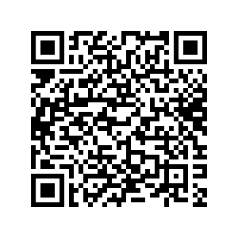
PROVINCIAL SCHOLARSHIP PROGRAM
BC Pathway to Teacher Education Scholarship $5,000
(20 awards available to students entering a recognized Faculty of Education program) Apply direct.
BC Excellence Awards $5,000 One nominee per school for consideration
There are 55 BC Excellence Scholarships available to recognize well-rounded B.C. graduates. Winners will have demonstrated service and leadership, both at school and in their communities, and shown aptitude and commitment to their chosen career paths. They will receive a $5000 scholarship voucher to use for post-secondary tuition. Internal form DUE: Jan 22 for submission Feb 15th
BC Achievement Scholarships $1,250 Automatic Students do not apply.
Recognize the top 8000 graduates in the province.
link to website

Slide 16

District Authority Awards $1250.00 - Due April 15
Apply via our internal local scholarship package in the SPRING. 35-40 available for Centennial graduates.
Must be a CDN citizen or PR (landed immigrant) Be a B.C. resident. Valid for 5 years.
Superior Achievement/Excellence in
• Fine Arts
• Applied Skills
• Trades and Technology
• Physical Activity
•Curricular Second/international Languages
•District / Curricular Technical & Trades Training
•School & Community Service (min 100 hours to apply)
• Indigenous Languages and Culture
The application will require teacher signature which verifies that you EXCEL in the focus area.

Slide 17
Major Scholarships & Major Entrance Scholarships (Merit based)
Deadlines are early in the school year
.
Major and Entrance Awards:
Loran Awards (October 15) Community service no nomination required. Appy directly
Queen’s University Entrance Award Chancellors (December) (3) Merit – Speak to your counsellor
SFU USES Entrance Awards Dec 15
UBC Centennial Scholars Awards Dec. 1
Schulich Leader Scholarships - Early January (internal via Form due Jan 15) (1) Apply to be our nominee
Cmolik (Jan 22) (1) Apply internally to be our nominee (Adversity/Tenacity)
University of Western Ontario (Jan 20) Merit
SFU UGGLA (January 19th 2026) Apply direct. Ten scholarships are awarded each year to students who face significant financial barriers to participation in post-secondary education. This may include students who identify as Indigenous, Black, or a person of colour, students living with disabilities, LGBTQIA2S+ students, and students of all gender identities.
Horatio Alger Awards (Opens in March)

Slide 18
Loran Scholars Program / Major Award
Value: up to $100,000, $5,000 and $2,000 awards available.
Eligibility: Must be a graduating student, have a minimum cumulative average of 85%, over the past 3 years be a Canadian Citizen or permanent resident
Loran Awards are only tenable at participating universities in Canada, but finalist and provincial awards are tenable at any accredited public university in Canada.
Criteria: Must have outstanding service, leadership and character (integrity, humility, kindness, courage, tenacity and personal autonomy) and demonstrated a commitment to serving and improving their community/school.
Deadline OCTOBER 15th 2026

Slide 19
Queen’s University. Major Admission Awards
To give you enough time to access the online Major Admission Award Application (MAA), we strongly recommend applying to Queen’s on OUAC by November 20.
QUARMS – Queens U Accelerated Route to Medicine is no longer linked to Chancellors Scholarship application- The goal of QuARMS is to offer a carefully selected group of up to 10 outstanding Black and/or Indigenous peoples that are graduating high school, an exciting and innovative 2-year pathway that culminates with application for admission to the 1st year of Med School at Queen’s. Apply via OUAC by Dec. 1 https://meds.queensu.ca/academics/quarms

Slide 20
UBC Major Entrance Awards
UBC Presidential Scholars Award (academic/leadership)
Apply to UBC through the online application by December 1 each year Select yes.
Centennial Scholars Entrance Award 80K and due December 1
(based on financial need and still be a strong academic student who is involved and meet all UBC admission requirements) Application is required. 2027 UBC Entrance Awards - The University of British Columbia
Beyond Tomorrow Scholarships - You must self-identify as Black (African, African-American, African-Canadian, Afro-Caribbean 2027 UBC Entrance Awards - The University of British Columbia
Submit your UBC application by December 1.
Awards for Aboriginal students: must self-identify on UBC application

Slide 21
SFU Entrance Awards
High School Entrance Scholarships, Awards, and Bursaries are only available to applicants applying to SFU for the Fall.
The Fall 2027 Undergraduate Scholars Entrance Scholarships application is open October 1 - December 15, 2026.
The Undergraduate Scholars Entrance Scholarship (USES) Program is designed to attract both domestic and international high school applicants who demonstrate potential to enrich the university community through ongoing academic and community contributions. The USES Program has a number of scholarships that range in value from $20,000 to $140,000. Eligible applicants will be considered for all USES Program scholarships based on one application.
(Other Entrance Scholarships may require individual applications.)

Slide 22
The process is ongoing all year:
Scholarship Applications open and close all year.
Search: which awards match your criteria?
Be clear and concise in your application. Use word counts to your advantage.
Get feedback on your essay: Edit. Edit. Edit.
Do not use companies like Grant Me to write your applications or essays – Donors may disqualify you. Do not ChatGPT or AI
This is your time to shine! Highlight what experiences you have that make you stand out!
Apply, apply, apply! Be aware of deadlines!

Slide 23

Notes: General Scholarship applications/essays:
Apply if you meet the criteria.
Tailor your application /essay to the donor’s goals and criteria
Know your competition/candidate pool:
  Centennial only (school based) or
  Coquitlam (Local) or
  BC (Provincial) or
  Canada-wide
Note: Local & Community awards = best odds & less competition!
The #1 complaint from donors:
“STUDENTS DON’T ANSWER THE QUESTION!”
Notes:
Expected value is the product of the chances of winning the scholarship with the amount you get if you win the scholarship. A less competitive scholarship with a lower top prize may have a higher expected value because your chances of winning are better.
The accomplishments resume can help you complete the scholarship application and improve your awareness of your strengths and interests. It can also help your teachers write better letters of recommendation.

Slide 24
Where can you find scholarships?
The Centennial Today, Instagram @cent43careercentre, Bulletin Boards, TV’s
The Career Centre Website (under construction)- Scholarships of note will be updated and available on the Financial Aid page.
Register for Scholarship search engines. Visit Post-secondary Financial Aid pages
Financial Aid Handbook posted/emailed
Ask your parents/co-workers/friends about scholarships from:
Employers, Unions, Community Clubs, Sport associations, Cultural, Heritage, Arts, Dance, Music, Foundations etc.

Slide 25

Strategies for Winning Scholarships
… JUST START.
  25% of graduating students don’t apply for any funding!
  Even among talented students, winning money involves a bit of luck, not just skill.
  To win more scholarships, apply to more scholarships!
  It gets easier after your first few applications!
  Essays can be reused and tailored to each new application
Notes:
It is very difficult for scholarship sponsors to choose between two extremely talented finalists for a scholarship, so the decision can often be arbitrary. Often there is no wrong choice for a winner. Skill gets you selected as a finalist, but the final choice of who wins may be purely random. So applying to more scholarships (for which you are qualified) will increase your chances of winning a scholarship.

Slide 26
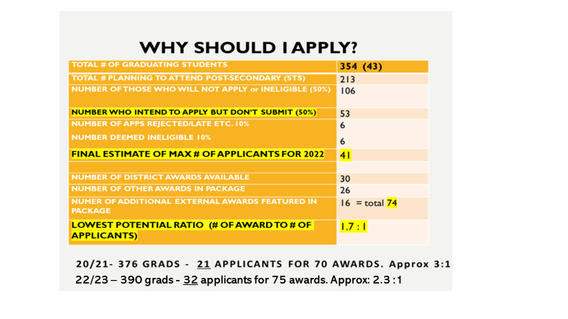
Sample ratio of winners in our local scholarship package.
23/24 360 grads, 36 applicants for 73 awards. Approx 2 : 1
24/25 375 grads, 38 applicants for 69 awards. Approx 1.7:1
25/26 360 grads, 23, applicants for 70 awards Approx 3:1

Slide 27

Writing a Winning Scholarship Essay or Personal profile
Give specific examples – unique to YOU!
Personalize your essay and be passionate! Brag a bit!
Write about something of interest to you! Be vulnerable. This makes the reader more interested.
Talk about your impact on other people and the impact of your experiences…what did you learn.
DO NOT USE CHATGPT, ESSAY WRITERS OR AI.
I am happy to support you if given time to review!
Notes:
Most people can speak and think at a rate of 100 to 200 words per minute, but type or write at a rate of 35 to 60 words per minute. The act of writing interferes with the flow of thought. After you transcribe the recording, you can revise the essay to add structure through an outline of your thoughts. Such an essay will be more fluent and passionate, making it more interesting and lively.
You should proofread a printed copy of the essay because it will be easier to find errors when you are looking at the essay in a different format. Don’t rely too much on the spelling and grammar checkers that are built into the word processing software, as these programs miss a lot of errors, such as valid-word spelling errors (e.g., its vs. it’s, though vs. through, principal vs. principle).

Slide 28

Grade 12 is YOUR best opportunity to win a scholarship!
There will never be a time with more opportunities and less competition than your grad year.
A scholarship search is…
NOT “quick and easy.” It can be a lot of work!
Expect to spend a lot of time finding leads and researching, editing your essay, filling out applications, asking for references.

Slide 29
May 30th
Hi Ms. Healeywright,
I understand it may be late, but I would like help finding scholarships.
I've been going through quite a lot of scholarship websites and haven't found
any I qualify for.
Thanks.
Most sholarships will have closed by then. Start to prepare now.
Scholarship funding is… NOT fast money! HAVE A GAME PLAN! Talk to your parents about your tuition & costs.
There is usually a 4 to 6 month delay between the time you applying and receiving funding. Your first semester tuition and fees will be due (usually in full) in August so plan accordingly.
Please DO NOT wait until MAY

Slide 30

Make the time:
Spending 2 hours applying for a scholarship saves the future you both time and money.
Win $1,250 = 73 hours of work
Win $5,000 = 294 hours of work
Beware….There are no ‘guarantees.
You might apply and receive nothing. (Centennial package applicants usually win something)
Anyone who “guarantees” scholarship/contest money or asks for money from you is probably a scam artist. Beware!

Slide 31
$ucce$$ i$ po$$ible!
Centennial Grads have WON:
2026 UBC International Scholars 180K
2025 Terry Fox Humanitarian Award 28K
2022 and 2024 U of T Arbor scholars 20K.
Cmolik 40K, Beedie 30K and SFU Uggla (full ride) 2023 and 2024!
2020 Schulich Leader winner: $80,000.
Reminder: Most grads who apply to our local package and/or District Authority Awards ($1250) and meet all criteria will win.(Spring)

Slide 32
Fall 2027 Application Timeline - BC Schools
Apply via Education Planner BC Application system (create account)
Douglas College – Applications OPEN Oct. 1 Apply for limited entry right away
SFU – Applications OPEN Oct. 1SFU Application deadline is Jan 31
SFU USES Entrance Scholarship deadline Dec. 15
UBC –Apply by Dec. 1 for the UBC Major Entrance Scholarships. Application Deadline is Jan. 15
UVic (open)–Application deadline is Jan 31 (most programs)
Capilano U – (Oct 7) Entrance Awards deadline March 1
BCIT – Applications open Oct 1 until full or by deadline date. Apps for trades programs accepted all year. (rotating). Get a DVR from your counsellor to upload

Slide 33

Deadlines are set in STONE !!
Do your research
    College & University application deadlines
    Online/Distance course completion deadlines
    Standardized test deadlines TOEFL, SAT, IELTS etc.
    Transcript request deadlines: BCeID#, STS
    Forms close automatically

Slide 34
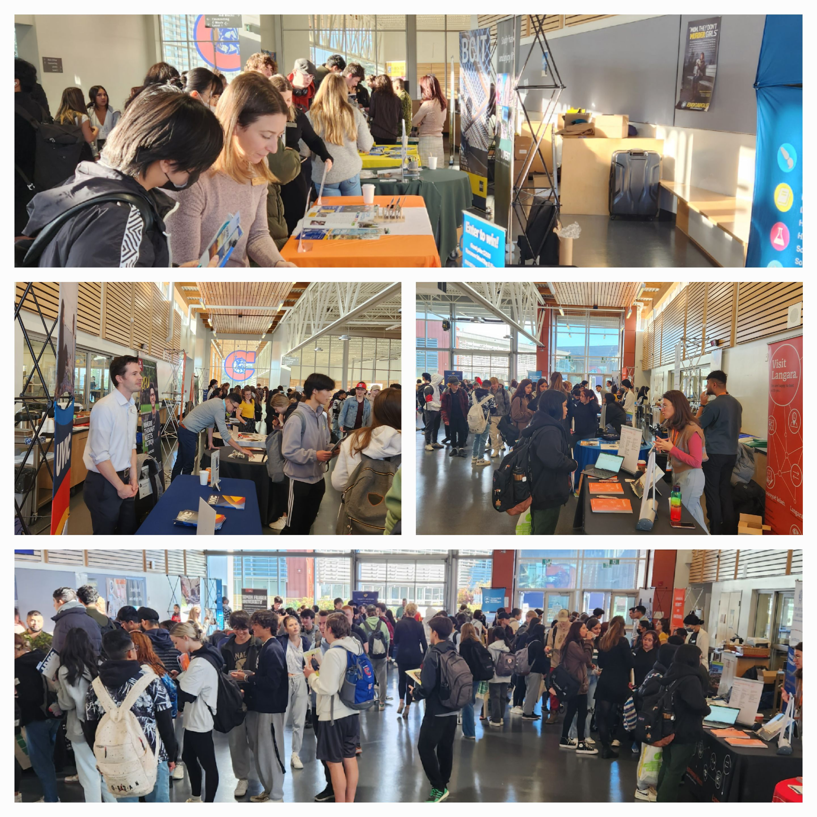
UPCOMING EVENTS & INFO SESSIONS
BCIT BIG INFO – Oct 14th Burnaby Campus
U of C info table flex at Centennial Oct 15 foyer
UVIC Gustavson Business at Centennial Oct 16 info table foyer
SFU Beedie at Centennial Oct 21 Lunch library
SFU Faculty of Applied Science at Centennial Oct 22 Lunch library
Langara Info Week Nov 2-6 (campus)
Douglas Campus Info Fair (New West Campus) Oct 27th 4-7pm
PSBC FAIR NOV 2 9-11 AM at Centennial Gr. 11/12’s
Explore CapU Campus Open House Nov 28th

Slide 35
Thanks for attending!
Next scholarship meeting Thurs. Feb 17th
Local Scholarship Application package & SD43 Community Awards/Provincial DAA Awards.
Career Centre website

Slide 36
