Slide 1

DR. CHARLES BEST SECONDARY
Grad 2027

Slide 2


GRADE 12 SURVIVAL GUIDE
Counsellors:
Ms. Rachel John Ms. Zafrin Alam Ms. Irina Birsan rjohn@sd43.bc.ca zalam@sd43.bc.ca ibirsan@sd43.bc.ca
(A-G) (H-O) (P-Z)
Post-Secondary and Career Advisor:
Mrs. Silke Kaufmann
skaufmann@sd43.bc.ca

Slide 3
80 CREDIT GRADUATION PROGRAM
Required Courses (48 credits – including 4 Indigenous course credits)
  English 10 4 Credits
  An English 11 4 Credits
  English 12 4 Credits
  Social Studies 10 4 Credits
  A Socials 11 or 12 4 Credits
  Science 10 4 Credits
  Biol., Chem., Phys., Earth Sc., Sc&Tech 11 4 Credits
  A Math 10 4 Credits
  A Math 11 4 Credits
  Physical Ed. 10 4 Credits
  CLE 10 4 Credits
  a F.A. or App. Sk.10/11/12 2 or 4 Credits
  Numeracy/ Literacy Assessments
  Elective Courses (28 credits – 7 Courses)
  ____________________________12 4 Credits
  ____________________________12 4 Credits
  ____________________________12 4 Credits
  Career Life Connections 4 Credits
  Total: 80 Credits

Slide 4
ASSESSMENTS
  Required to graduate:
  Numeracy 10
  Literacy 10 and 12
  If you have not written a grade 10 assessment, please see your counsellor so that you can be placed on the next assessment date
  French Immersion students:
  Français 12 Assessment

Slide 5

INDIGENOUS COURSE CREDITS
One of the following is required
​​
    EFP English 11
    Contp. Indigenous Studies 12
    Peuples Autochtones 12

Slide 6
CAREER LIFE CONNECTIONS CLC12
  Purpose: Capstone, 30 Hours (grad requirements) and a successful transition out of high school.
  Delivery Model: Blended/Hybrid through MS Teams & monthly in-person workshops. Support is available in every block of every day: Room 514.
  KEY! CLC12 is 4-credit, graded course that will appear on your June report card and your high school transcript.
Notes:
7 assignments:
4 of which should have been completed in Grade 11
3 others which include finding a mentor and meeting with them 3 times, 30 hours of volunteer/work experience and a financial plan
Capstone Project (worth 40% of your mark)
<number>

Slide 7
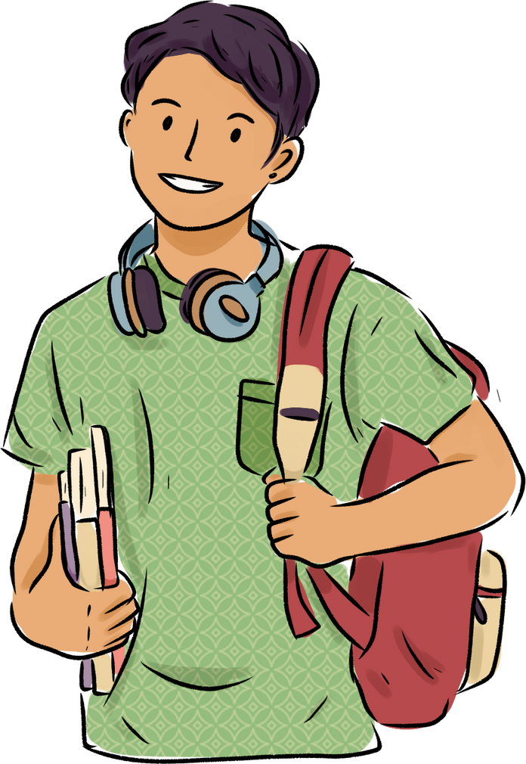
CAREER LIFE CONNECTIONS CLC12
  Part 1: Capstone (50%)
      Showcase project including proposal, two check-in meetings, presentation
      (Jan. 28).
  Part 2: Coursework (50%)
      3 workshops + assignments completed within the workshop
      Evidence of 30-hours (work or volunteer experience)
Notes:
7 assignments:
4 of which should have been completed in Grade 11
3 others which include finding a mentor and meeting with them 3 times, 30 hours of volunteer/work experience and a financial plan
Capstone Project (worth 40% of your mark)
<number>

Slide 8
CAREER LIFE CONNECTIONS CLC12
Upcoming Dates
  Sept. 30 – Capstone Proposal DRAFT 1 is DUE
  Oct. 7 to 30 – Capstone Check-In Meeting #1.
  Make sure you’re attached to a Team.
  Visit your CLC12 Team 1 – 2/week.
  Visit Room 514 during your off block with questions.
  For students who are graduating early or off site in Sem II, make arrangements with your CLC teacher
Notes:
7 assignments:
4 of which should have been completed in Grade 11
3 others which include finding a mentor and meeting with them 3 times, 30 hours of volunteer/work experience and a financial plan
Capstone Project (worth 40% of your mark)
<number>

Slide 9
LANGUAGE CHALLENGE EXAMS
  French
  Japanese
  Korean
  Mandarin
  Punjabi
  Spanish
  Farsi
  ASL 11 (American Sign Language) (NEW)
Application deadline: 29th October 2026
Exam Dates: Jan 30th & Jan 31ˢᵗ, 2027
https://www.deltasd.bc.ca/schools/secondary/challenge-exams/

Slide 10

EXTERNAL COURSE CREDIT
  Credit may be given for coursework taken outside of the school system.
  Examples: Music, Languages, First Aid, Sports (provincial/national level), Cadets, Driver Education, Dance, Scouts, Guides

Slide 11
WHAT ARE YOU GOING TO DO….

Slide 12
POST SECONDARY
The requirements for each institution vary
Please do your research!!
See Ms Kaufmann if you need clarification.

Slide 13


POST SECONDARY PLANNING AND APPLICATIONS
Many different forms of post-secondary institutions available in BC:
Large research universities, such as UBC, SFU, University of Victoria
Smaller teaching-focused universities, such as UFV, KPU, Capilano
Colleges
Visit EducationPlanner BC to explore your local options.
A great resource to explore Ontario universities is
Applications open around October 1 (UBC Oct 5, 2026)

Slide 14
The pros and cons of
University
and
College
Which is a better fit for you?

Slide 15
UBC and SFU
  Highly competitive
  Check program requirements (do your research)
  Gr 11 +12 grades count (academic courses only)
  Transcripts sent through STS after application is submitted

Slide 16
Polytech and trades schools
  More practical
  BCIT/Kwantlen/VCC
  varying application
  waitlist for most trades
  high job possibilities
  Hands-on learning

Slide 17
POST SECONDARY INSTITUTION DAY
NOVEMBER 4, 2026
​
  All Grade 11 and 12 students.​
  Go to Period 1 class. Attendance will be taken, then you will watch a short introductory video after which you will attend two small sessions and then go to the Mini Fair. If you do not have a Period 1 class, please report to the small gym at 8:40am. ​​
Schedule​
8:40 – 8:50 am: Scope of the Day Presentation (in-class)​
9:00 – 9:25 am: Session 1​
9:30 – 9:55 am: Session 2 ​
10:05 – 11 am: Mini Fair (large gym)​
​
Attending institutions:
SFU
Douglas College
Vancouver Community College
Langara College
Capilano University
Kwantlen Polytechnic University
BCIT
Emily Carr University of Arts & Design
University of Victoria
Vancouver Island University
University of the Fraser Valley
University of Northern BC
Fairleigh Dickinson University
Corpus Christi College/ St Mark's
Trinity Western University
Canadian Armed Forces
AND MORE!!!

Slide 18
POST SECONDARY APPLICATION
  For B.C schools www.educationplannerbc.ca
Applications for most schools open in early October
  For Ontario schools www.ouac.on.ca
Out of province students should apply as early as possible.
  Many College programs work on a first-come-first-served basis. Apply Now!!

Slide 19
POST SECONDARY APPLICATION
Use your full legal name when applying to post-secondary. Check MyEd if your name is spelled correctly. If the name used on your application doesn't match what the Ministry of Education has on record, they can't match your application with your transcript.​
Some programs require you to complete supplementary applications. Understand what's required and when it is due.​
Some post-secondary institutions require you to self-report marks and/ or to upload a SCHOOL transcript in their applicant portal. Make sure to check. See Ms Kaufmann if you need help.​

Slide 20
APPLYING TO POST SECONDARY WORKSHOP
with Ms John
Wed, OCTOBER 21
AFTER SCHOOL
Room 214
If you need help understanding requirements, the application process, or even if you are a competitive applicant for your chosen program, you can also talk to Ms Kaufmann at the Career Office.

Slide 21
STUDENT TRANSCRIPT SERVICE (STS)
  www.studenttranscripts.gov.bc.ca
  This form gives the B.C. Ministry of Education permission to release marks to the selected post-secondary institutions (ongoing updates)
  To be completed once after you have applied for admission (at the latest by the document deadline!!)
  Make sure to allow PSI access until at least September 2027
  October 26-28, 2026 Block 3 Presentation

Slide 22

SAT
For students going to school in the United States
Some schools need Subject Exams (Check)
Get done by December

Slide 23
B.C. ACHIEVEMENT SCHOLARSHIPS:
$1250
  The Ministry of Education determines recipients (no application required)
  Based on students’ achievement in Grade 10, 11, and 12 courses that satisfy graduation program requirements.
  Includes elective courses.
  Based on a cumulative average percentage
  Rank among the top 8000 students in B.C.
  Scholarship meeting after school Wed, Oct 7

Slide 24

District/Authority Scholarships: $1250
  Fine Arts
  Applied Skills
  Physical Activity
  International Languages
  Community Service
  Trades/Apprenticeship
  Indigenous Languages and Culture
SUPERIOR
ACHIEVEMENT
IN ONE OF:
*Part of our school's internal scholarship package (released in February)

Slide 25
REFERENCE LETTERS
  Complete a Brag Sheet (can be found on the Career Centre website > Financial Aid section)
  Give at least 2 weeks notice to teachers if you require one
  Provide referee with scholarship criteria

Slide 26

GRADUATION PHOTOS
November 13– November 23, 2026
  If you missed these sittings you will need to go to GradsBC.com (follow Links) to arrange for a make-up sitting
  Students must be photographed to appear in the yearbook and on the graduation composite

Slide 27
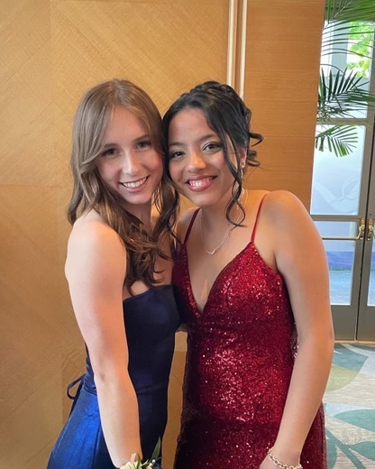
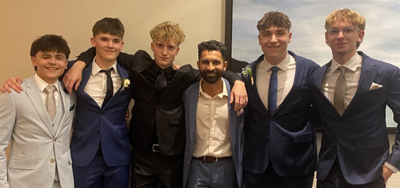
GRAD DINNER DANCE
  Saturday, June 12
  Fairmont Waterfront
  6 pm

Slide 28

  Following the Dinner/Dance
  Dr. Charles Best Secondary

Slide 29
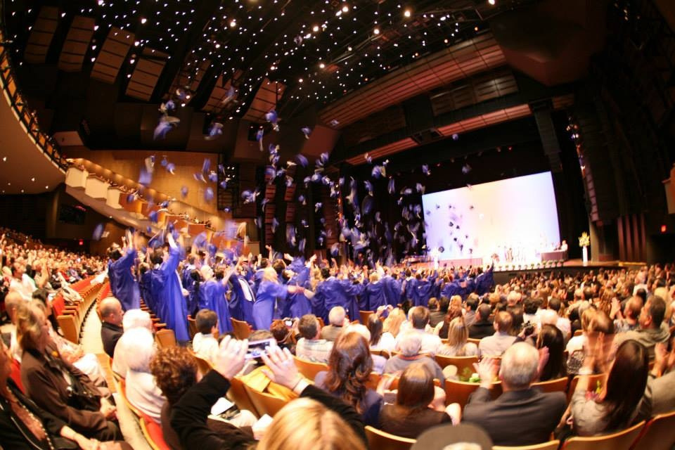
COMMENCEMENT
June 23rd 2027
SFU

Slide 30
CONGRATULATIONS TO THE BEST CLASS OF 2027!

Slide 31

SWAG

