Slide 1
Pinetree Secondary
Grade 10-12 Parent Night
Graduation Program Requirements
Pinetree special programs
Number of courses
Choosing courses
Post Secondary options
Timeline information
Notes:
Meena

Slide 2
People to know!
Administration at Pinetree
Principal: Ms. Janine Close
Vice Principals:
Ms. Aoyama A-J
Ms. Mehai K-P
Mr. Rao Q-Z
Counsellors at Pinetree
Ms. Bishop A-I
Mr. Nelson J-0
Ms. Dhillon P-Z
Mr. Sharma All International Students
Post-Secondary and Career Advisor
Ms. Moorhouse
Youth Workers
Ms. Alavi Tabrizi (**speaks Farsi and Arabic**)
Ms. Xie & Ms. Jeoung (International Youth Workers)

Slide 3
GRADUATION PROGRAM (Grades 10-12)
80 Credits
Required 52 credits:
  English Language Arts 10, 11, and English Studies 12 12 credits
  Social Studies 10 4 credits
  A Social Studies 11 or 1 4 credits
  Science 10 4 credits
  A Science 11 4 credits
  A Mathematics 10 4 credits
  A Mathematics 11 4 credits
  Physical and Health Education 10 4 credits
  Fine Arts or Applied Skills 10, 11, or 12 4 credits
  Career Life Education 10 4 credits
  Indigenous focused coursework
Career Life Connections 4 credits
Electives (Grade 10, 11, and 12) 28 credits
Numeracy 10 Assessment
Literacy 10 Assessment
Literacy 12 Assessment
TOTAL - 80 credits
*16 of your credits (4 classes) must be grade 12 level*
Notes:
Meena

Slide 4
Graduation Assessments
Numeracy 10 Assessment:
All students will be required to complete the Numeracy 10 assessment as a graduation requirement.
Literacy 10 Assessment:
All students will be required to complete the Literacy 10 assessment as a graduation requirement
Literacy 12 Assessment:
All students will be required to complete the Literacy 12 assessment as a graduation requirement
All grade 12 students will be registered to write the assessment in January.
See the Ministry website for more info:
https://curriculum.gov.bc.ca/provincial/grade-10-numeracy-assessment
https://curriculum.gov.bc.ca/provincial/grade-10-literacy-assessment
https://curriculum.gov.bc.ca/provincial/grade-12-literacy-assessment
Notes:
Gio

Slide 5
Arts Education 10, 11, or 12 --Applied Design, Skills, and Technologies 10, 11 or 12
Students are required to complete 4 credits in Arts Education or Applied Design, Skills, and Technologies:
SOME EXAMPLES INCLUDE:
Drafting 11 (AS)
Graphic Arts 11 (FA)
Marketing & Promotion 11 (AS)
Drama 11 (FA)
Textiles 11 (AS)
Art Studio 11 (FA)
Food Studies 11 (AS)
Auto Tech 11 (AS)
Composition & Production 11 (FA)
Choral Music 11 (FA)
Automotive Tech 11(AS)
Any Info Tech 11 (AS)
Instrumental Music (Band) 11 (FA)
Notes:
Gio

Slide 6
English
English 10 Course Offerings:
Each of the grade 10 English classes will be paired with Literary Studies 10. Choices include:
  Creative Writing 10
  Composition 10
  New Media 10
  Composition and Literary Studies 10 HONOURS
English 11 Course Offerings:
Each of the grade 11 English classes will have an English First Peoples component. This will meet their Indigenous Focuses Coursework, graduation requirement
  EFP Literary Studies and Writing 11
  EFP Literary Studies and New Media 11
  EFP Literary Studies and Writing 11 HONOURS
Notes:
Gio

Slide 7
English
Year 12 English Language Arts:
Students must complete one of the following “Year 12” English courses for Graduation:
English Studies 12
English Studies 12 Honours
English First Peoples 12
The following course can be taken as an English 12 elective:
Literary Studies 12 (this alone will not meet English 12 requirement)
Notes:
Gio

Slide 8
Mathematics
Math 10 Options (Grad Requirement)
  Workplace Mathematics 10
  Foundations of Math & Pre-Calculus 10
  Pre-Calculus 10/11 Honours (full year program)
Math 11 Options (Grad Requirement)
Workplace Mathematics 11
Pre-Calculus 11
Foundations of Math 11 (Bridge )
Notes:
Meena

Slide 9
Mathematics
Math 12 Options
  Pre-Calculus 12
  Calculus 12
  Pre-Calculus 12 Honours/Calculus 12 Honours
  Statistics 12 (Calculus 12 is a pre-requisite)
  Grade 12 Math is not required for Graduation but check post-secondary program requirements
Notes:
Meena

Slide 10
Math Honours Program:
Grade 9:
Math 9 Honours
Grade 10:
Pre-Calc 10 Honours (sem 1) Pre-Calc 11 Honours (sem 2)
Grade 11:
Pre-Calc 12 Honours (sem 1) Calculus 12 Honours (sem 2)
Grade 12:
Statistics 12

Slide 11
Lifeguarding Fitness/ Learn to Swim(new)
Learn to Swim Fitness 11/12 (Grades 10-12)
  Whether students are brand-new swimmers or looking to strengthen their technique, the class emphasizes skill progression, teamwork, and personal fitness in group lessons. Held at the City Centre Aquatic Complex during block 5,
  this course provides a fun, inclusive, and active experience that supports lifelong comfort and safety in and around the water. Cost: $250
Lifeguarding Fitness 12 (Grades 10-12) (Year Long – 8 credits)
  Lifeguarding Fitness 11/12 is a full-year program that trains you to become a certified lifeguard and swim instructor.
  Students will earn the Bronze Medallion and Bronze Cross in Semester 1, then advance to the National Lifeguard (NL) and Swim Instructor (SI) certifications in Semester 2.
  All classes run at City Centre Aquatics Complex, during Block 5, through the entire school year.
  Attendance is mandatory as this program is offered in partnership with the City of Coquitlam.
  $350 (Sem. 1 -Medallion and Cross) + $900 (Sem. 2 – NL (National Lifeguard) and SI (Swim Instructor)

Slide 12
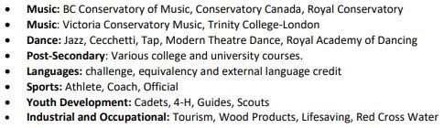
Course Equivalency/External Credits
Students may also obtain credits towards graduation through:
Equivalency: Course equivalency is the process of receiving credit based on documentation indicating that the student has achieved the learning outcomes for an approved grade 10, 11 or 12 course at an institution outside of BC or Canada (Course must be an 80% match with BC curriculum)
External Credits: credit for courses completed outside Pinetree (see your counsellor)
Notes:
Meena

Slide 13
PINETREE Programs
Honours Courses
  Focused Literary Studies and Composition 10 Honours
  English First Peoples and Writing 11 Honours
  English Studies 12 Honours
  Socials 10 Honours
Pre-Calculus 10 Honours/11 Honours (year-long/2 semesters)
Precalculus 12 Honours/Calculus 12 Honours (year-long/2 semesters)
Science 10 Honours
Life Science 11 Honours and Anatomy and Physiology 12 Honours (AP)
Physics 11 Honours and Physics 12 Honours (AP)
Chemistry 11 Honours and Chemistry 12 Honours (AP)
Notes:
Gio

Slide 14
PINETREE Programs
Advanced Placement
Advanced placement offers academic challenge in senior courses.
It can provide advanced credit or standing in first year university courses in some post-secondary institutions.
The following are the only AP courses offered at Pinetree:
  AP Anatomy & Physiology 12
  AP Chemistry 12,
  AP Physics 12
You receive 8 credits for an AP course (4 credits for honours, 4 credits for AP)
If you wish to receive University credits, you must register to write the AP exam through the College Board.
Notes:
Gio

Slide 15
Pinetree's Advanced Placement/Honours Program
1. What type of student is the AP/Honours program designed for?
❖ Gifted students, extremely talented and motivated students.
❖ Students who enjoy hard work and being challenged in class.
2. What are the advantages of an Honours class?
❖ Students of similar abilities and interests work together in an enriched environment.
❖ Students develop their higher- level thinking skills.
❖ Students participate in the subject areas that match their talents.
❖ Honours courses help prepare students for AP courses.
3. Students should only select if they are prepared for the rigors of an Honours Program
4. Successful candidates will know in late June when draft schedules are available
5. Once you are admitted into an Honours class, you WILL NOT be able to change this course. Choose carefully.

Slide 16
Honours and AP Courses
Students should only select if they are prepared for the rigors of an Honours Program
Departments have established a process to select candidates.
Successful candidates will know in late June when draft schedules are available
Once you are admitted into an Honours class, you WILL NOT be able to change this course. Be certain you want the course.
Notes:
Gio

Slide 17
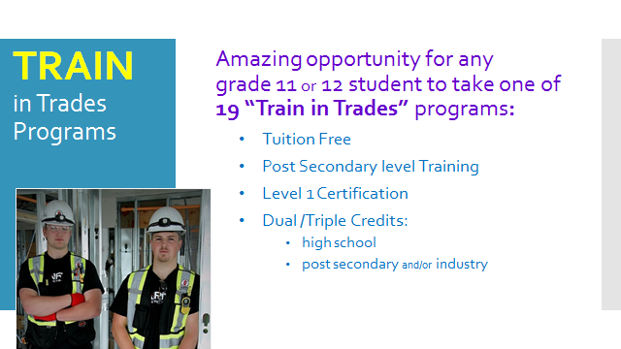
Notes:
Doug

Slide 18
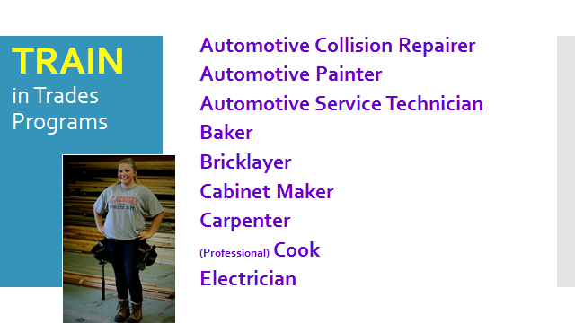
Notes:
Doug

Slide 19
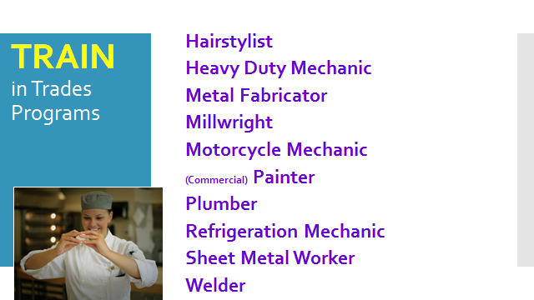
Notes:
Doug

Slide 20
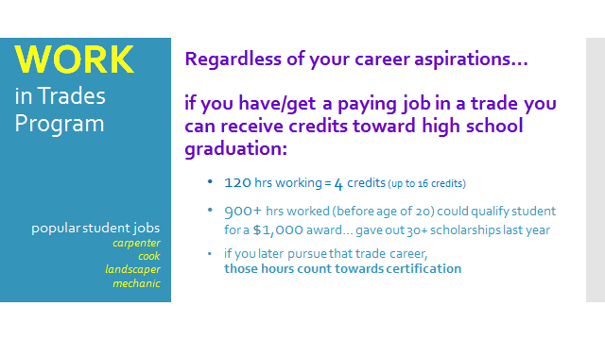
Notes:
Doug

Slide 21
TRADES program contact information:
Train In Trades Contact:
Ben King
phone number: 778-984-1354
email: bking@sd43.bc.ca
Work in Trades Contact:
Joanna Horvath
phone number: 604-312-7739
email: jhorvath@sd43.bc.ca

Slide 22

SD43 Trades Program Open House

Slide 23
Post Secondary
Applications and Admission
  It is YOUR responsibility to research post-secondary admission requirements and to be aware of the application process & deadlines.
  Be aware that in most instances, post-secondary institutions will also be looking at your grade 11 marks.
  Counsellors and Ms. Moorhouse (Post Secondary & Career Advisor) are available to assist you.
  Ms. Moorhouse can be reached at: cmoorhouse@sd43.bc.ca
Notes:
Meena

Slide 24
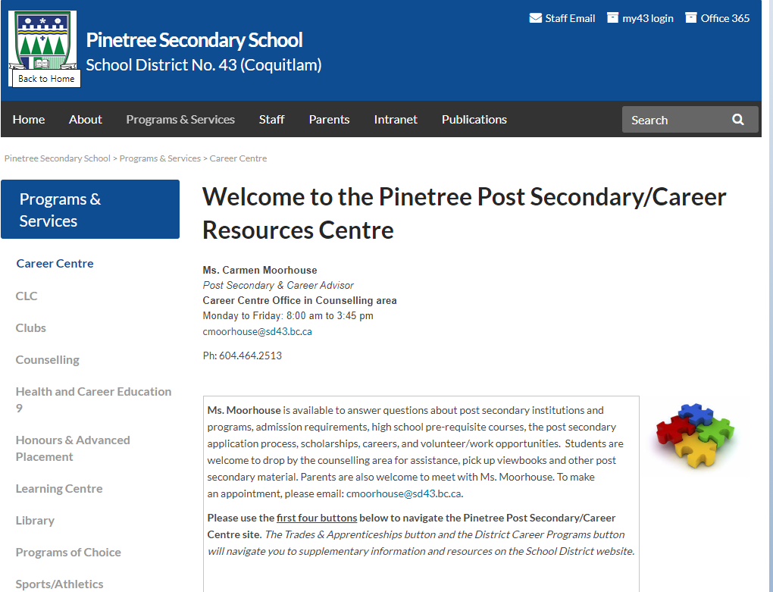
Notes:
Meena

Slide 25
University & College Options in BC
UBC, SFU, UVIC, UNBC
Capilano University
Kwantlen Polytechnic University
Trinity Western University
Emily Carr University of Art and Design
BCIT
Thompson Rivers University
University of the Fraser Valley
Vancouver Island University
Douglas College
Langara College
Vancouver Community College
Some universities and/or programs are competitive entry
Check required courses, % grade, English and Math and OTHER requirements for each university and program
Notes:
Carmen

Slide 26
Language Courses
**NEW** UBC no longer requires a second language 11
**NEW** SFU no longer requires a second language 11
Language Challenge exams:
If you are fluent in a second language, you can register to write a language challenge exam
UBC will not accept a Language 12 challenge towards the admission average.
SFU will accept a Language 12 challenge towards the admission average.
Language Challenge Exam registration opens in October. Exam writes are in January

Slide 27
Benefits of a Second Language
Learning a second language helps students build and strengthen skills for their future
  Improves communication skills
  Ability to interact with others
  Public speaking skills
  Fosters cultural awareness and global perspectives
  Builds confidence through interactive and engaging activities
  Prepares students for real-life language use

Slide 28
Post Secondary Education:
SFU General Admission Requirements
General Admission Requirements:
Have a minimum of five approved academic Grade 12 courses, including English 12
Have a minimum 70% or higher in Language Arts 11, English 12 or equivalent
Have a minimum grade of 60% or a C in an approved grade 11 math course. Either Foundations of Math 11 or Pre-Calculus 11
Admission is based on evaluation of all approved academic Grade 11 and 12 courses, including specific course requirements set by the faculty.
**Note: the list of approved academic courses is extensive. We encourage you to look through the SFU website to view updated list.
Notes:
Carmen

Slide 29
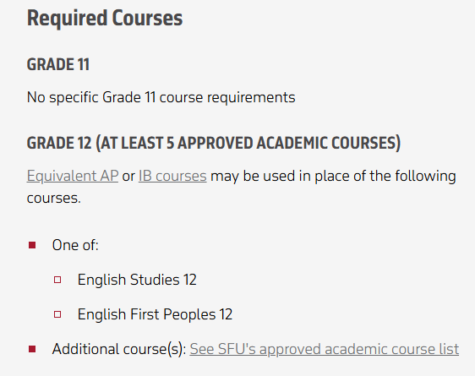
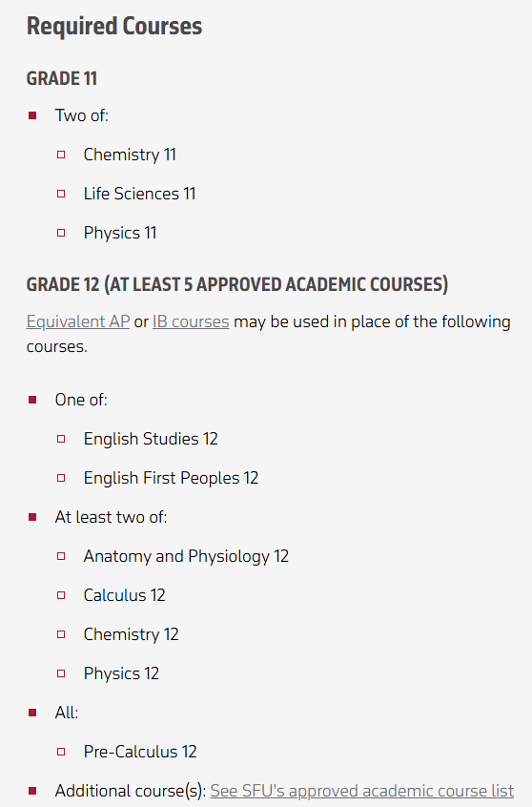
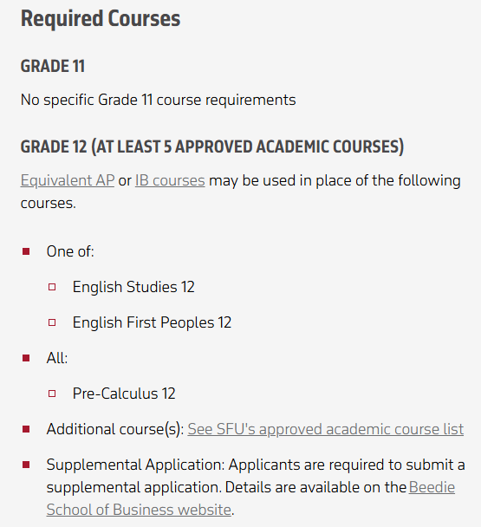
Arts
Sciences
Beedie School Business

Slide 30
UBC Holistic Admission Evaluation
General Admission:​
    At least 6 academic/non-academic Grade 12 courses (recommended not required) ​
    Minimum 70% in Grade 11 or 12 English​
    UBC considers your grades in all academic Grade 11 and Grade 12 classes, paying special attention to courses that relate to the degree you are applying for (they do not look at career education courses, physical and health education courses, skills-based courses, or courses in applied design and technology) ​
    Course Choices: Did you pursue academic interests by taking a range of courses? Did you challenge yourself by taking academic, advanced (Honours/AP) courses? Did you demonstrate high level of knowledge in subjects related to the degree you are applying for? ​
Personal Profile​:
    2-5 short essay questions depending on the program to which you apply ​to
​
    Evaluated based on breadth and depth of your experiences ​
    Things to consider: "Describe five activities you have pursued or accomplishments you have achieved, in the following areas": clubs, family/community, creative/performing arts, work/employment, athletics, volunteer, service to others, other​
Additional requirements for some programs: video interview, test, resume, audition etc. ​
​
Literacy 12 Assessment​:
UBC requires a 3 out of 4 to be considered for admission

Slide 31
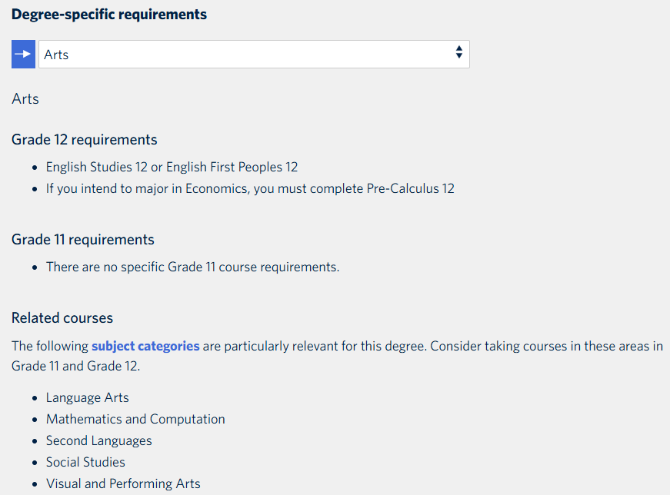
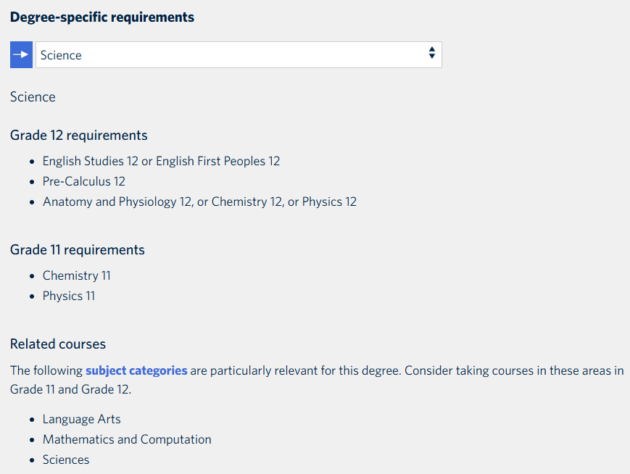
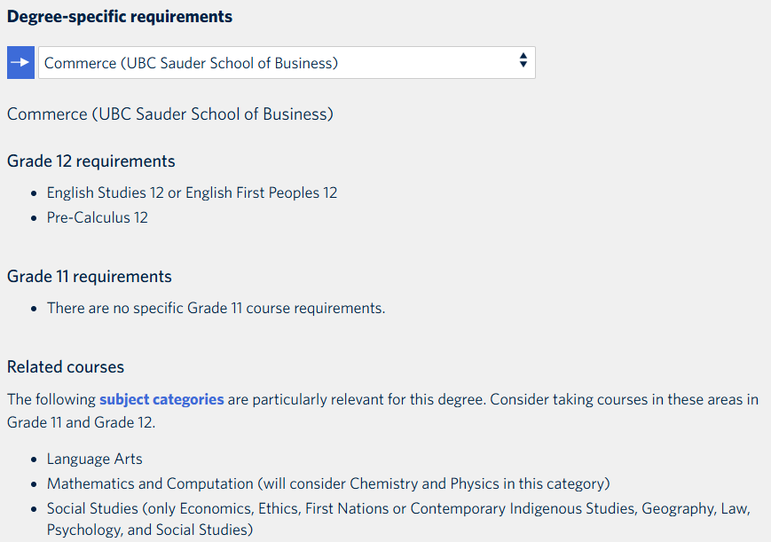

Slide 32
University of Victoria
General Admission Requirements
Admission Averages are based on:
English 12 and 3 additional approved academic grade 12 courses
Grade 11 requirements
  English 11, Social Studies 11, Pre-Calculus 11 or Foundations of Math 11 (depending on the faculty), an Academic Science 11 (Life Sc 11, Chem 11, Earth Sc 11, Ph 11)
  Check the website for approved grade 12 courses for each faculty!
  https://www.uvic.ca/future-students/undergraduate/admissions/high-school/bc-yt/index.php
  NOTE: Supplemental application needed for some programs including Business.
Notes:
Carmen

Slide 33
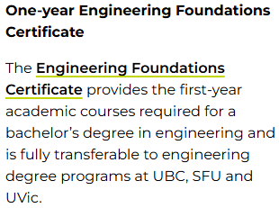
Douglas College
www.douglas.bc.ca
Eligible for admission if you:
Completed BC secondary school and minimum mark in English 12 (C)
Different deadlines and entrance requirements for each program **Check carefully!**
Open Enrollment versus. Limited Enrolment programs
If you are applying to a university transfer program, your registration date for courses depends on your GPA! Check with an academic advisor at Douglas College or Mrs. Moorhouse for more information.
Amazing university transfer opportunities! One-year Engineering certificate (equivalent to first year University) with guaranteed transfer to UBC, SFU or UVIC (for UBC: need a 3.1 gpa)
Notes:
Carmen

Slide 34
CHOOSING COURSES
Important Decisions…
Ensure you meet Graduation requirements
Check post-secondary requirements
  (See Ms. Moorhouse or your counsellor)
Seek out the advice of family members, mentors, and/or your counsellor
Read the Course Calendar Online
Be aware that we will not be able to change classes once the school year starts
Notes:
Meena

Slide 35
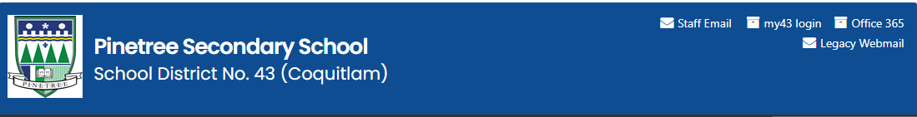
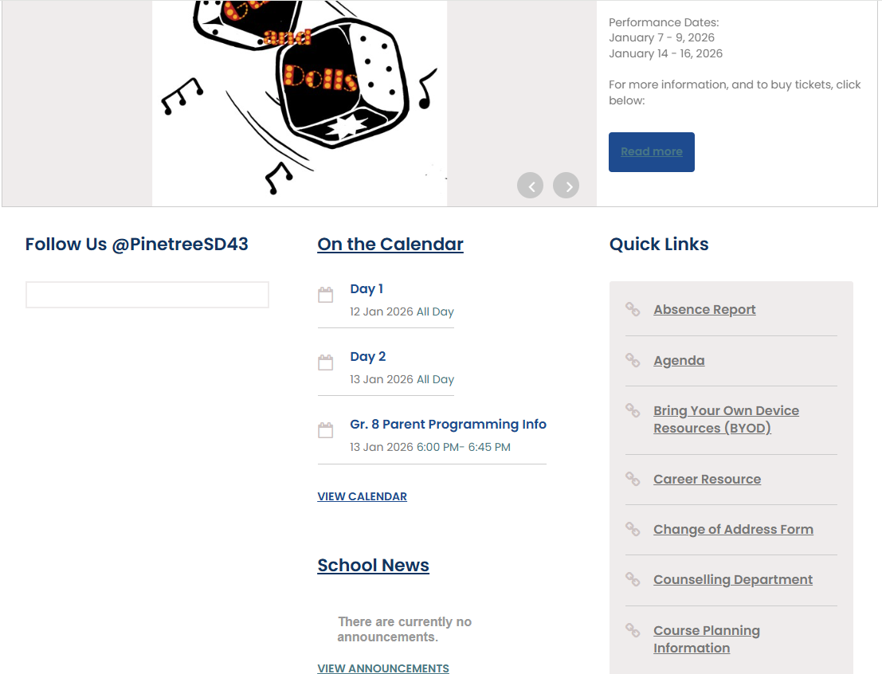
Course Calendar Online

Slide 36
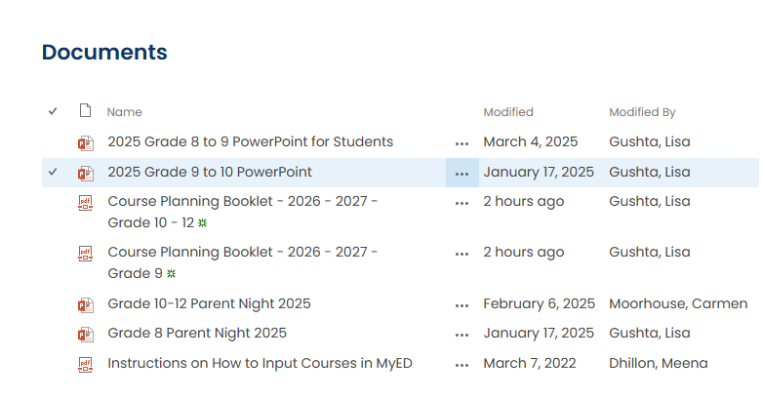

Slide 37
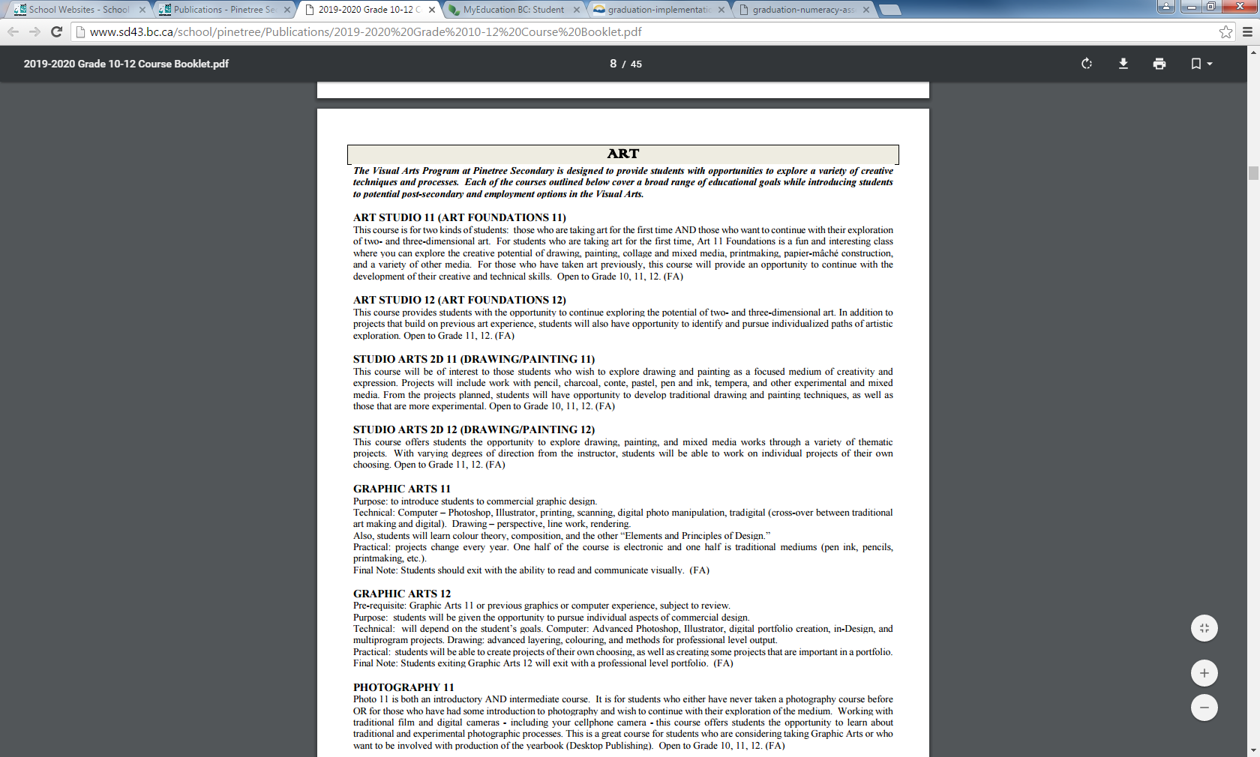
Detailed Description of all courses!

Slide 38
Required Courses
Grade 10
(8 classes)
English Lang. Arts 10
Social Studies 10
Career Life Educ. 10
Science 10
A Mathematics 10
Physical Education 10
Two (2)Electives
Grade 11
(8 classes)
One of Lang Arts 11 Options
Any Science 11
Any Mathematics 11
Social Studies 12 (can be done
Grade 12 year)
Four (4) additional courses
Grade 12
(8 classes)
English Studies 12 1.___________12
2.___________12
3.___________12
Four (4) additional courses
Career Life Connections
Consider whether you need grade 11 pre-requisite courses to set you up for grade 12.
Grade 11 courses count! Treat it like grade 12. Universities take grade 11 marks into consideration for admission.
Grade 12 is about setting yourself up for life after high school. If you are planning to attend post-secondary, make sure you have the required courses for your program.
Notes:
Meena

Slide 39
When Choosing Courses:
For all core academics, you must have completed the prerequisite course for all grades 9 through 12
  i.e. for Chemistry 11 you must have successfully passed Science 10
  i.e. for French 11 you must have successfully passed French 10
For all gr 12 electives you must have the grade 11 prerequisite as well
  i.e. you cannot take Auto 12 without having completed Auto 11
  i.e. you cannot take Physics 12 without having completed Physics 11
Notes:
Meena

Slide 40
Extra and Online Classes
Extra Courses: Jazz Band, Choir , and Vocal Jazz, Musical Orchestra, Leadership, Athletic Leadership, Red Cross Leadership, Graphic Production (yearbook), any online courses (these would be in addition to your 8 courses)
Grade 9-11 students must have 8 classes in their Pinetree timetable (extra courses not included, online courses not included)
Grade 12 students may apply to have 7 classes in their timetable (and receive an off block) – on the back of the course planning sheet.
Although, a minimum 80 credits are needed for graduation most will graduate with over 90.
If you wish to Grad earlier in January of your grade 12 year, please see your Counsellor to discuss further
Notes:
Meena

Slide 41
Summer School
Summer School info available April/May Visit www.summerlearningcoquitlam.ca for more info about programs.
Secondary Academic Completion (counsellors will have referral forms in April)
  for grade 9 and 10 students who were unsuccessful (failing/40-49%) during the school year and are being given the opportunity to receive credit (passing grade) for the course.
Summer School Credit (Grade 10-12, registration dates TBA)
  In-person schooling and option of Fast track for some courses (blended online)
  6 weeks (3 hours/day)
  Morning and afternoon sessions @ 2 different high school sites
  Must login early to get a spot. Classes fill quickly.
Notes:
Meena

Slide 42
Questions?
If you have any questions, please contact the appropriate counsellor, based on your child’s last name:
A-I: Ms. Bishop cbishop@sd43.bc.ca
J-O: Mr. Nelson kenelson@sd43.bc.ca
P-Z: Ms. Dhillon mdhillon@sd43.bc.ca
International: Mr. Sharma vsharma@sd43.bc.ca
School phone #: 604 464 2513

