Slide 1
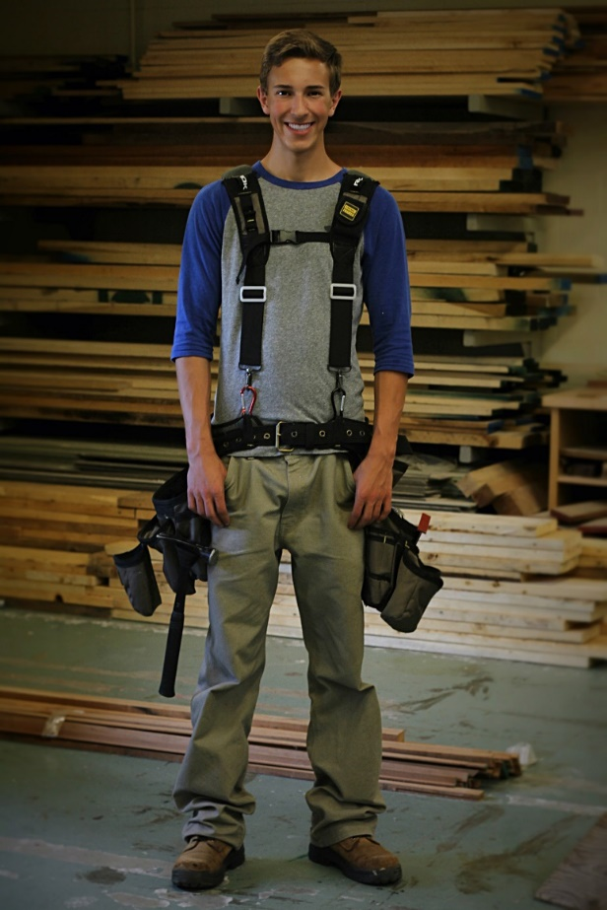
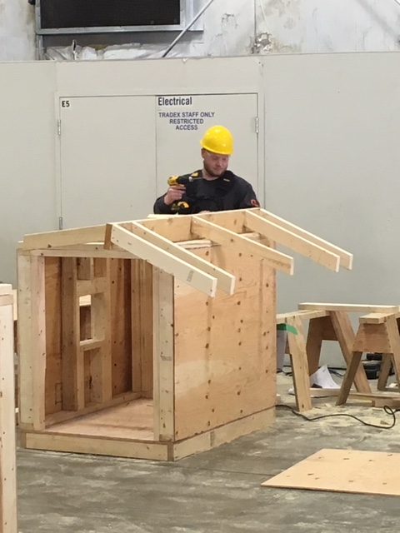
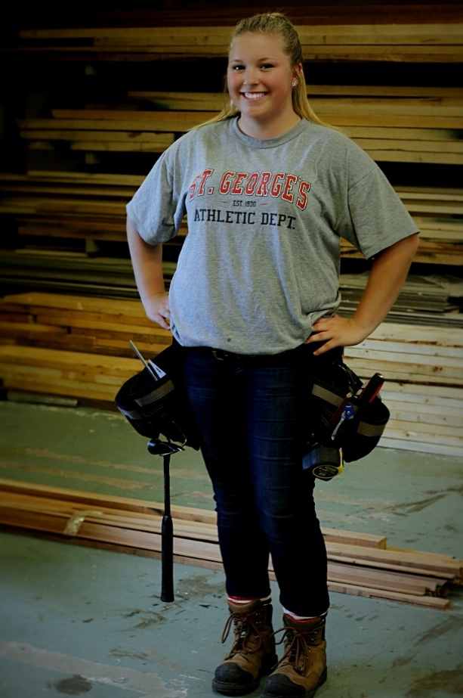
Trades Training Carpentry Program
January 31 – June 24, 2022
SD43 Coquitlam + BCIT
Ryan
Nathan
January 19, 2022
Jaymee

Slide 2
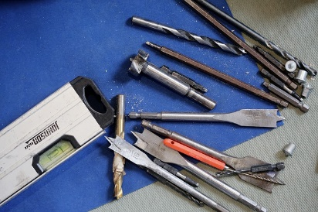
Introductions
Doug
Coquitlam School District
  Rich Vickers, Carpentry Program Instructor
  Doug MacLean, Career Programs (TRAIN in Trades) Coordinator
  Joanna Horvath, WORK in Trades teacher
BCIT
  John Akers, Carpentry Instructor (subject to change)
  Don Naidesh, Chief Instructor
  Carol Martina, High School Partnership Coordinator

Slide 3
Quick Points
Doug
Career-Life Connections (CLC 12)
  Complete them through your home school… mandatory for graduation
Graduation
You will graduate from your home school
Commencement, Dinner & Dance, etc will not interfere with Terry Fox or BCIT learning… “Grad Weekend” does not mean 2-3 missed days of school
  have a contact (best friend and counselor) at your home school to get information
  Use the school app to get notifications

Slide 4
Quick Points
Doug
Credits & Marks
Ministry of Education – high school credits
  registered in four grade 12 level courses (16 credits) that will all count towards graduation
    five courses (20 credits) if you are in Work Experience 12
  50% or higher in your final mark will be a “pass”
Industry Training Authority (ITA) – certification credits
  for all trades, all levels, students must have a mark of 70% or higher to “pass” and gain that technical training certification level
Potential Certifications… students register themselves, not part of program
Occupational First Aid – level 1
  1 day training… $80 + GST
Forklift
  2-day training session… $175
Bobcat
  1 day of training... $175-ish

Slide 5
Learning Sites
Doug
January 31 – February 4:
@ BCIT… some schools have Jan 31 as pro-d, but you will be at BCIT
February 7 – March 11:
@ Terry Fox
March 14 – March 25:
Spring Break… no school in session for the program… will look at maybe running a forklift and/or bobcat training sessions (depending on commitment)
March 28 – April 29:
@ BCIT
May 2 – June 24:
@ Terry Fox

Slide 6
Parental Involvement
Doug
While at Terry Fox
Like other high school courses you’ve had in the past at your home school,
contact the teacher (Mr. Vickers) directly
While at BCIT:
  BCIT instructor(John Akers) will talk about marks, absences, lates, tuition and other school-based information with the student and/or SD43 personnel
  The parent “liaising” regarding the above is done through:
  son or daughter, and/or
  Rich Vickers
  Doug MacLean

Slide 7
Individualized Education Plan
Doug
Students with IEPs:
  Able to get a “reader” and/or “extra time”
  While at Terry Fox, it will go through the Education Assistant (EA) there who will help facilitate this for the student
  For BCIT, must make appointment with Accessibility Services
    www.bcit.ca/accessibility
  FYI, for levels 2,3 and 4:
    ITA - need to make request/application for Exam Accommodation
    Post secondary – talk to disability/accessibility resource services

Slide 8
Carpentry Program
Rich
Basic Information
  Starts at 7.30am (both at Terry Fox + BCIT) and ends around 1.45pm, with appropriate breaks
  Program cost: $425 for tools, materials & supplies +
  $100 refundable book deposit
  ‘Typical day’ look like?
    “Classroom” (theory 60-70%) vs “Practical” (in the shop 30-40%)
  Program evaluation
    “Testing” – theory and practical assessments

Slide 9
Carpentry Program
Rich
Topics Covered
  Line A (6%) – Safety Work Practices
  Line B (16%) – Document & Organizational Skills
  Line C (20%) – Tools & Equipment
  Line D (6%) – Survey Instruments & Equipment
  Line E (12%) – Access, Rigging & Hoisting Equipment
  Line F (2%) – Site Layout
  Line G (20%) – Concrete Formwork
  Line H (16%) – Wood Frame Construction
  Line J (2%) – Building Science

Slide 10
Carpentry Program
Rich
Being Successful in this whole Program
  Absences & Lates… do not have any !
    tell instructor, in advance… there is a “3-strike and you’re out” policy at BCIT
  Maintaining your Grades… at least 70% !
    Tests, Quizzes and other evaluations – both written and practical
  Homework & Extra Studying
  Extra help: from instructor and/or tutors
“School Supplies”
  CSA approved safety boots + rain gear
  Paper, Binder, Pens/Pencils & Ruler, calculator… just like other classes

Slide 11
Carpentry Program
Rich
Skills that will make you more successful in this Program
  Being safe, always!
  High degree of commitment and maturity
  Solid grasp of basic numeracy and literacy skills
  Self-motivated, self-reliant and self-advocating
  Physical and mental abilities to perform the daily tasks associated with working in construction
  Ability to work outdoors in all weather
  Driving – get your “N”

Slide 12

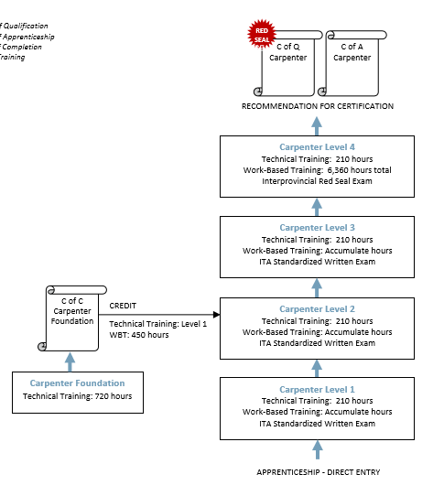
Becoming a ‘Red Seal’
Doug
In order to become a Red Sealed Carpenter you will need two things:
Paid carpentry work…
6,360 hours registered with the Industry Training Authority (ITA)
  Sponsor must have his/her Red Seal
  (or Cert of Apprenticeship)
Technical training… 4 levels
  level 1 while in high school
  subsequent 3 levels at BCIT,
  or other post secondary institutions that offer this training (7 weeks/level)

Slide 13

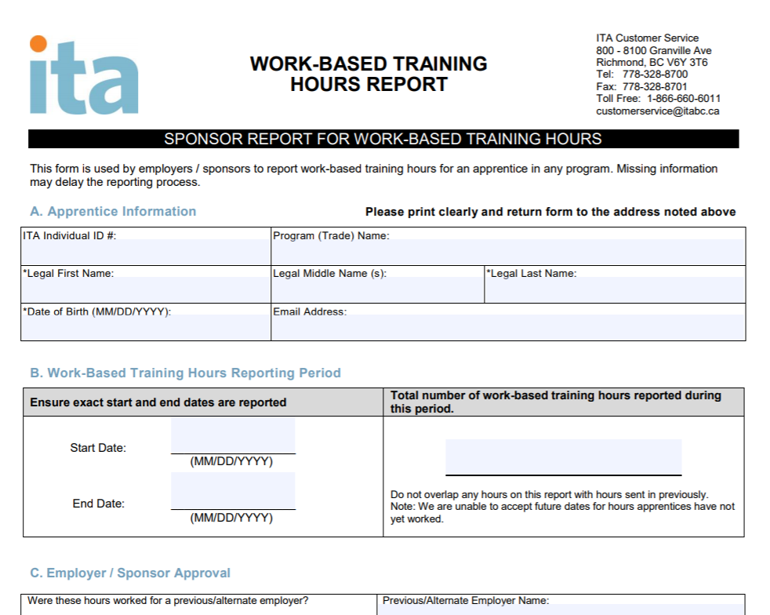
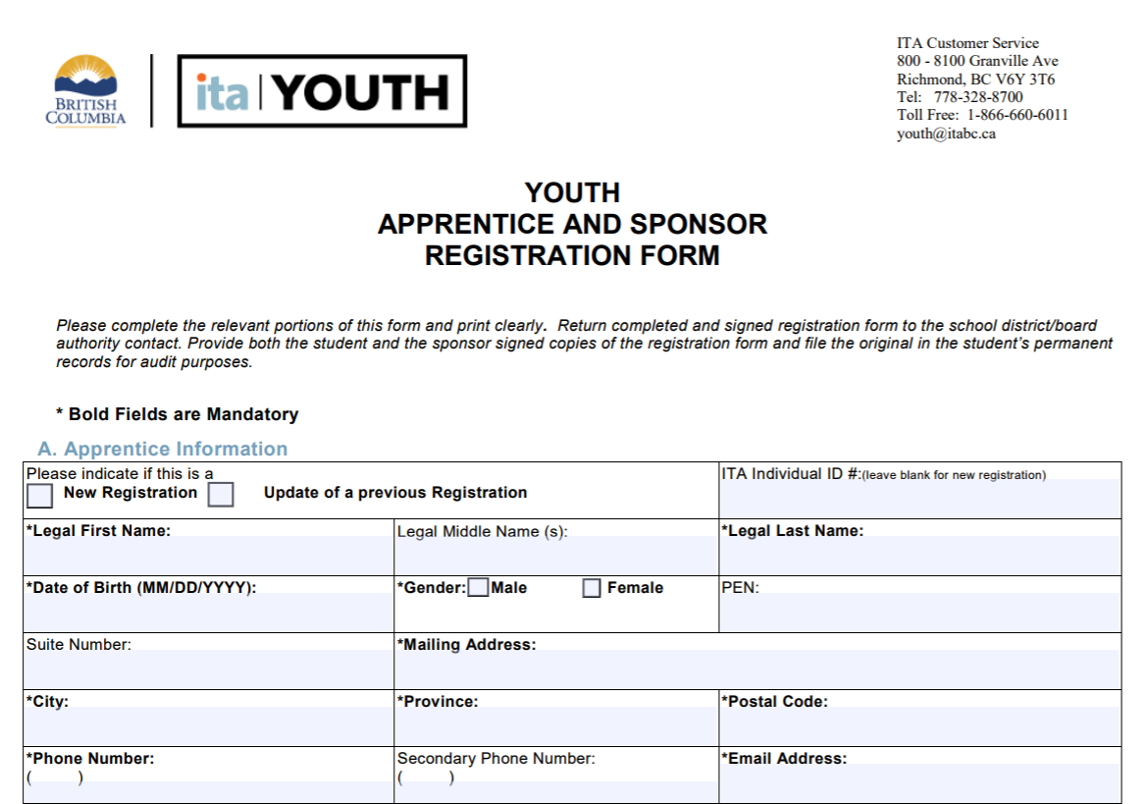
Youth ‘WORK’ in Trades
Joanna
When you get a paid job in a trade, ideally as a Carpenter, then we’ll help with the paperwork to get your registered with the ITA as an apprentice via “ITA reg form”
We’ll also help register your worked hours via “ITA Work-based Training Report”… these help towards certification

Slide 14
Great Opportunity
Doug
Tuition-free
(23-week program after graduation ≅ $2,900… plus $1,300 books/supplies… application and other fees)
Avoid potential waiting lists
Gain your Level 1 technical training while still in grade 12
Others will be going to school next Sept… you’ll be working $$
$1,000 award if you have 900 work hrs, basically, before you turn 20
More employable and hirable… put this on resume
Great life-long skill
Following your Passion

Slide 15
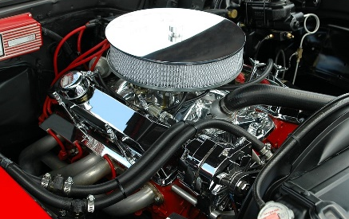
Contact Info
Doug
SD43 Contact information:
Rich Vickers, Carpentry Program teacher
  RVickers@sd43.bc.ca
  phone: 604-941-5401
Joanna Horvath, WORK in Trades teacher
  JHorvath@sd43.bc.ca
  phone/text: 604-312-7739
Doug MacLean, TRAIN in Trades coordinator
  dmaclean@sd43.bc.ca
  phone/text: 604-341-8977
www.43Careers.com > TRAIN > Carpentry

Slide 16
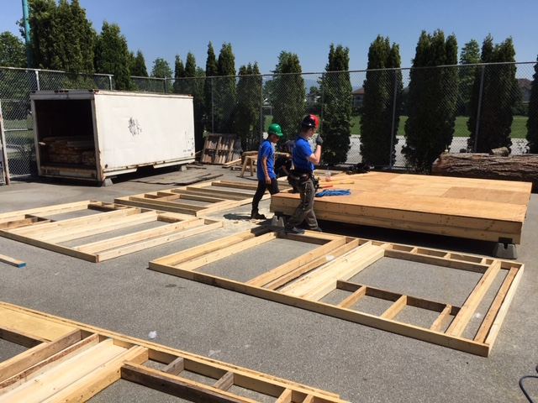
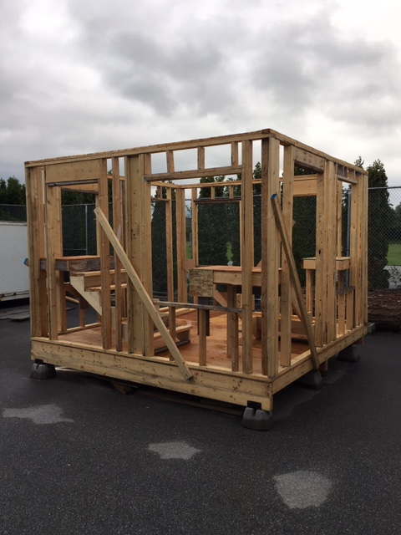

Slide 17
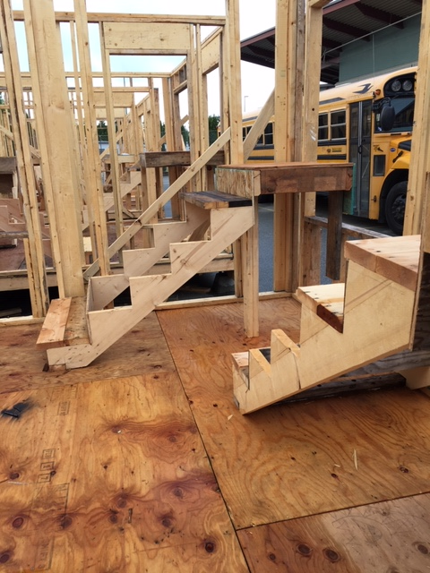
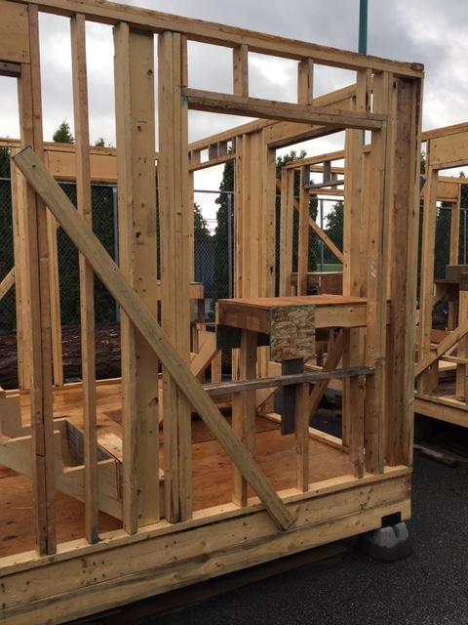

Slide 18
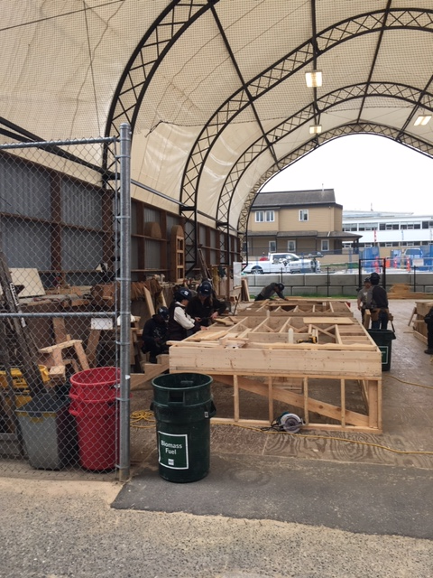

Slide 19
Questions / Comments
Anything you are still wondering about…

