Slide 1
Welcome to Riverside
Parent Information Session
French Immersion Program
Tuesday, January 29, 2013

Slide 2
Introductions
Anthony Ciolfitto: Principal
Elizabeth Bancroft: Languages Department Head
Miriam Cyr: Mathématiques, Étude des aliments
Monica Tang: Français, Sciences humaines
Catalin Ursu: Français, Sciences humaines

Slide 3
Benefits of the program
French Immersion students enjoy the ‘small school’ feel of a specialized program -- one that establishes strong connections with French immersion teachers and student peers -- while still enjoying all that the ‘big school’ has to offer.

Slide 4
Continuing in the secondary program builds upon the students’ foundation of French immersion studies to enable them to maintain and improve their French language skills.

Slide 5
Benefits of bilingualism
Increased sensitivity to others; heightened awareness, receptivity and appreciation of language.
  more sensitive to communication
  better able to understand the needs of others and to respond appropriately.
  more respectful of differences between people and their cultures

Slide 6
Mental Flexibility
  Greater mental flexibility and better performance on tasks requiring mental manipulation.
  More original in verbal expression, greater non-verbal intelligence and increased ability to answer open-ended questions more freely than monolinguals.

Slide 7
Graduation
French Immersion students write the same required exams
  English, Math, and Science in Grade 10
  Sciences Humaines 11
  English 12
  plus
  Français Langue Seconde – immersion 12
Immersion students graduate with the
Dogwood Certificate and
Bilingual Graduation Certificate
…and may write the optional exam for the
Diplôme d’études en langue française (DELF)

Slide 8
Required courses
Grade 9
  Conversation
  Français
  Sciences humaines
  Mathématiques
Grade 10
  Français
  Sciences humaines
Grade 11
  Français
  Sciences humaines
Grade 12
  Français
Plus French electives…

Slide 9
French Electives
French Immersion students are required to take at least one of the following in Grades 10-12 but encouraged to take at least two:
  Communications 10
  Peer Tutoring (immersion) 11
  Étude des aliments 11
  Conversation 12

Slide 10
Opportunities
Students should take advantage of all the activities in the school to use their French: films, plays, peer tutoring, electives, and writing for the eddy.
Outside of school, Riverside facilitates student participation in summer work exchange programs, Encounters with Canada, summer study programs, and trips to Europe. Many links are posted on the department’s web page.

Slide 11
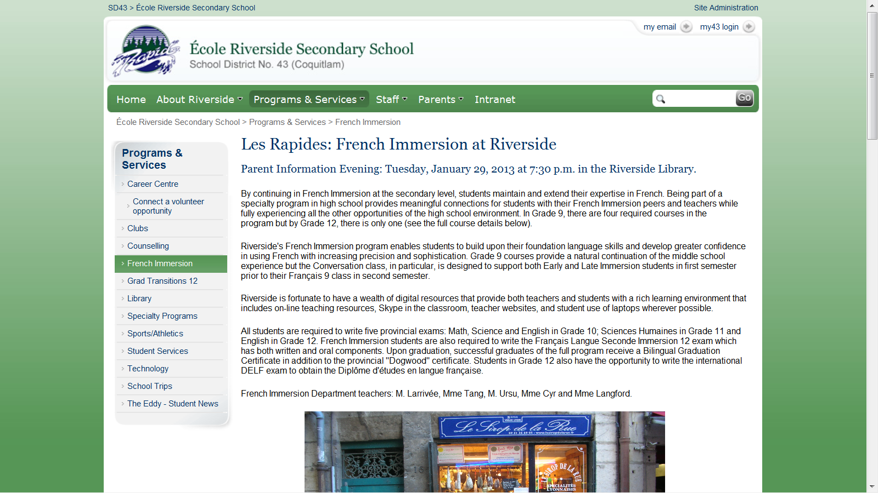

Slide 12
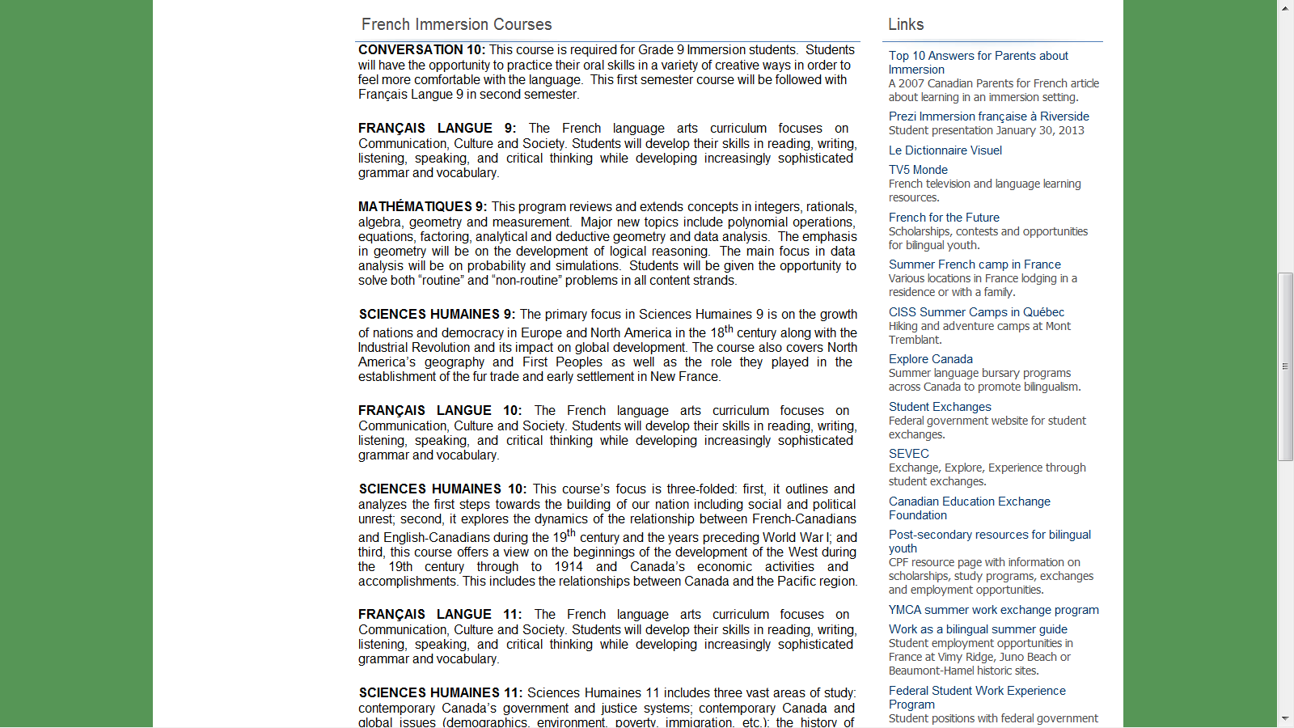

Slide 13
Support for learning
Teachers available at lunch or after school.
Teacher e-mail and class web sites.
French Immersion Peer Tutors.
Assistante, Mme Grieg, is here for teachers and students on Mondays and Wednesdays.
On-line resources available for parents and students on department web page.

Slide 14
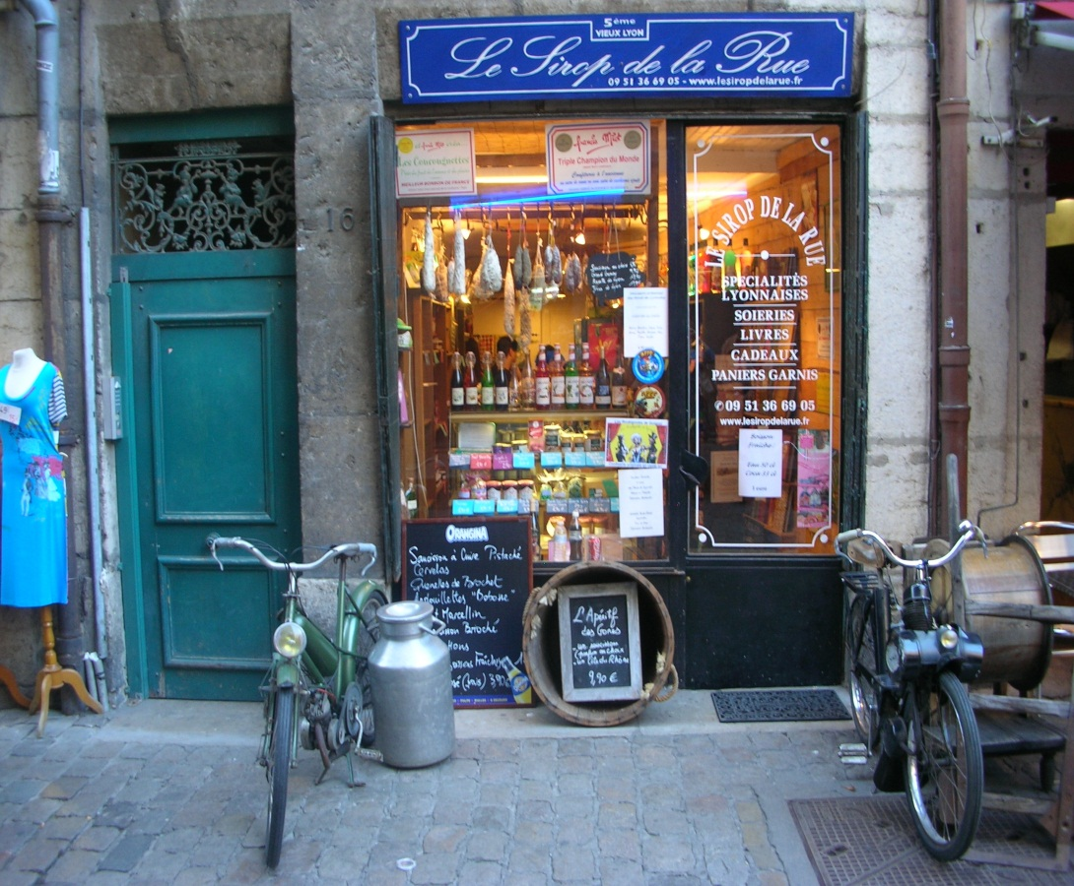
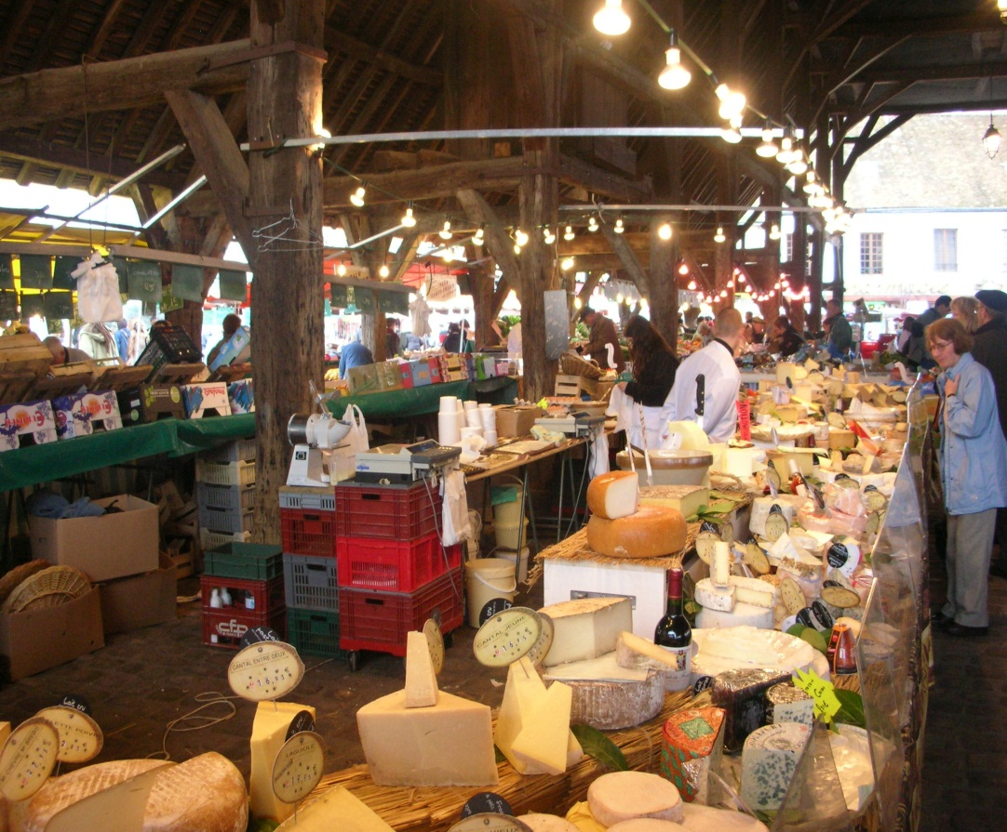
En voyage….

Slide 15
Technology
Students are encouraged to bring their own personal device to school.
There is a wealth of teaching and learning resources available on line to provide a rich learning environment and offer authentic French communication.

Slide 16
Developing digital citizens
In addition to the French Immersion program, Riverside has an established Digital Immersion program as well as a Science Co-op program.
We wish to be able to offer French Immersion students the same opportunity to use technology to enhance their learning and development of digital citizenship.

Slide 17
Personal devices
  Wi-fi provides classroom internet access for everything from on-line research and learning resources to writing blogs and on-line dictionaries.
  Word processors will be used for producing written assignments.

Slide 18
Personal devices
  Students will be recording their dialogues so they can replay them and listen to their errors and self-correct.
  Students and teachers will use webcams for Skype and for filming presentations. Various programs are used to produce video projects.

Slide 19
Merci!
We look forward to meeting your children tomorrow morning at both
École Pitt River Middle School and
École Kwayhquitlum Middle School

