Slide 1
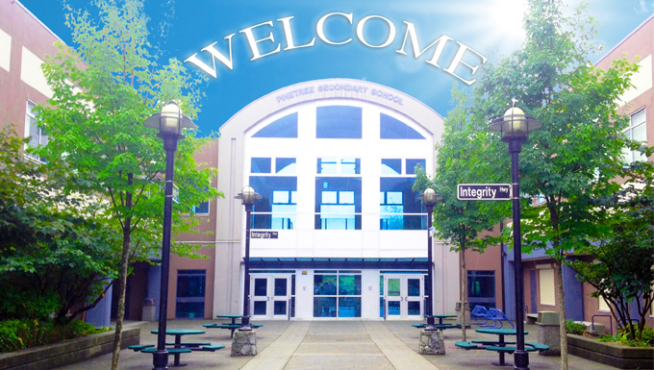
to Pinetree Secondary!
Getting Ready for Grade 9
“Accepting Challenges Together”

Slide 2
People to Know!
Administration at Pinetree
PRINCIPAL:
MS. JANINE CLOSE
VICE PRINCIPALS:
MS. AOYAMA A-J
MS. MEHAI K-P
MR. RAO Q-Z
Counsellors at Pinetree
MS. BISHOP A-I
MR. NELSON J-0
MS. DHILLON P-Z
MR. SHARMA International Students
Youth Workers
Ms. Alavi Tabrizi
Ms. Xie and Ms. Jeoung (International youth workers)
Notes:
Include new counsellor

Slide 3
Success=Getting Involved
(Leadership and Volunteering, Fine & Performing Arts)
Teams and Clubs
Board games club
Badminton club
Chess club
Debate club
Drone club
Fitness club
Karaoke club
Bouldering (rock climbing) club
Rock band club
Piano club
Math and game theory club
Model United Nations
  And many more..!
Sports/Athletics
  Cross Country
  Soccer (Girls/Boys)
  Volleyball (Girls/Boys)
  Basketball (Girls Jr, Boys 9/Jr./Sr.)
  Ski and Snowboard
  Swimming
  Badminton
  Tennis
  Track & Field
  Golf
  Mountain biking

Slide 4

FALL
Swimming – boys/girls, all ages, dependent on numbers
Volleyball-9/10/Sr. girls
Soccer-Boys
Cross country - boys/girls, all grades
Highlights
Senior girls' volleyball team made Fraser Valley Finals
Swim team- 4 students made provincials
Cross Country- 3 team members made provincials in Victoria

Slide 5

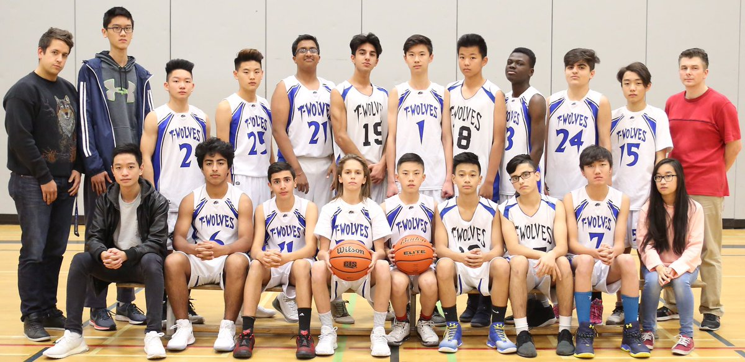
WINTER
Boys Basketball - 9/10/Senior
Girls Basketball – Jr/ Senior
Ski and snowboard team – boys/girls, all grades

Slide 6

SPRING
Tennis – boys/girls, all ages
Badminton – boys/girls, all ages
Track and Field – boys/girls, all ages
Basketball – Spring league, all ages
Soccer – girls all grades
Mountain Biking - – boys/girls, all ages
Golf- boys/girls, all ages

Slide 7

INTRAMURALS
All year long at lunch
Co-ed
Emphasis on sportsmanship
T-shirts for sportsmanship
Handball, Basketball, Floor Hockey, Dodgeball, Soccer, Badminton, Volleyball, drop in activities

Slide 8
Counsellor Role at Pinetree
NEED HELP? LET US GIVE YOU A HAND!
Course planning.
Career planning and Career Center.
Post secondary information, admissions, and financial aid.
Help with academic, personal, social, and family issues/concerns.
Prevention and awareness education.
Crisis intervention and referral to community services.

Slide 9
Supporting Pinetree Students
ENGLISH LANGUAGE LEARNERS
  ELL Program for students learning the English language
  Assessment and placement to develop English language skills
TEACHER SUPPORT
  Teachers can provide support outside class time during ESS
  Arranged independently with students as needed
LEARNING SERVICES– LEARNING CENTER
  Academic support for grades 9 – 12
  Work with teachers, students, and parents to facilitate student success
LIBRARY
  Print materials, audio-visual resources, and computer lab – online access for students
ESS (Enrichment and Support)
  Tuesdays and Thursdays 10:18am -11:06am
  Opportunity to get support from teachers and catch up on missing work
TUTORING
  Tutoring lists available from your counsellors early in the FALL (Paid Student Tutors)
  Homework club (A100) is after school from 3:20pm- 4:00pm. Student tutors available. (Free service)

Slide 10
The Transition from Grade 8 to 9
Our goal is to help grade 8’s make a smooth transition to high school. To help ease the transition, we provide the following information/events:
  Grade 8 Walkabout: January 23rd , 2026
  Visits to Middle Schools: Early March to program and make course selections
  Articulation meetings: With teachers at the middle schools in mid- April
  First day of School in September: Grade 9’s come in for ½ the day for a mini- orientation, to learn about Digital Literacy, get their pictures taken, Office 365 password and a lunch!
Notes:
Date needed

Slide 11

Choosing Courses:
The Programming Process
Read the course calendar descriptions carefully. Calendar is available online.
Don’t worry about what your friends are taking; instead, focus on your skills and abilities.
Discuss your choices with your parents.
Contact your counsellor if you have questions.
Grade 9 is a year for exploration. These are not pre-requisite courses ( other than languages and core academics)

Slide 12
Course Programming
Grade 9 students are required to take 8 courses:
5 are mandatory:
  English 9 (or ELL)
  Socials 9 (or ELL)
  Science 9
  Math 9
  PE 9
  3 Electives
  * Applications of Digital Learning 10

Slide 13
Applications of Digital Learning 10
Although categorized as a grade 10 credit, the course will be taken by all grade 9 students. Instruction is delivered through a combination of online assignments and learning activities during ESS block.
Goal of the course:
In this course, students will be required to navigate the technology required to accomplish the competencies of our curriculum and beyond.
Students will be able to
  understand and define a task
  choose the correct digital tool for the right purpose,
  deliver a finished product ethically and responsibly
  and by protecting the personal security and privacy of themselves and others.

Slide 14
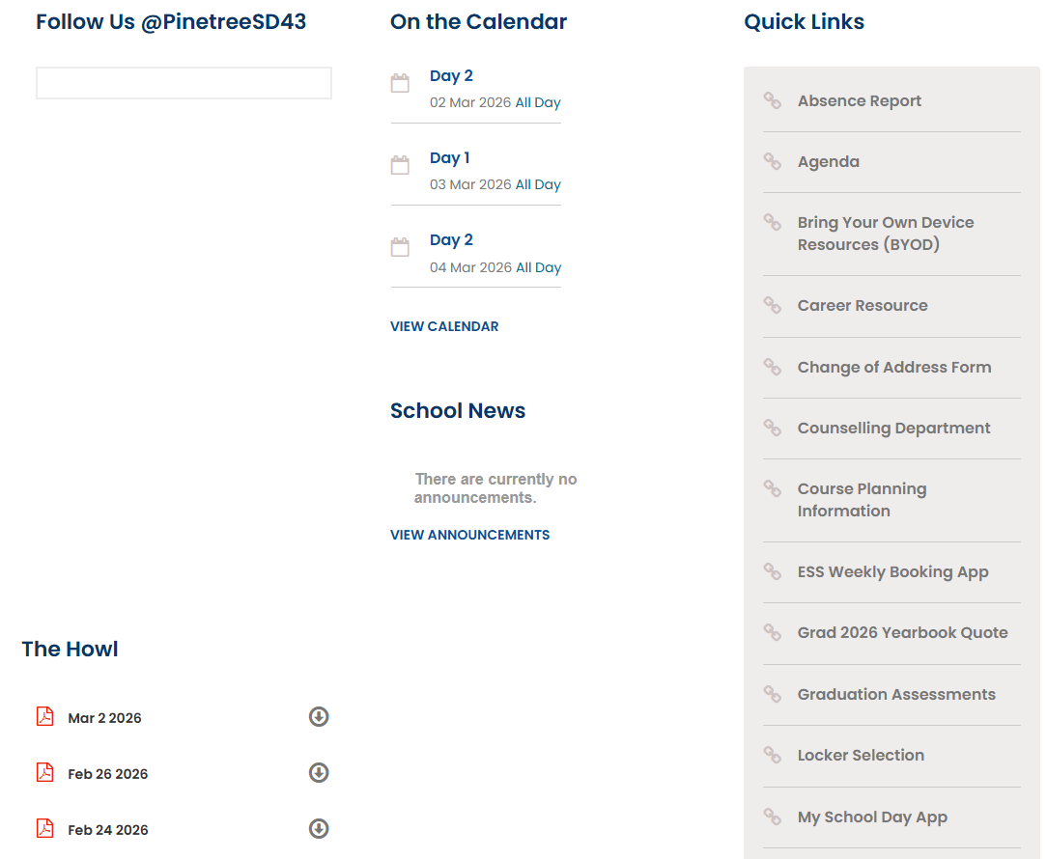
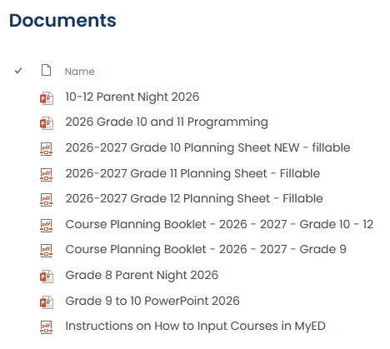

READ THE GRADE 9 Course Calendar

Slide 15

Detailed description of all courses.

Slide 16
Elective Choices
VISUAL ART 9- learn skills in drawing, painting, collage, mixed media, printmaking, paper mâché, and photography
BUSINESS TECHNOLOGY 9- Students will learn about advertising, money, communications and creating their own businesses using computer software programs. This course is an excellent foundation of business knowledge and skills and introduces students to the senior business education curriculum
PERFORMING ARTS 9- Drama, Dance, and Musical Theatre
FOODS & NUTRITION 9- Explore great food and food culture. A “hands – on course”
TEXTILES ARTS & CRAFTS 9- An opportunity to learn a variety of skills for traditional and modern crafts involving painting, creative lettering, hand sewing, yarn, decorating and embellishment techniques.
FITNESS 9- designed for students looking to improve their performance as well as their fitness levels. Includes core muscle training, cardio workouts, advanced weight training. Note: this is an elective in addition to PE 9.

Slide 17
Elective Choices Cont.
INFORMATION TECHNOLOGY 9- Develop and refine your skills in every aspect of technology from graphic design and animation to programming and web design and film.
WOODWORK 9- learn to safely use tools and equipment to design, create and finish your own projects. . We learn and practice skills, so we can build cool things to make us proud. Be active, productive and have fun!
POWER TECHNOLOGY 9- get challenged to solve problems and design solutions that you can build or test! In the past, students have built C02 dragsters, Rube Goldberg (engineer/inventor) machines, mobiles, balances and more!

Slide 18

Elective Choices cont’d…
MUSIC PROGRAM:
  Concert Band 9 (linear- all year course)
    Band 9 will be one of your 8 courses
  Jazz Band 9 (linear - extra course)
  Choir 9 (linear - extra course)
  Vocal Jazz 9 (linear - extra course)

Slide 19

Second Languages
French 9
Japanese 9
Spanish 9
Note: Grade 9 Language courses are beginner classes. These courses are not intended for Native speakers or for students coming out of Immersion programs. Please discuss with counsellor regarding appropriate placement if necessary.

Slide 20
Language Considerations
Good at French? Keep French 9.
Good at Languages? Take French 9, Spanish 9, or Japanese 9.
Good student but want a change? Switch to a different language.
Not strong in languages? Don’t take one.
Want a break? Wait until grade 11 and take a beginner language in grade 11 ( i.e. Beginner Spanish 11 or Beginner Japanese 11).
IMPORTANT:
Grade 11 second languages are no longer required for admission into UBC or SFU.
Languages are not required for graduation

Slide 21
Benefits of a Second Language
Learning a second language helps students build and strengthen skills for their future
  Improves communication skills
  Ability to interact with others
  Public speaking skills
  Fosters cultural awareness and global perspectives
  Builds confidence through interactive and engaging activities
  Prepares students for real-life language use

Slide 22
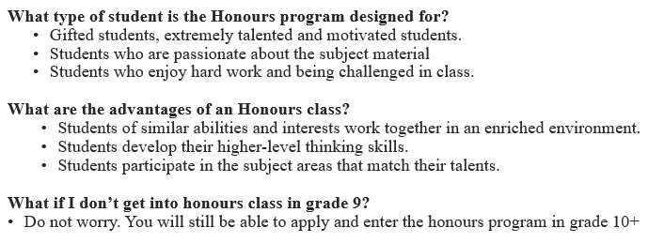
Pinetree Honours Program

Slide 23
Honours
Honours Courses:
    English Language Arts 9 Honours
    Mathematics 9 Honours
    Science 9 Honours
    Social Studies 9 Honours
How are students selected for the grade 9 Honours classes?
  All interested students must self-select honours classes in the Student Myed Portal
  Middle Schools will then provide feedback
  A lottery system will determine which students will have a seat in Honours
  If selected for Honours students cannot later opt to drop their honours class and ask to move to a regular class.

Slide 24
Timetable Features
TWO SEMESTERS PER YEAR
  September to January and February to June
  Semester courses last for 5 months (Science, Socials, English, Math, PE, Electives)
LINEAR COURSES (Full Year) AT THE GRADE 9 LEVEL
  Band+(PE for band students only), Choir
  September to June
STUDENTS IN GRADE 9 ARE REQUIRED TO TAKE 8 COURSES PER YEAR
COMMON MEETING TIMES FOR STUDENTS
  Lunch
  ESS
COMMON LUNCH FOR ALL STUDENTS
  Activities –intramural program
  Clubs, Meetings, Activities

Slide 25
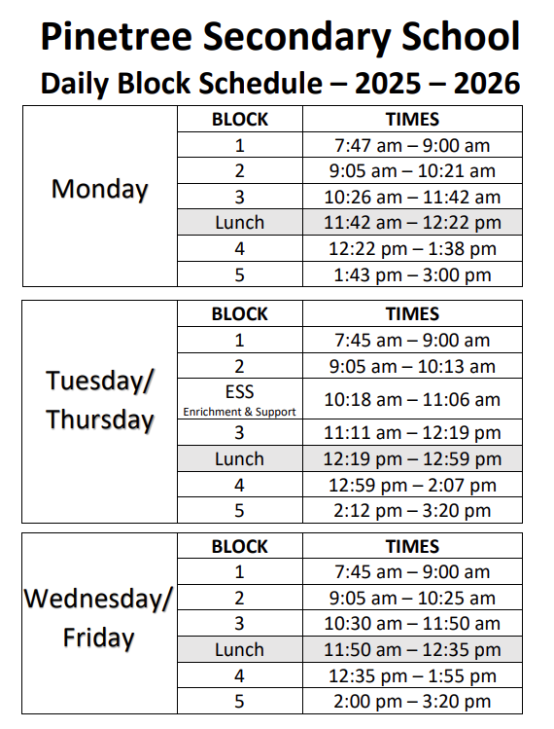

Slide 26
Timeline Grade 8’s
Cross Catchment :
Completed- students accepted to Pinetree will have received an email from the District and Ms. Close
Pinetree Honours:
Qualified candidates will be admitted based on consult with middle school and lottery system
You will be able to view your schedules before the start of school at the end of August before the 1st day of school in September.
Notes:
Dates needed

Slide 27
Timeline Cont.
Programming at Middle Schools: March 2026
  Maple Creek: March 12th
  Scott Creek: March 11th
  Summit Middle: March 11th
Deadline to input requests in the student myed portal is March 13th 4pm.
Myed Portal will close on March 30th (final deadline)

Slide 28
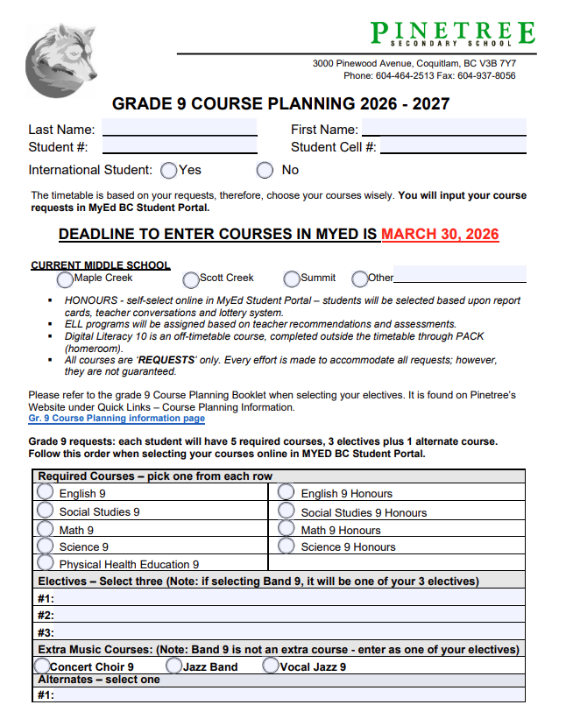
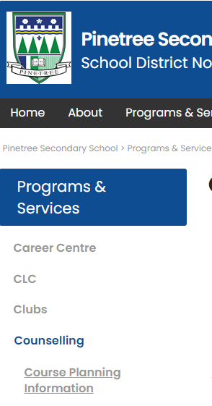
Use this sheet to help you plan! Go to the course planning page on the website to access this sheet.

Slide 29
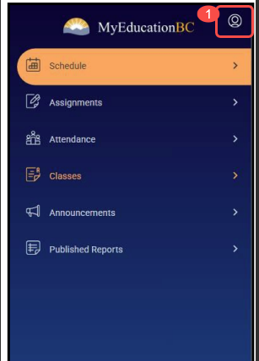
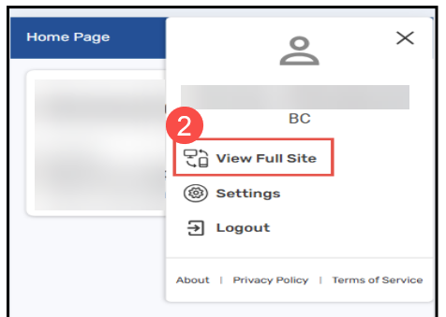
Inputting course requests in MyED
Once in the site click on the ‘human head’ thing!
Select ‘View Full Site’ under the login option

Slide 30
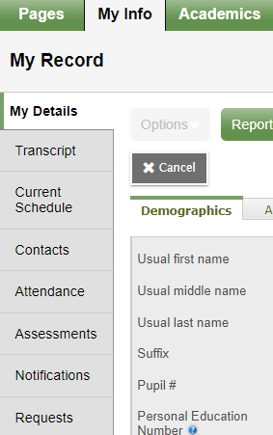
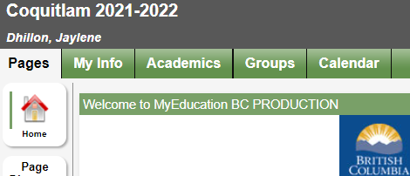
Inputting your Course Selection in MyEd BC
1. Log into your student MyED BC account
  You will see the heading as shown below. Click on the green tab title “My Info”.
2. Click on the tab in the left column that reads “Requests”.

Slide 31
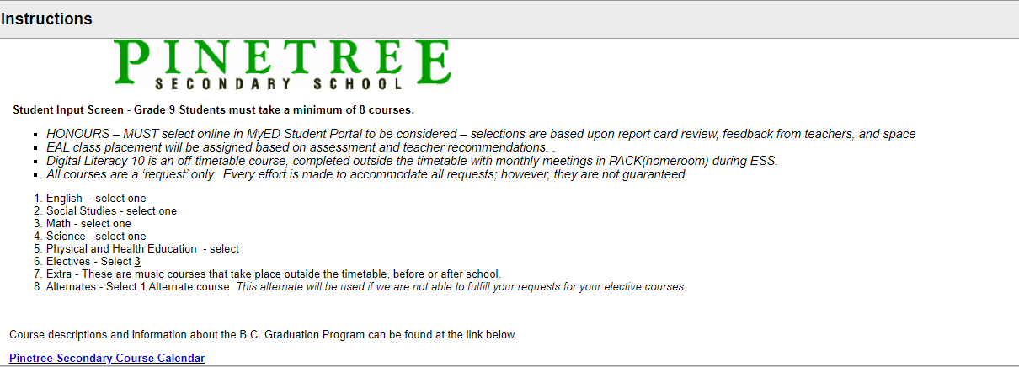
3. You will then see this page. Read the instructions carefully!

Slide 32
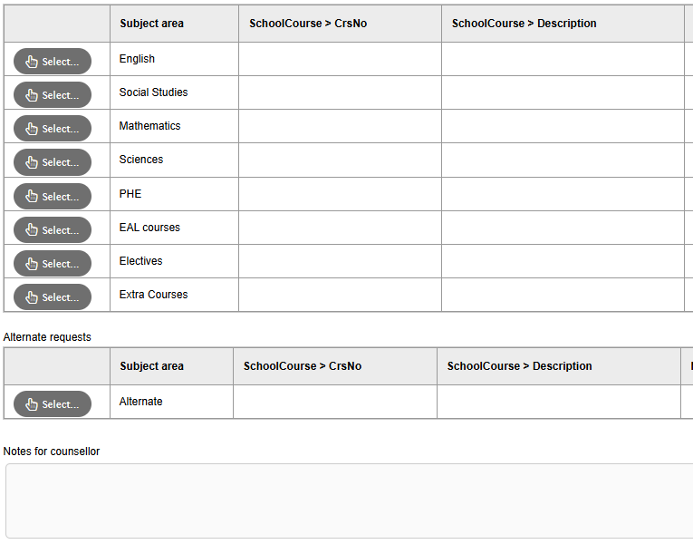
Enter your Primary requests:
English
PHE
Social Studies
Math
Science

Slide 33
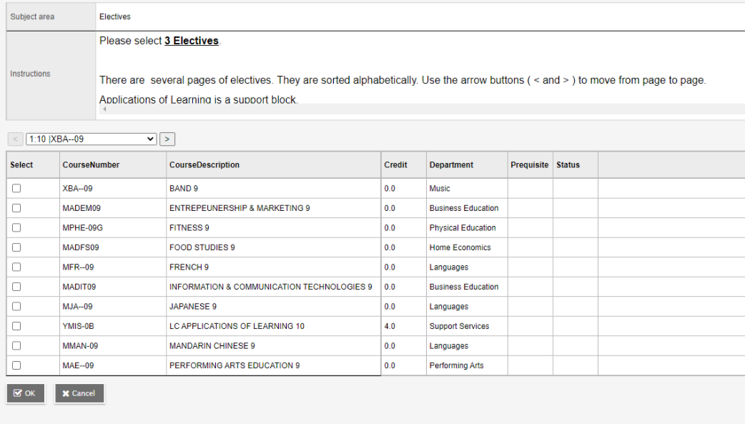
Enter Your Elective Choices: You Must enter 3 electives!

Slide 34
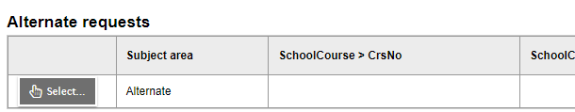
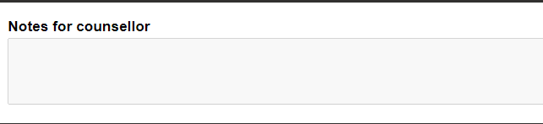
You will also need to enter:
1 alternate course (this is a course we would add if we are unable to accommodate one of your 3 elective choices)
Notes to Counsellor: If there is anything you would like us to know about your Course selection, please leave a message in the Notes to Counsellor.

Slide 35
COUNSELLOR CONTACTS:
Please call or email your counsellor if you have questions:
Ms. Bishop cbishop@sd43.bc.ca A-I
Mr. Nelson: kenelson@sd43.bc.ca J-0
Ms. Dhillon: mdhillon@sd43.bc.ca P-Z
Mr. Sharma vsharma@sd43.bc.ca International
Pinetree phone #: 604-464-2513
Notes:
Include new counsellor

