Slide 1
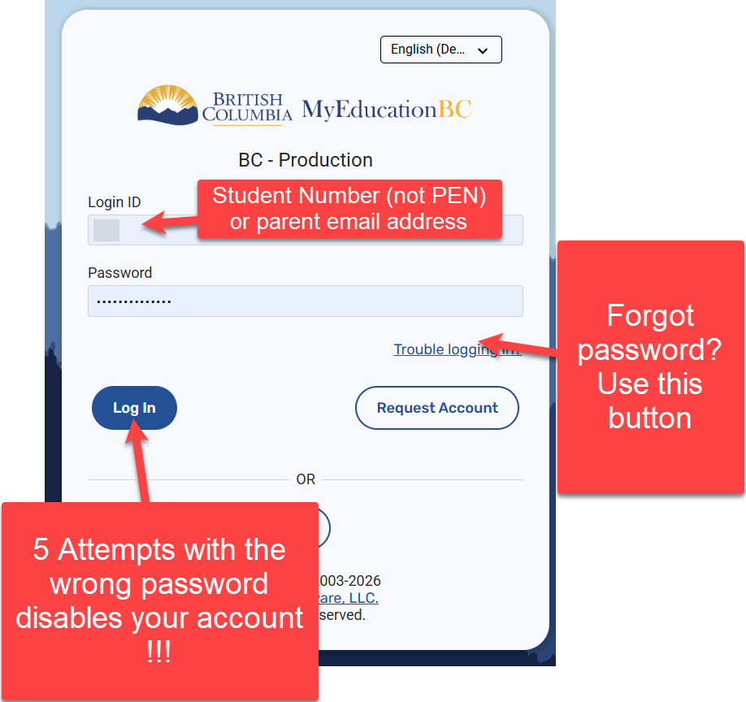
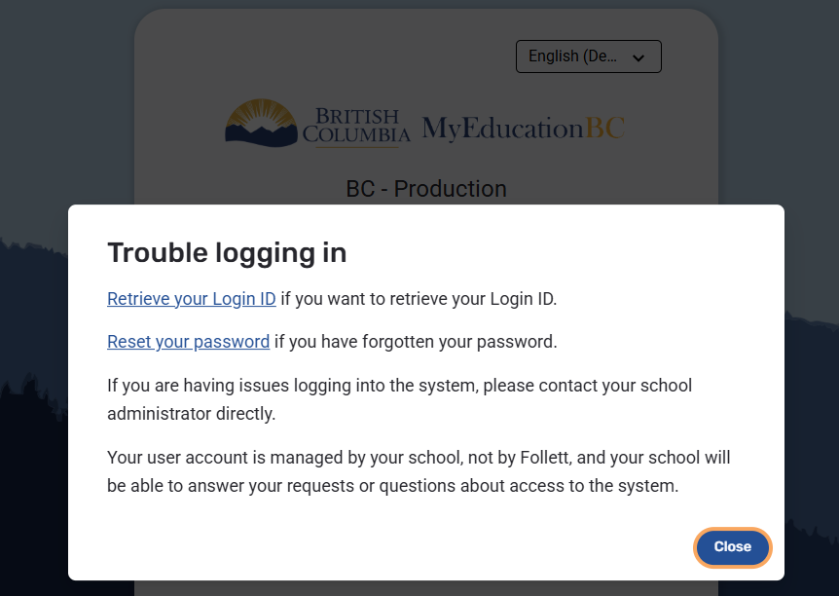
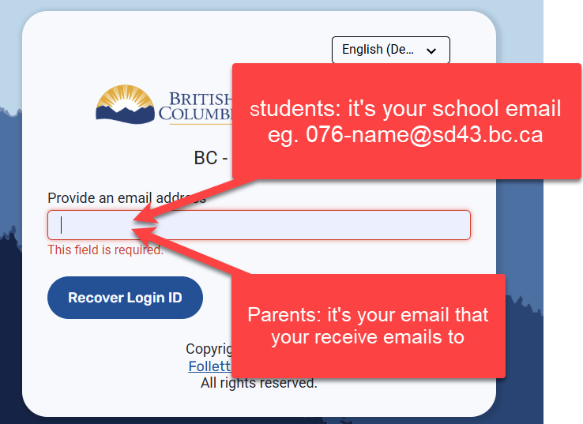
MyEducationBC - How to Log in Student/Parental Portal & Password Reset
Password reset requirements
Look for the email from sysadmin@myeducation.gov.bc.ca for your temporary password
New Password requirements: {WRITE DOWN NEW PASSWORD FIRST}
Length must be 8 to 14 characters
Must be at least one uppercase and one lowercase letter
Must have at least one special character: $, #, @, _, or !
These words can not be used:
  “password”
  login name
  first name or last name
  Date of birth
  Student number or PEN number
  No sequences of numbers or letters: “3456” or “EFGH
  No spaces- use”_” instead
DISABLING YOUR ACCOUNT REQUIRES A MANUAL RESET BY Charles Best OFFICE STAFF !!!
Use “Troubling logging in?” as the process is automated.

Slide 2
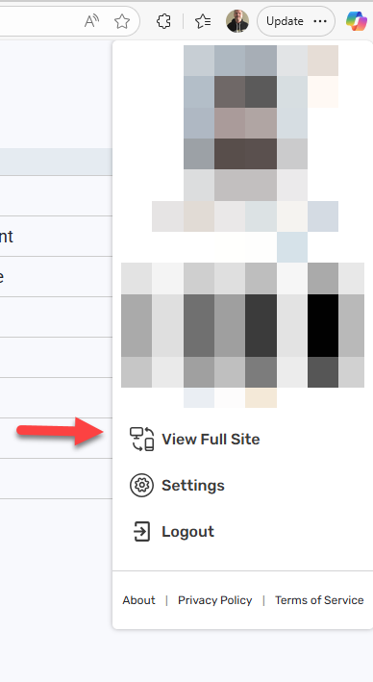
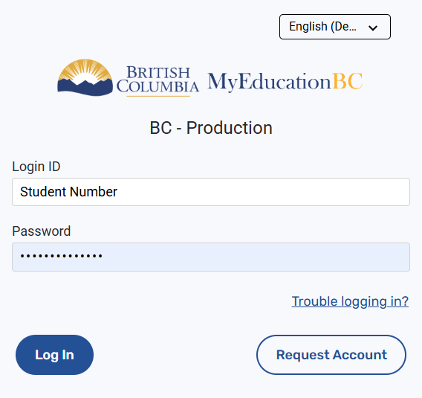
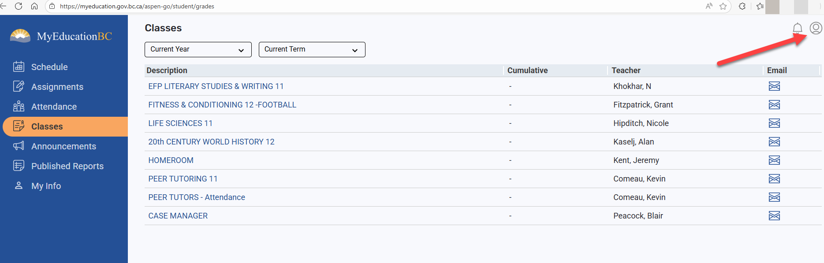
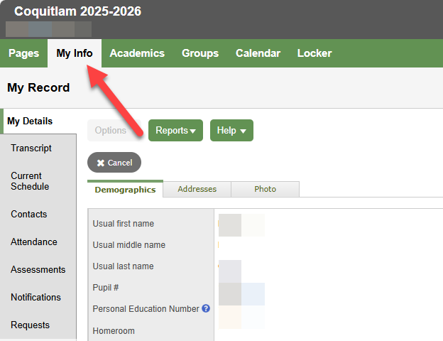
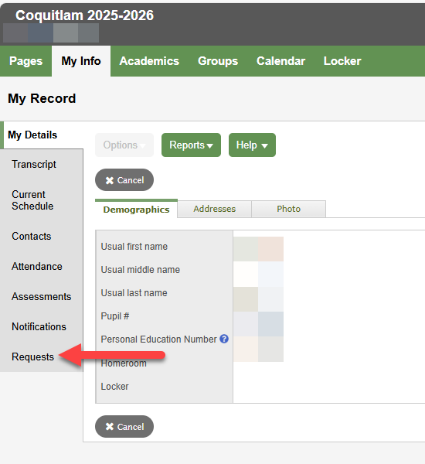
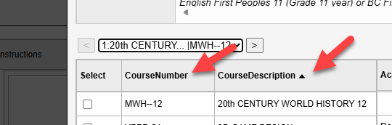

MyEducationBC - Completing your Course Requests
1
2
3
Follow the instructions for each of your course selections
4
6
You can sort the selections by Course Number or Description
5
7
in 6 or 7 easy steps
You can change your course selections up to February 8th (Grade 9) and March 1st (Grades 10-12).

