Slide 1

Class of 2026
The Road to Graduation

Slide 2

Make sure you are on Track to Graduate!
Review your Diploma Verification:- this is posted in MYED BC for you to download and review _____________

Slide 3
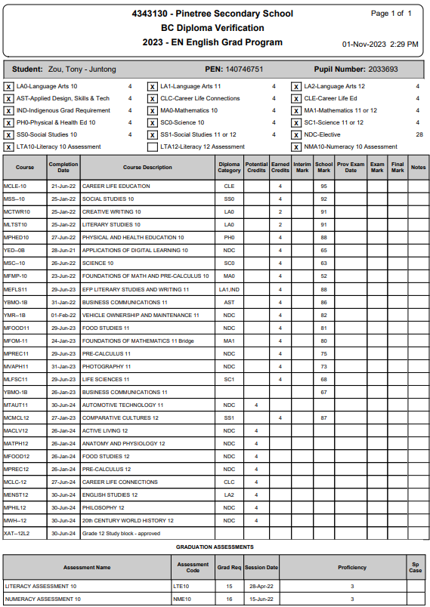


Sample Diploma Verification
Checklist:
All the boxes at the top should be checked with an X (exception for now Literacy 12 Assessment)
Assessments – Literacy 10 and Numeracy 10 must be completed
  If you are missing one of these grade 10 assessments expect an email from Mr. Rao.
  you will need to write in January
Total number of credits will be at the very bottom. Total should be = or > than 80. Top row indicates total # of Grade 12 credits. You need 16 minimum.
Check to see if Summer School marks/ Online marks are there if this applies to you.

Slide 4

Pinetree my school Day app – Grade 12 channel
All important relevant information for grade 12’s will be posted on this Channel. Make sure you have downloaded the APP so that you don’t miss out on important information and DEADLINES!

Slide 5
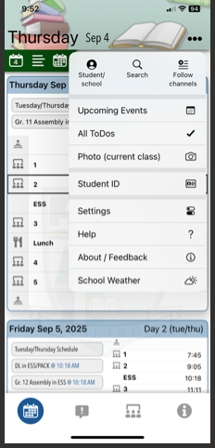
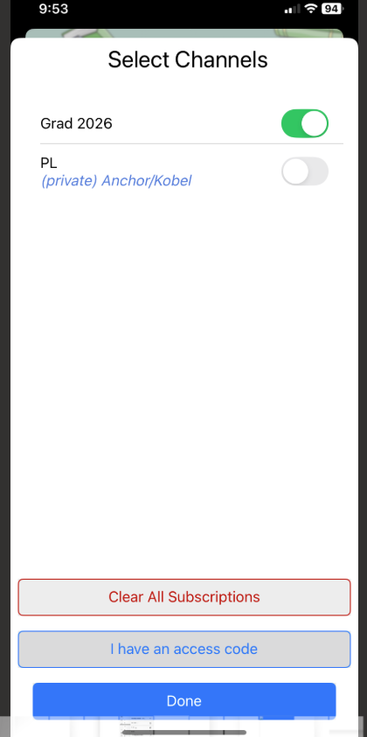
Go to My school Day APP now

Slide 6
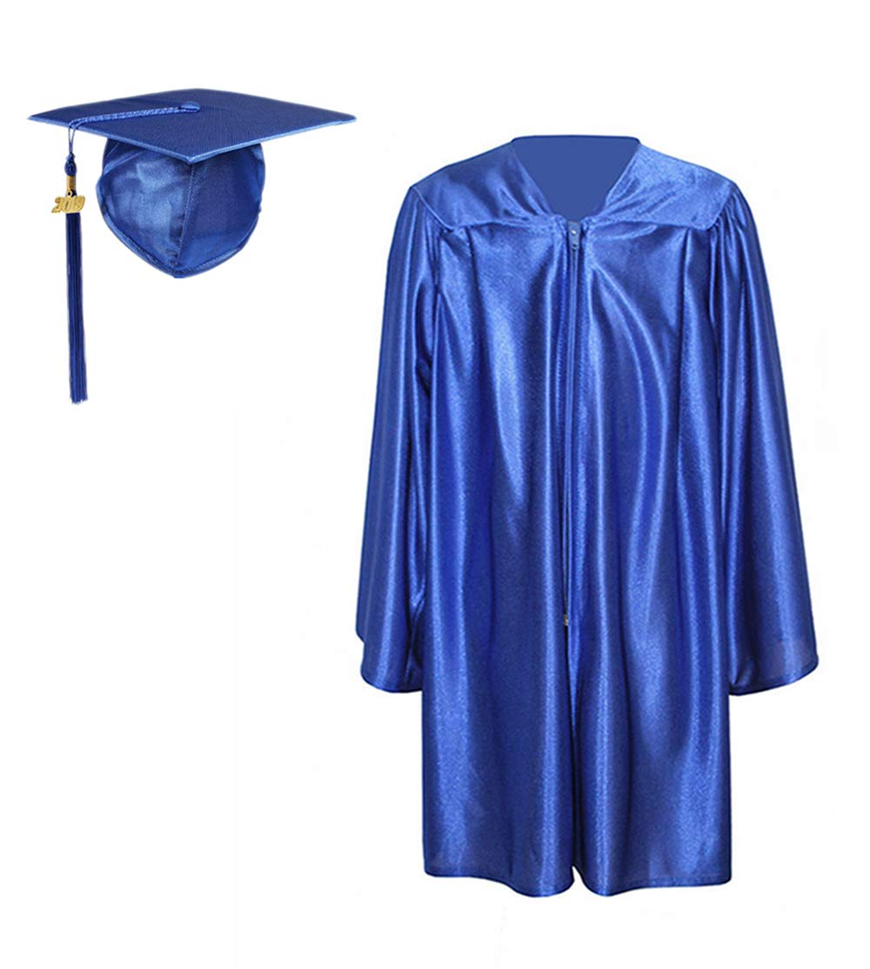
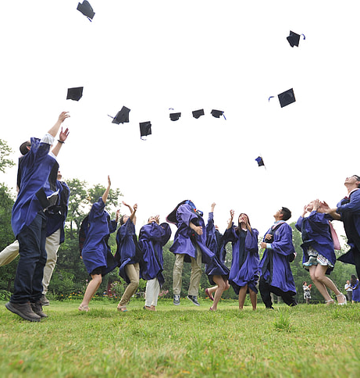
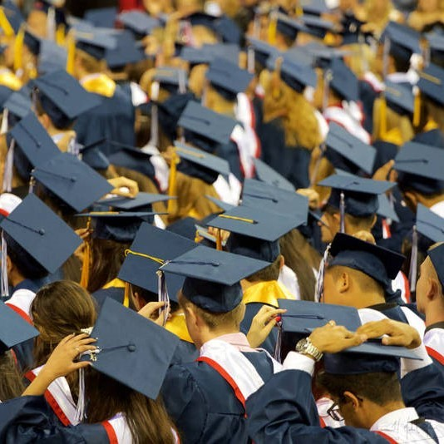
Cap & Gown Size!
Go to the link (Sent to your school email/Grad channel )and complete the form Today!
Your size and payment is needed for us to order your gown.
Deadline December 5th, 2025.

Slide 7

Link for the form will be emailed to students!
Cap and Gown Form
And put on the Grad 2026 Channel in the my school day app
Complete by December 5th.

Slide 8
POST SECONDARY APPLICATIONS
APPLICATIONS ARE OPEN
YOU NEED YOUR PEN# AND A CREDIT CARD
CHECK DEADLINE DATES (EARLY AND/OR FINAL)
REGISTER FOR STS
YOU DO NOT NEED FINAL GRADE 12 MARKS TO APPLY
YOU DO NOT NEED PAPER TRANSCRIPTS
IT IS OK TO HAVE REQUIRED COURSES IN SECOND SEMESTER
FOR BC UNIVERSITIES: EDUCATIONPLANNEBC
FOR ONTARIO UNIVERSITIES: OUAC (105 APPLICATION)
FOR ALBERTA: APPLYALBERTA (EXCEPT U OF ALBERTA)
FOR ALL OTHER CANADIAN UNIVERSITIES, GO DIRECTLY TO THEIR WEBSITE

Slide 9
STUDENT TRANSCRIPT SERVICE
WWW.STUDENTTRANSCRIPTS.GOV.BC.CA
REGISTER FOR A BASIC BCEID
IT WILL GIVE YOU ACCESS TO THE STUDENT TRANSCRIPT SERVICE

Slide 10
access student transcript service
StudentTranscripts Service Help Resources - Province of British Columbia (gov.bc.ca)
Using your bceid, you can register for the sts and you will be prompted to enter student information.
An email will be sent to the email address you provided, and it must be activated within 24 hours.
Once activated, you will be able to log onto sts using your bceid and password.
From your sts dashboard, you can choose up to 25 free (psi) selections, so that colleges and universities you are applying to will receive your official transcript. Do not change the pre-selected send options!

Slide 11
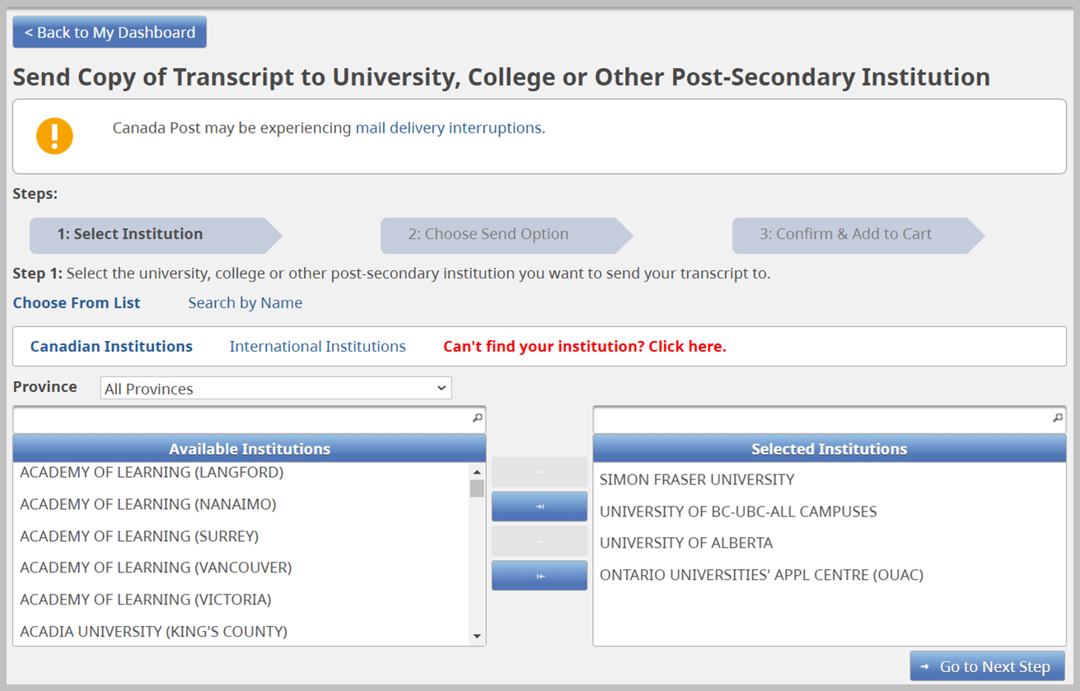

Slide 12
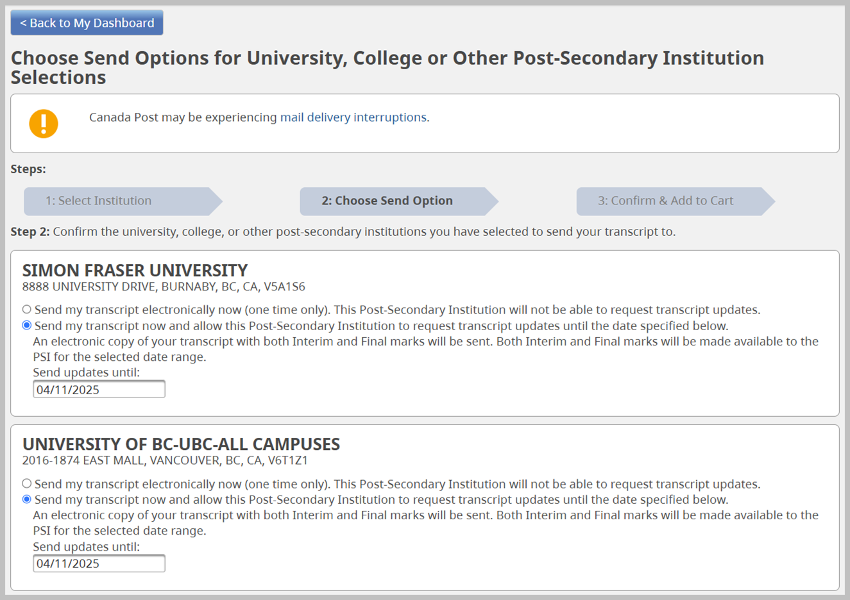

Slide 13
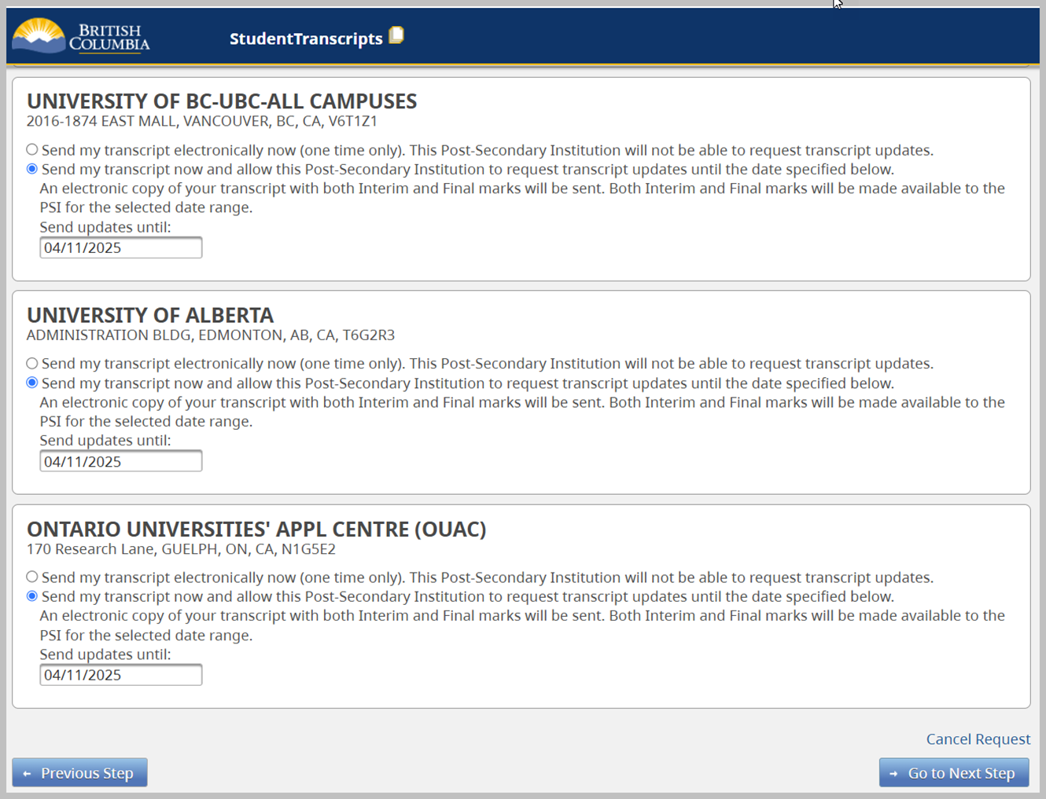

Slide 14
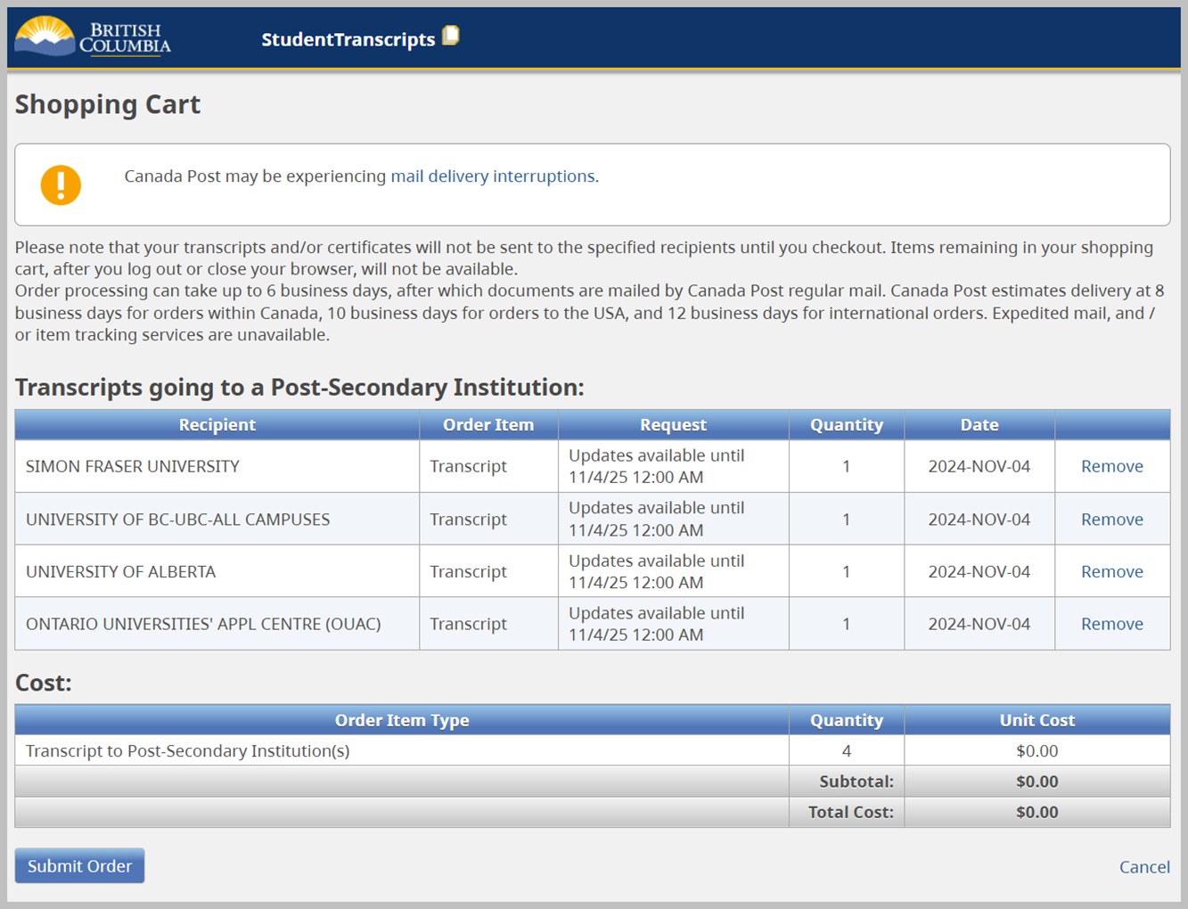

Slide 15
Grad wear website
Order your Grad Wear now!
Online store is open!
Deadline to order is November 30th
https://pinetreegrad2026store.itemorder.com/shop/home/

Slide 16
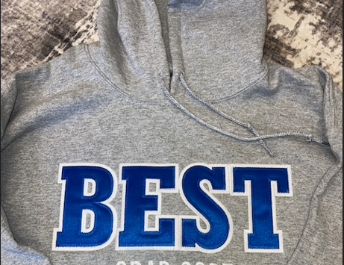
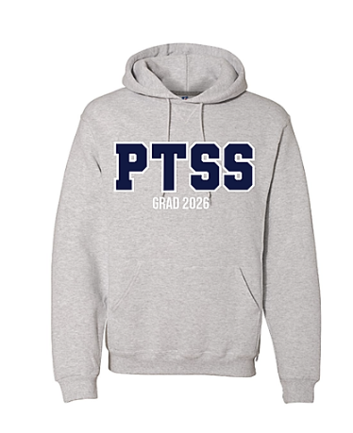

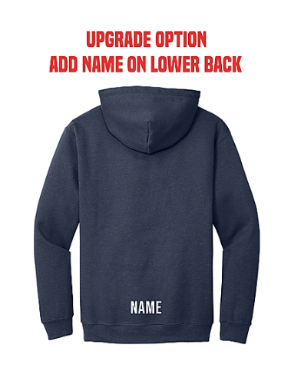

Slide 17
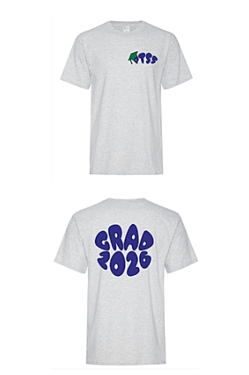
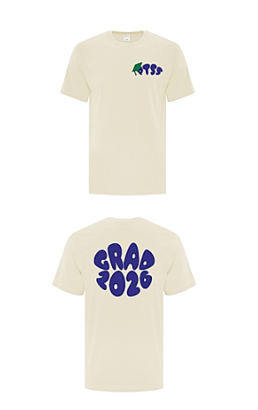
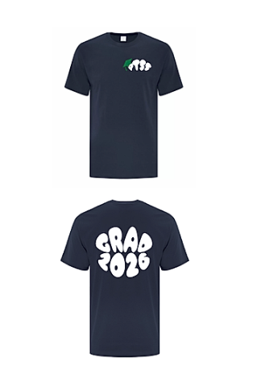

Slide 18
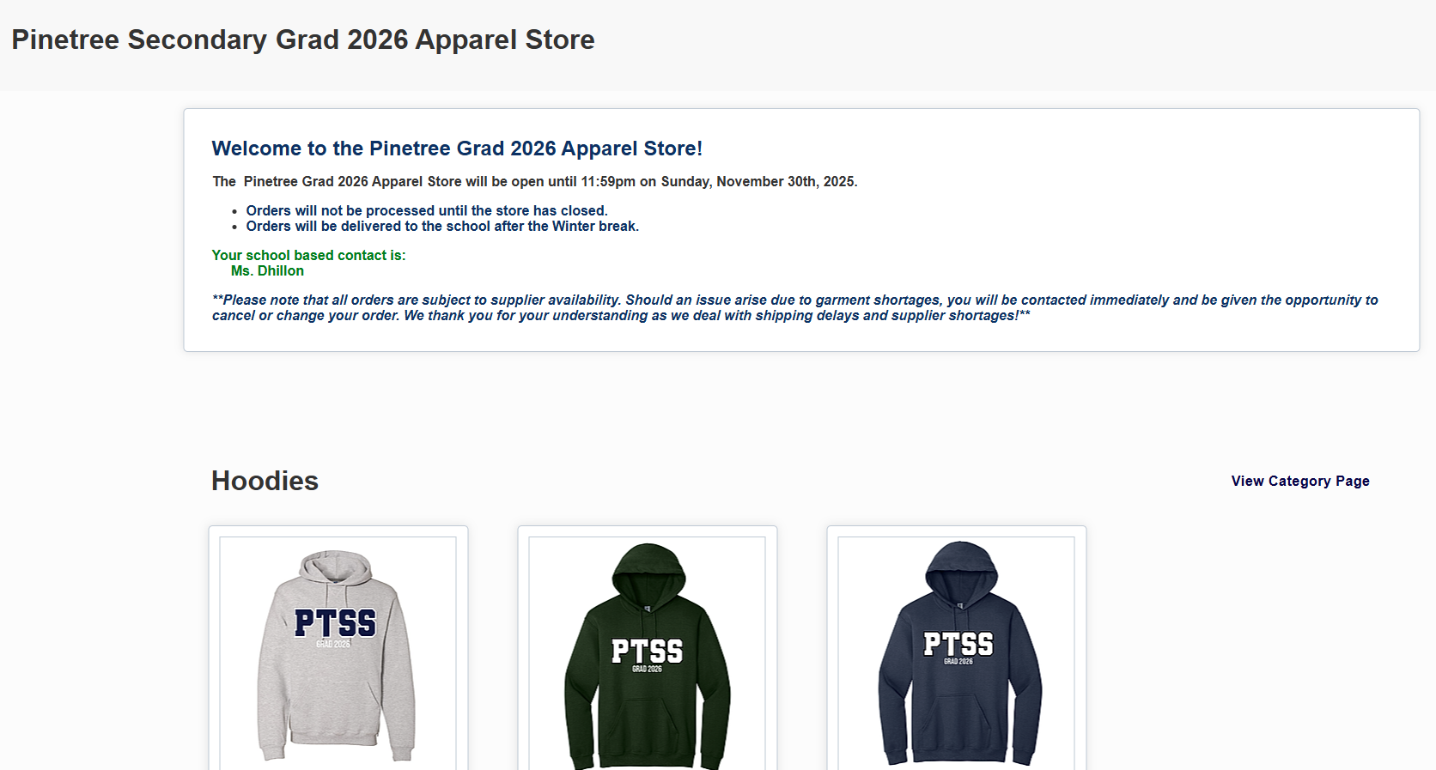

Slide 19
Grad Council Presents: Winter formal
December 11th 2025
Drum roll…….

Slide 20
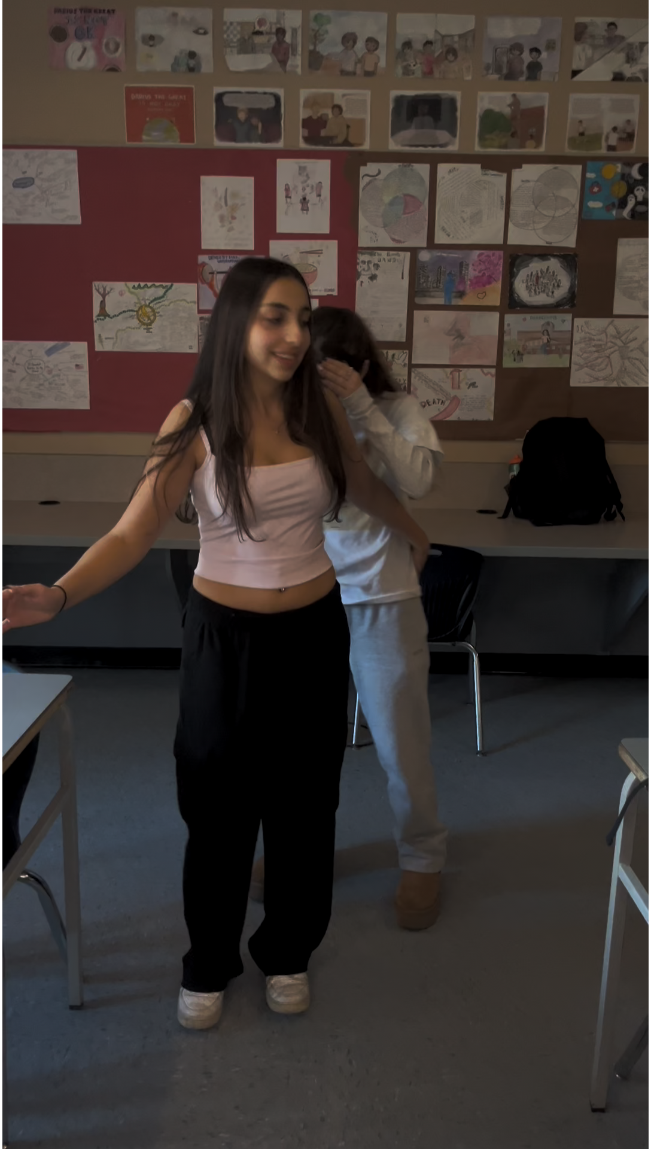

Slide 21
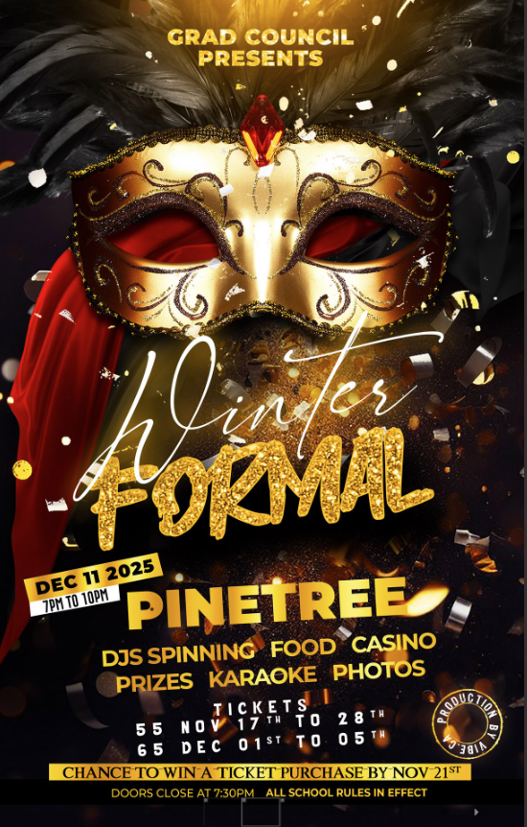

Slide 22
