Slide 1

The Road To Graduation…
CLASS OF 2026

Slide 2


AGENDA FOR TODAY…
  Applying to Post Secondary
  Scholarships
  Career Centre
  CLC
  Graduation Dinner & Dance
  After Grad
  Commencement
  Awards Night
  Questions?

Slide 3

POST SECONDARY
Unfortunately, many deadlines have passed. Douglas is still accepting applications.
Depending on the program some Uni’s accept applications until program fills
https://apply.educationplannerbc.ca/

Slide 4

SELF REPORTING OF GRADES
  Be honest and accurate
  Monitor emails and check status of application online
  IMPORTANT NOTE: If your child has been granted conditional admission to a post-secondary institution, it is subject to them maintaining their grades.

Slide 5

STUDENT TRANSCRIPT SERVICES
Electronically transfers marks to post secondary institutions
Students need to log on to the ministry site to give permission for their grades to be transferred to a PSI.
https://www2.gov.bc.ca/gov/content/education-training/k-12/support/transcripts-and-certificates

Slide 6

ON–LINE COURSES
Need to be completed ASAP. The sooner it is completed the faster it will get on the transcript for the post-secondary to view.

Slide 7

CAREER CENTRE
  Scholarship applications
  Post Secondary information
  Career information
  Volunteer opportunities
  http://public.sd43.bc.ca/secondary/CharlesBest/careercenter/default.aspx

Slide 8


CAREER LIFE CONNECTIONS
(FORMERLY GRAD TRANSITIONS)
In order to graduate students must complete:
    Vision Board (10%)
    Community Connections assignment (10%)
    Update resume and cover letter (5%)
    Write a Capstone proposal (10%)
    Document 30 hours of work or volunteer experience (10%)
    Write a financial plan (5%)
    Mentorship Record (10%)

Slide 9

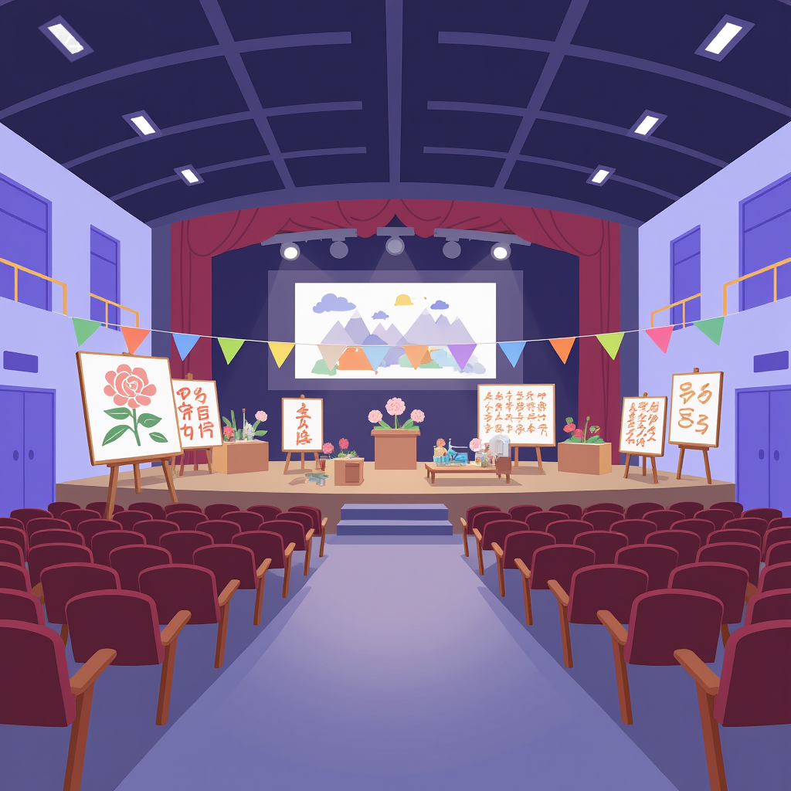
GRAD ASSEMBLY
  May 8
  Large Gym
  Valedictorian Nominations
Valedictorian Applications are due

Slide 10

  Tuesday, June 23
  7:00pm (Grads arrive at 6:15pm)
  Simon Fraser University
  4 tickets per grad. Additional tickets available for $5 each
  Ticket Sales (on-line)
COMMENCEMENT
Commencement Message due: May

Slide 11

SCHOLARSHIPS
  Application form for school based & local scholarships is available through our school website - Career Centre link.
  School based scholarship applications were due:
  March 29
  Check the Career Centre website regularly or the bulletin board in the hall for additional scholarships

Slide 12

AWARDS DAY
  Thursday
  June 18
  Large Gym
  6:30-reception
  7:00-programs starts
Invitations will be handed out early in June

Slide 13

FRENCH LEAVING CEREMONY
  June 24
  1:00pm – 3:00pm
  Small Gym

Slide 14
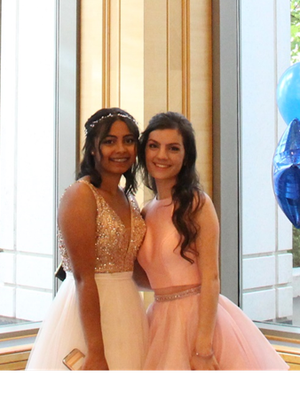
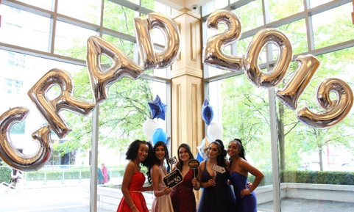
GRAD DINNER DANCE
  May 30ᵗʰ
  Saturday
  Fairmont Waterfront
  6 pm
  ~$170
  Ticket Sales:
  March 13ᵗʰ – April 30ᵗʰ
  Table Reservations:
  May 8th and 11th

Slide 15

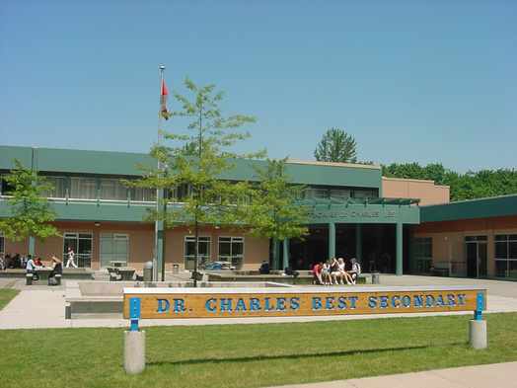
AFTER GRAD
  Following the Dinner/Dance
  Dr. Charles Best Secondary
  Cost: $55
  Mandatory Bus ride
  back to school $10

Slide 16











Dr. Charles Best Secondary
QUESTIONS
& ANSWERS…

