Slide 1
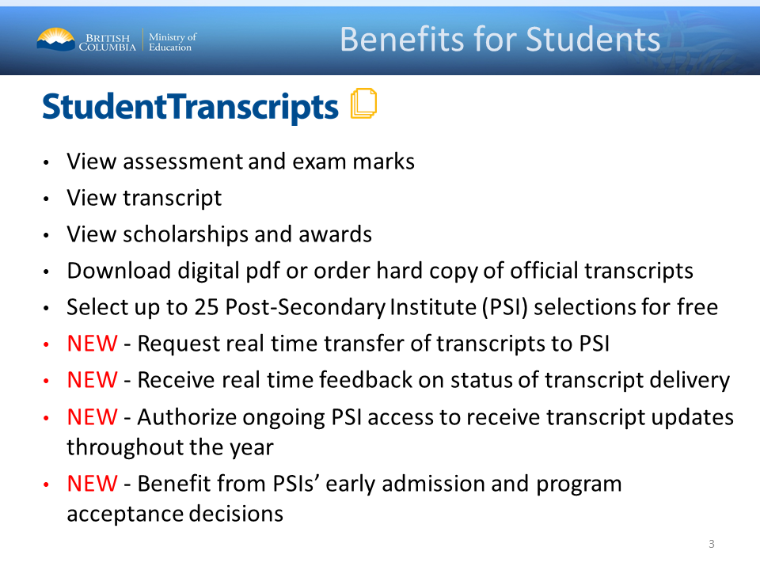
About the Student Transcripts Service
You can use the Student Transcripts Service (STS) to:
View or order your secondary school transcript
Send your secondary school transcripts to post-secondary institutions
Order your graduation certificate
View scholarships awarded by B.C.
View your provincial exam or graduation assessment results

Slide 2

Before you can access the STS you must create a BASIC BCeID Account
https://www2.gov.bc.ca/gov/content/education-training/k-12/support/transcripts-and-certificates/studenttranscripts-services-help/studenttranscripts-service

Slide 3
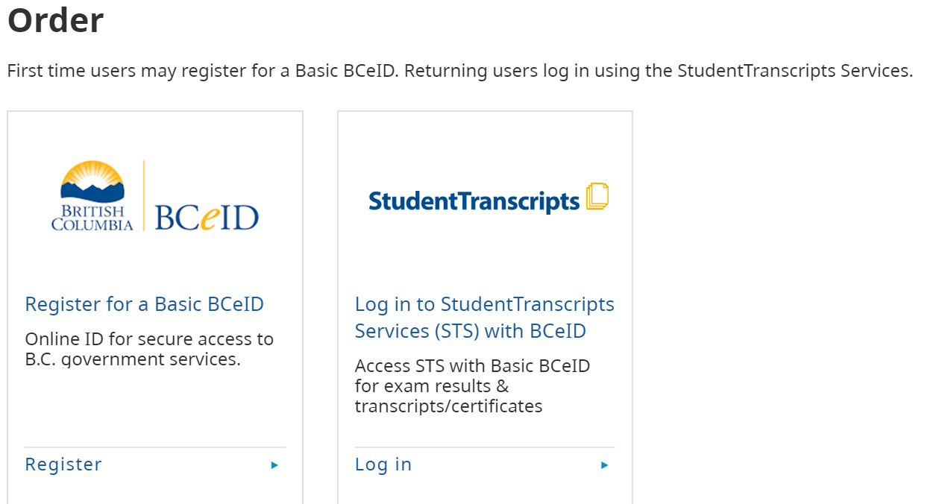
Click Here to Register

Slide 4
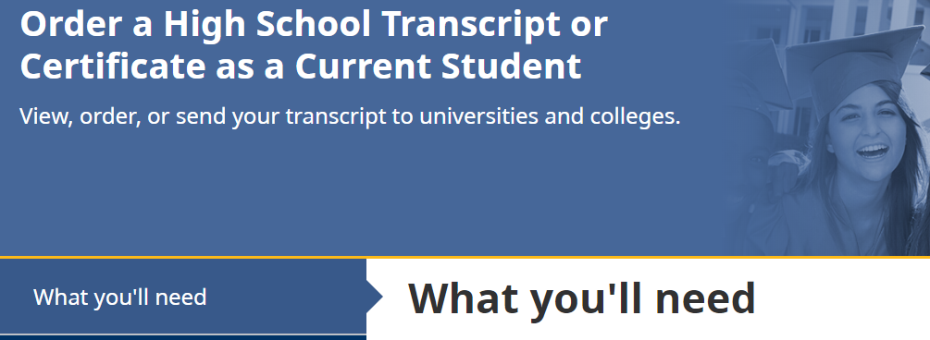
YOU WILL NEED
Personal Education Number
Full LEGAL Name
Date of Birth
Personal Email Address
Scroll Down to the Bottom

Slide 5
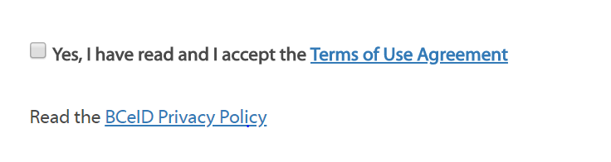
Step 2
Register for a BCeID
Complete & Select your PASSWORD, RESET QUESTIONS & ANSWER! *Don’t forget to save these, you will need them more than once*
Follow Prompts & Sign up for Student Transcript Service
Don’t forget to click on this box to complete this page!

Slide 6
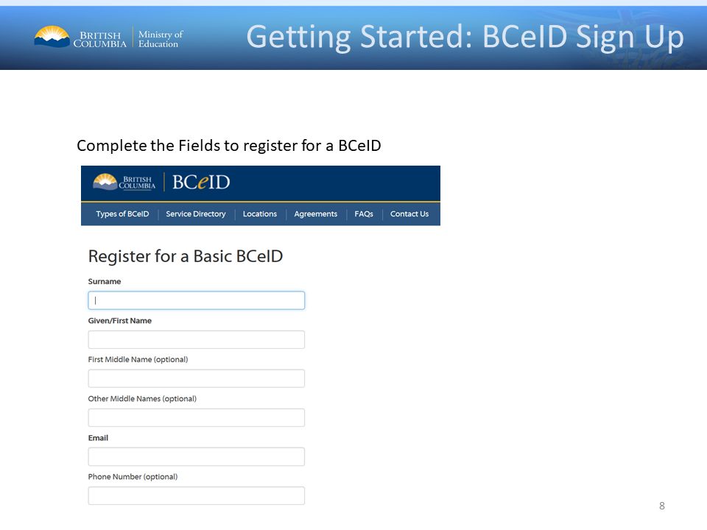

Slide 7
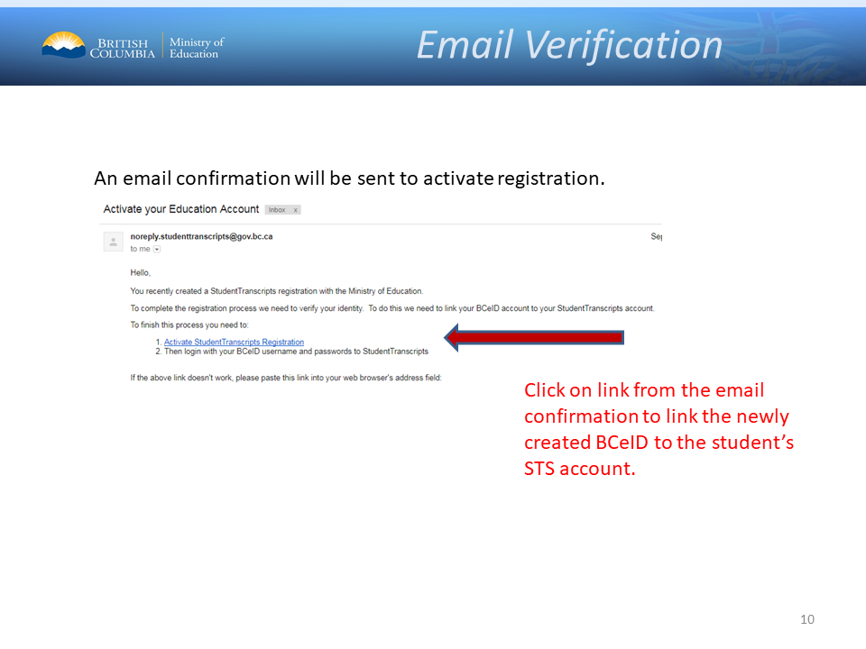
Once you click the link you are not finished. You still need to enter some personal information.

Slide 8
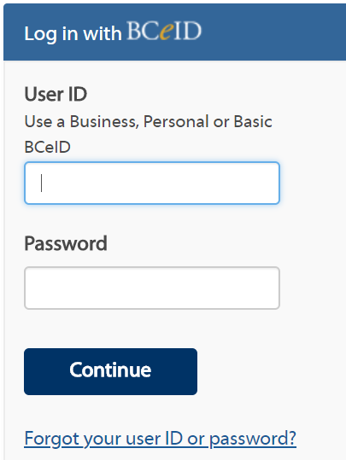
Step 3
Log in with your BCeID

Slide 9
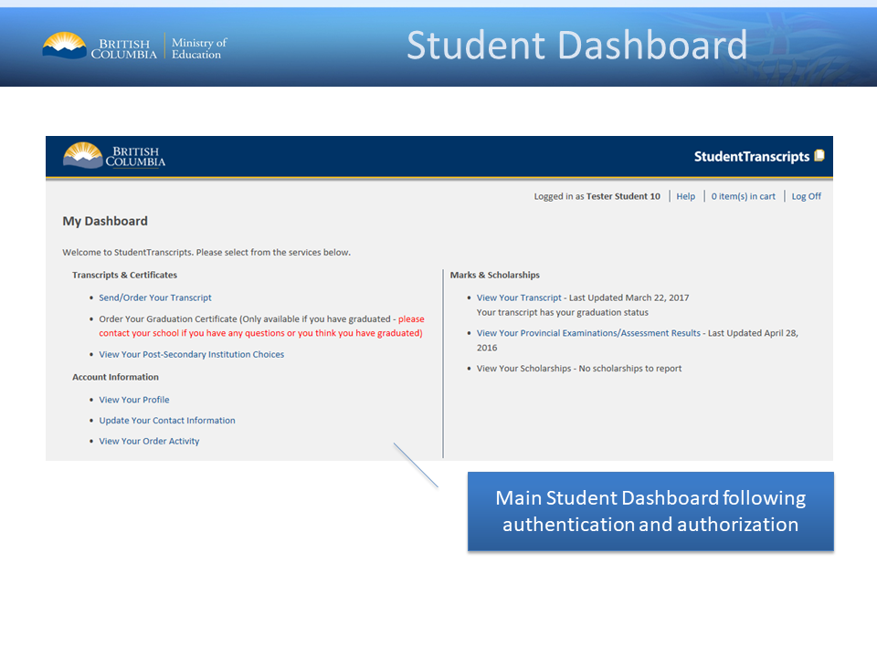
Step 4
There are several things you can do on this page.

Slide 10
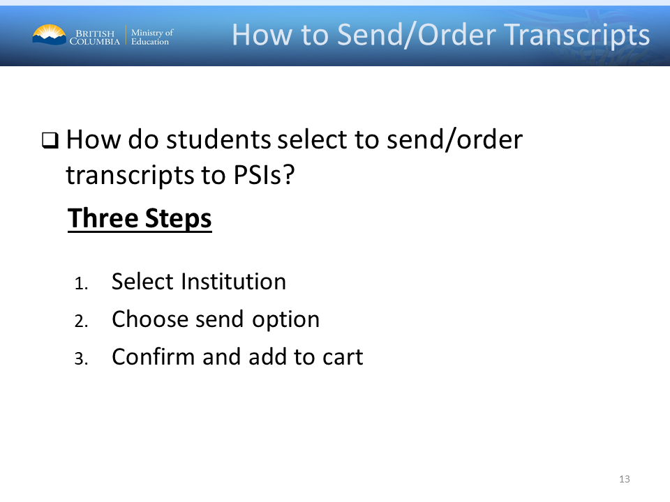
Do NOT change the auto-selected send option

Slide 11
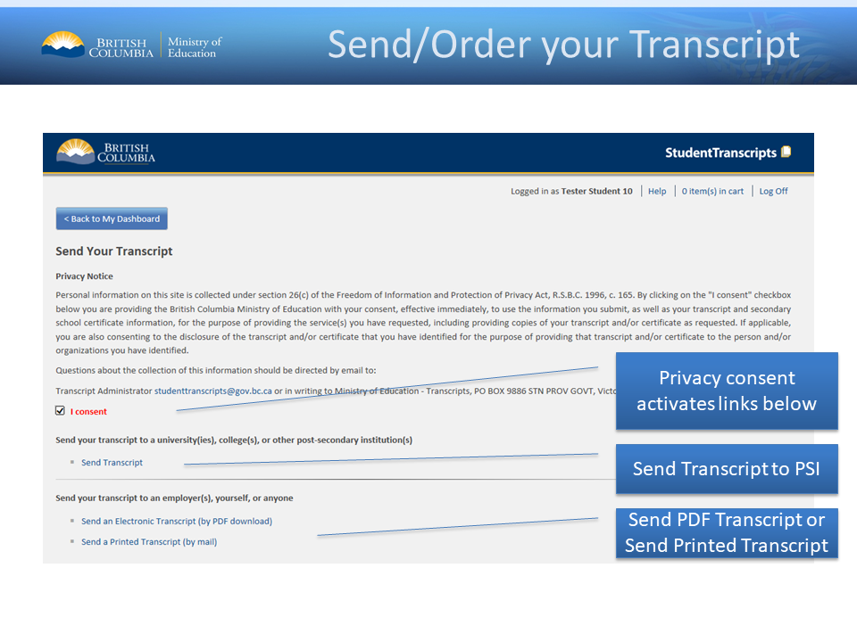
If you want a printed copy you can get ONE here – but do not do it until August after graduation. And DO NOT OPEN it or it is no longer official.

Slide 12


Slide 13

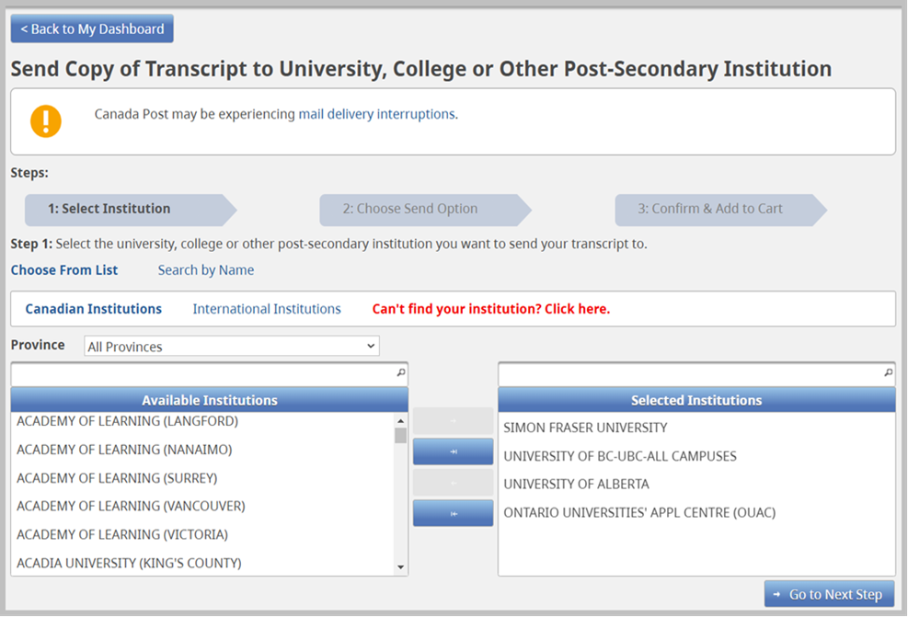

Slide 15
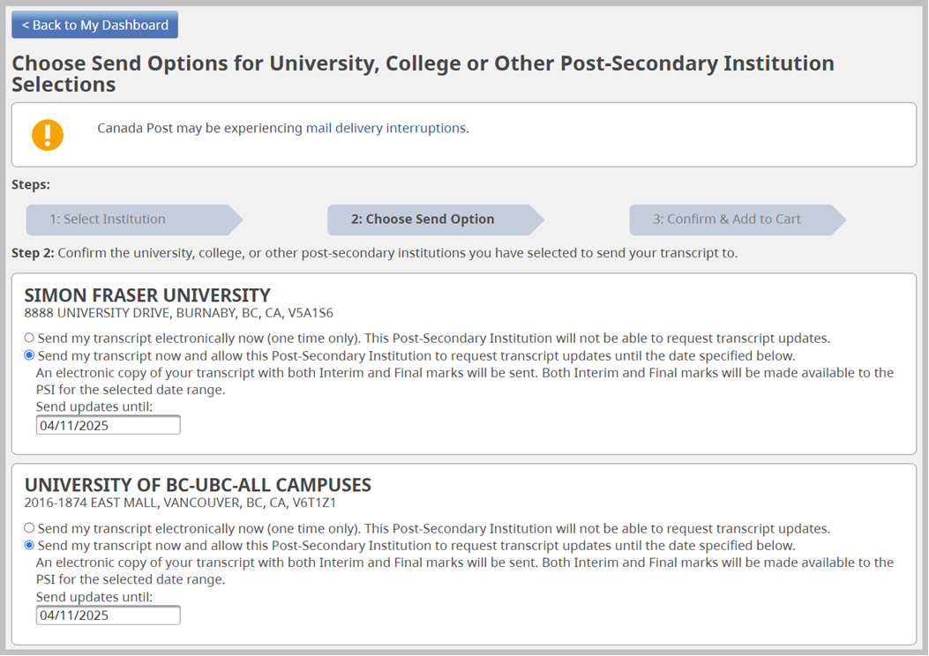

Slide 16
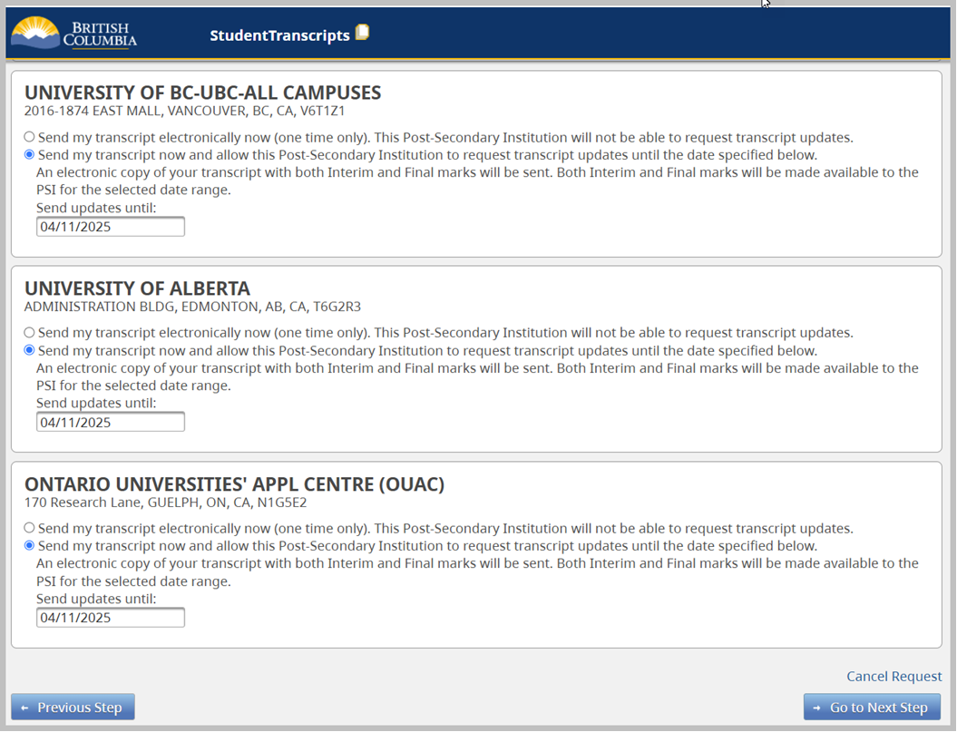
Notice you select OUAC, not individual Ontario schools

Slide 17
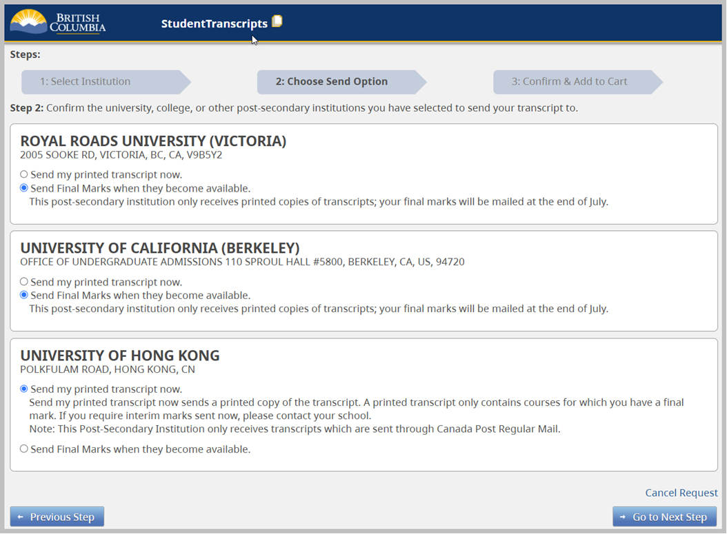
Notice these schools have different send options. You must determine what they need from you if these are the only options. Some schools may ask you to upload a transcript as they will only get your final marks in July. Pay attention to what they ask you for on your TO-DO List.

Slide 19
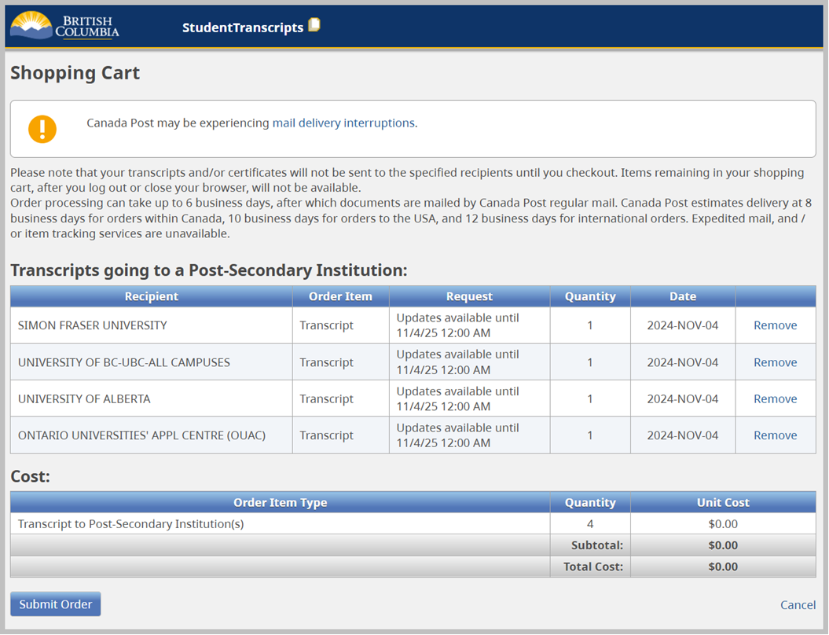

Slide 20
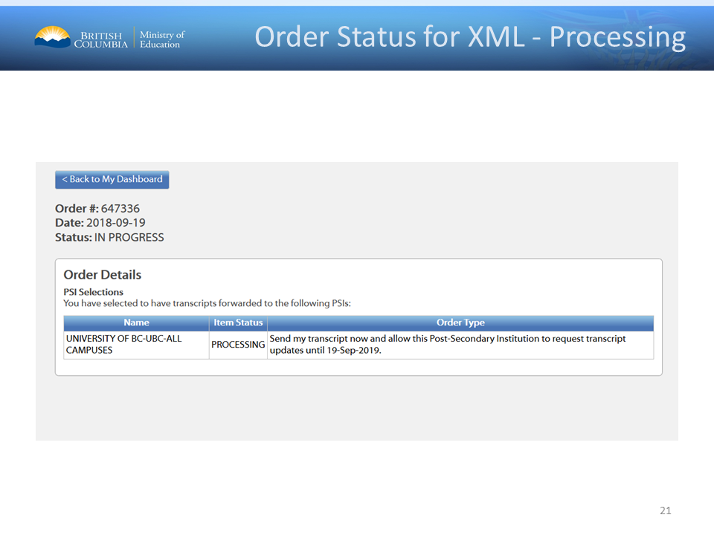
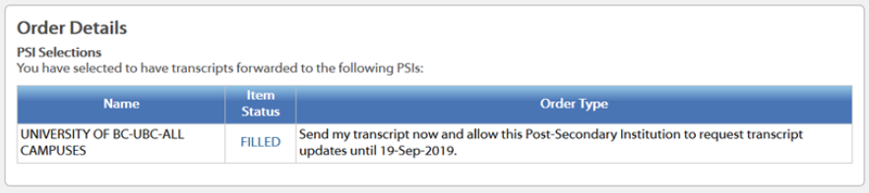

Slide 21
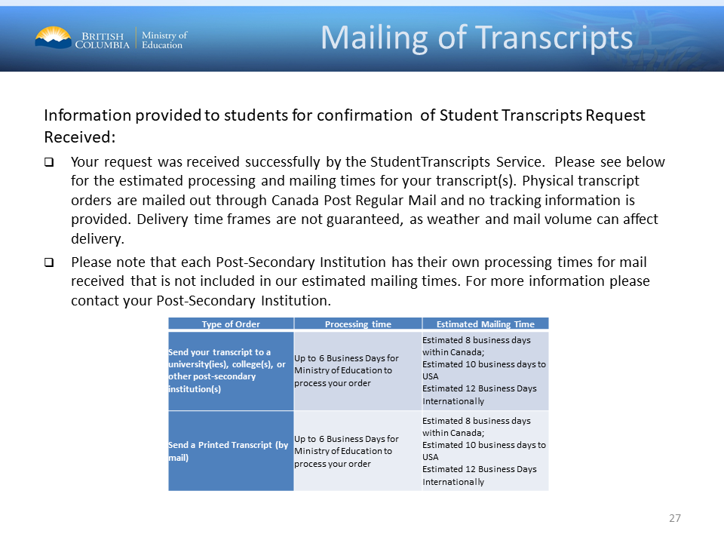

Slide 22
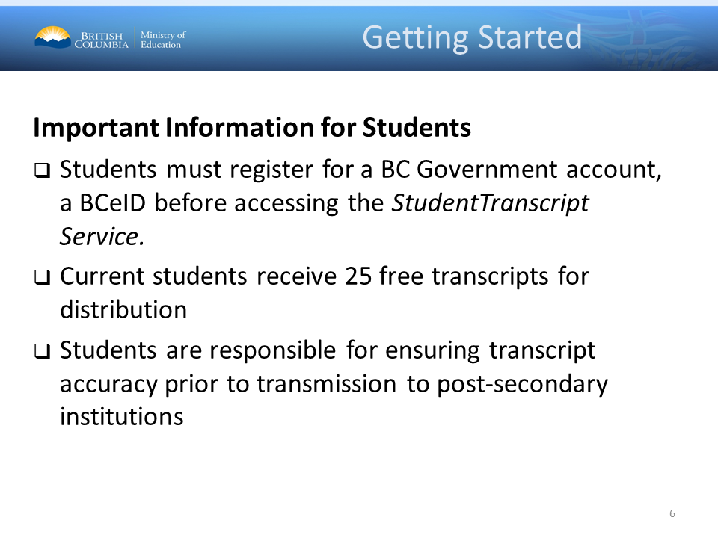

Slide 23


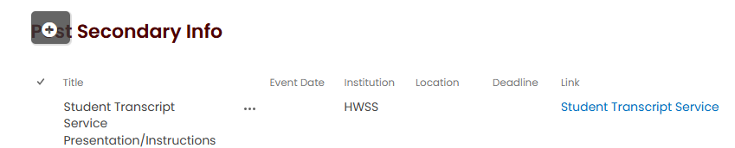

Slide 24
If you run into problems, see Ms. Butler sooner than later.
Remember, Post-secondaries cannot process your application to give you an offer without your transcript. After you apply, do your transcripts.
Some schools want transcripts no later than January!
If your TO-DO List says they have not received your transcripts and you sent them more than 2 weeks ago, follow-up, do not assume it will all be fine.

