Slide 1


Student Transcript Service
Sending Transcripts to Post Secondary Schools

Slide 2
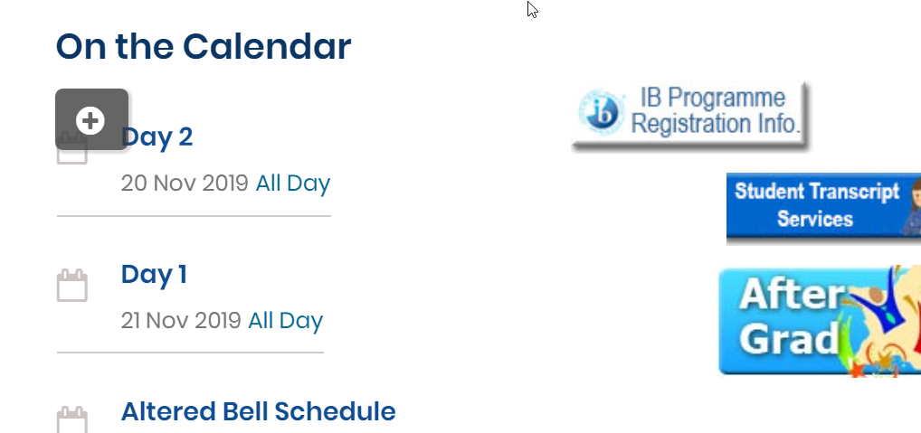
A link to the STS is on the PMSS Home page

Slide 3
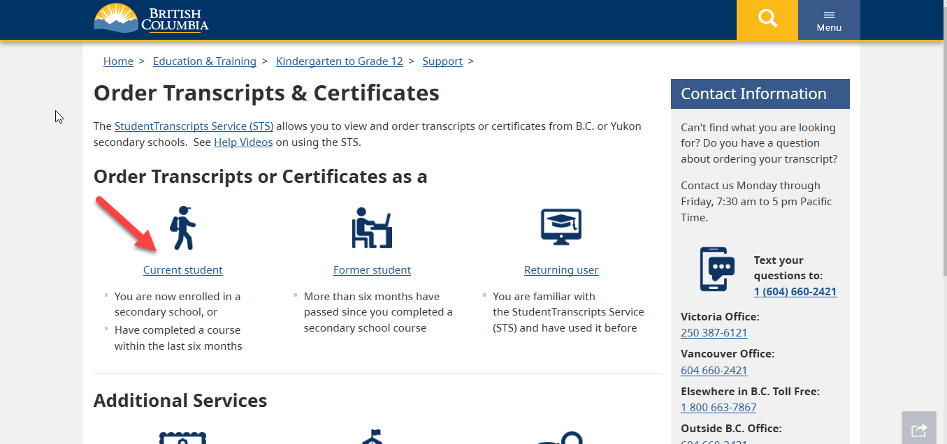
1. Accessing the Transcript service:
studenttranscripts.gov.bc.ca

Slide 4
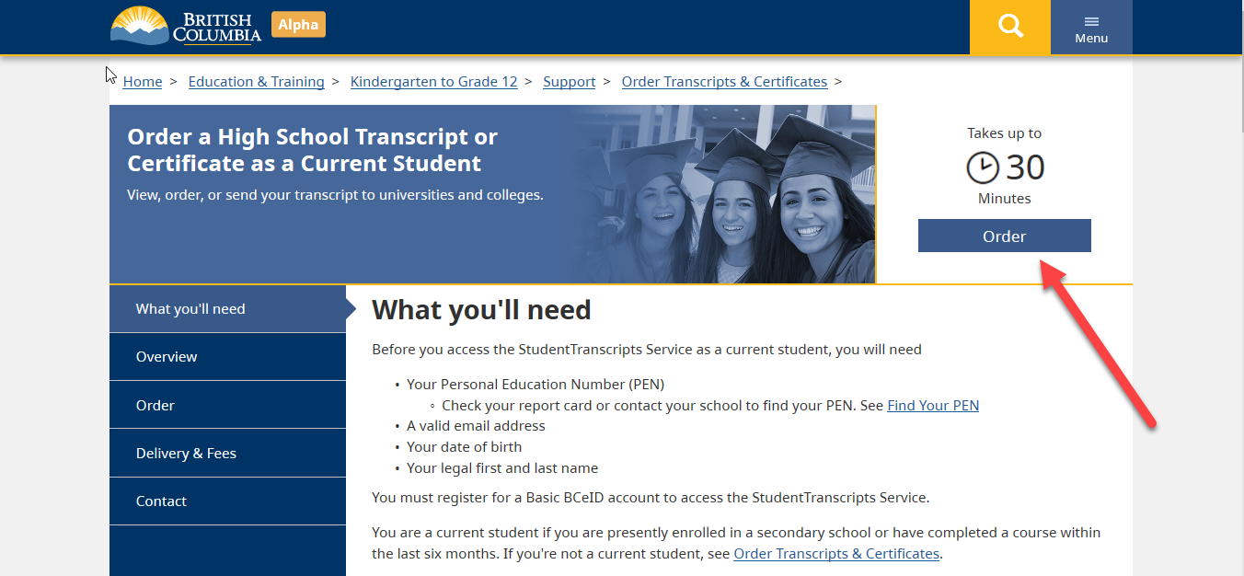
2: Ordering the transcripts —the steps

Slide 5
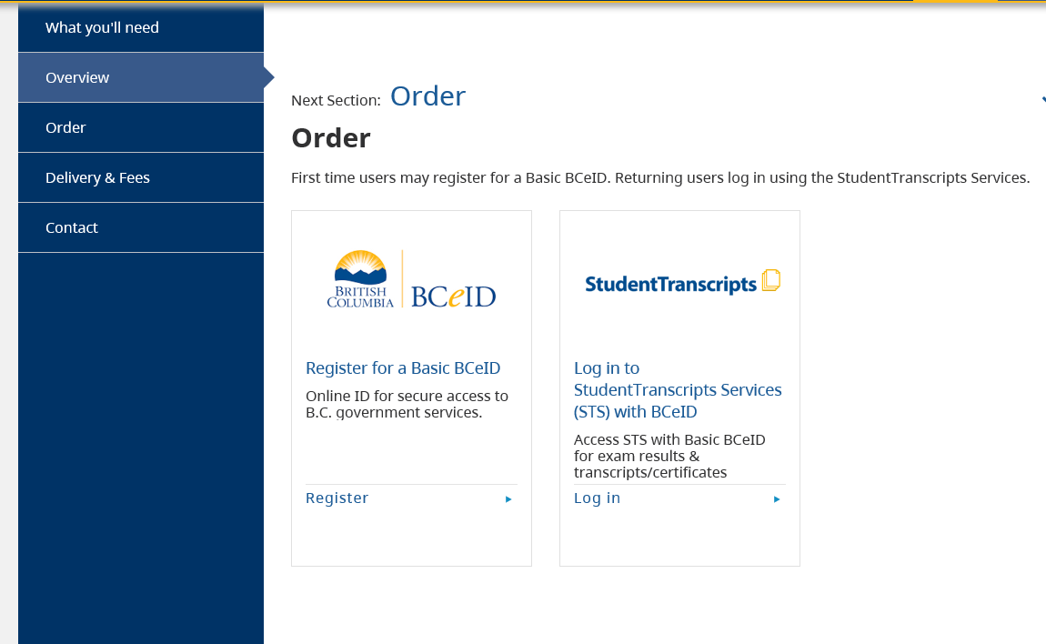
3. Register for BCeID

Slide 6
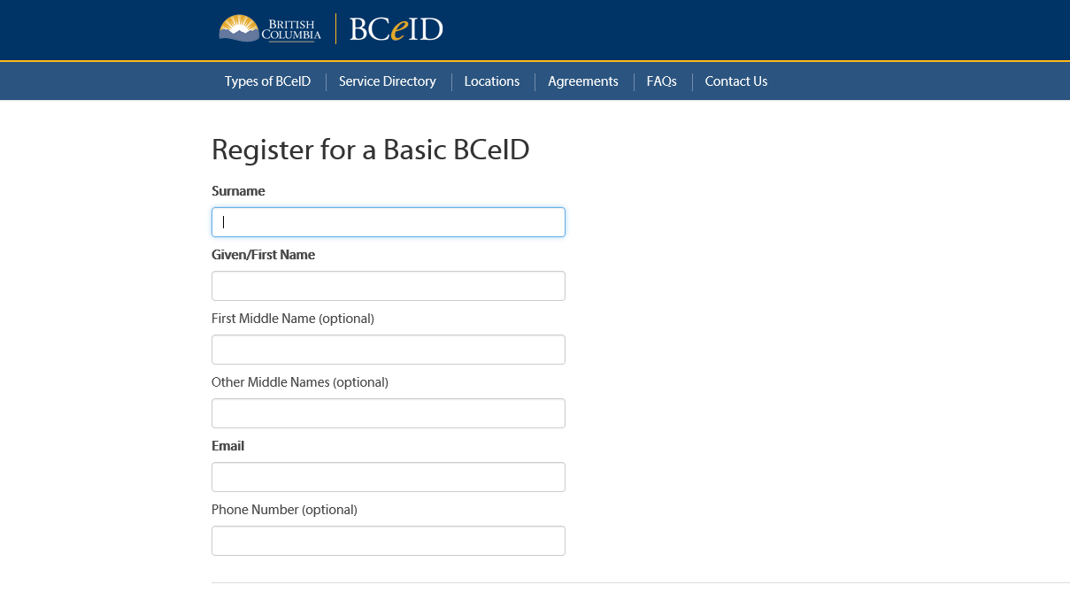
4. Follow the instructions complete the fields to register for a BCeID

Slide 7
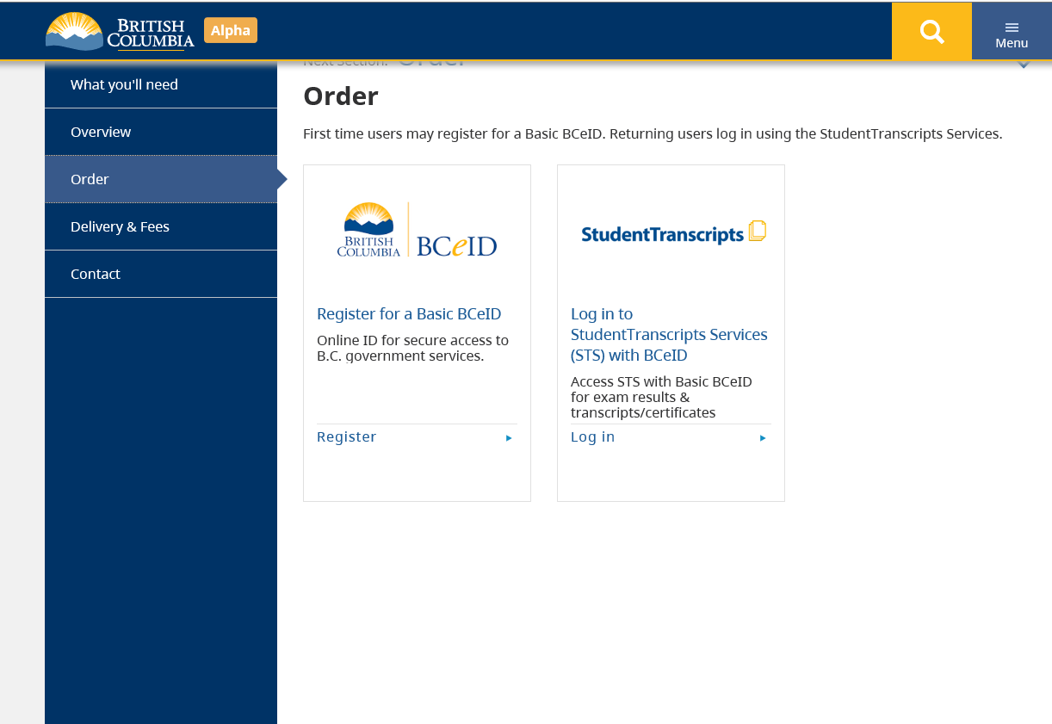
5. Go back to studenttranscripts.gov.bc.ca/ and click “studenttranscripts” under “order”
HOW TO ORDER THE TRANSCRIPTS

Slide 8
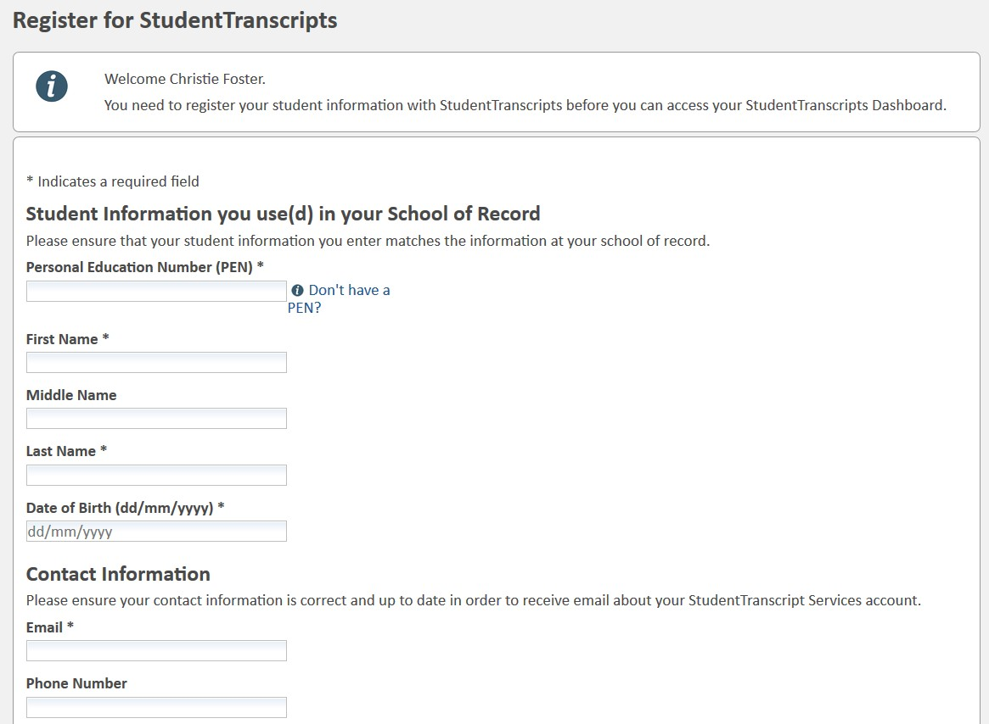
Tip:
PEN, First Name, Last Name and email are mandatory fields and must be correctly entered to avoid delays
*PEN is available on report card
6. Registering for Student Transcripts Service (STS)
8

Slide 9
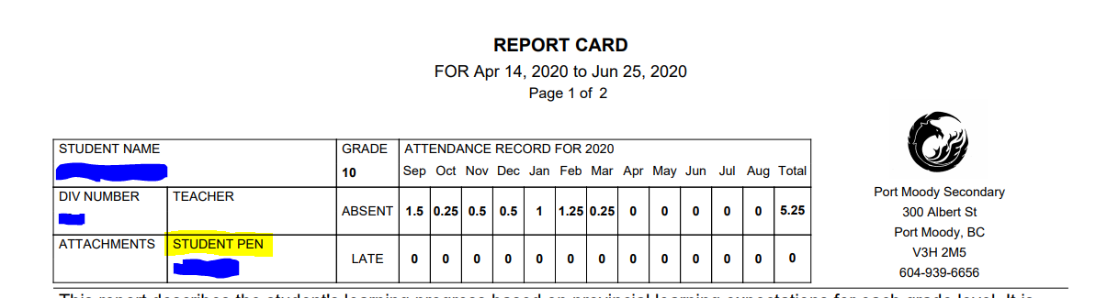
PEN Number Location: at the TOP of your report card

Slide 10
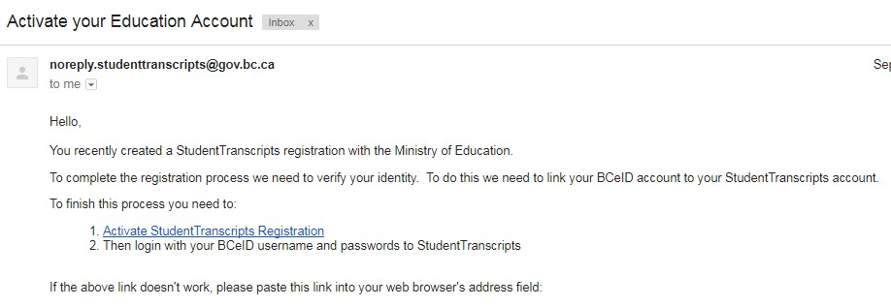
7. Look for an Email…
An Email Confirmation will be sent to activate registration.
Click on link in the email confirmation to link the newly created BCeID to your STS account
MUST ACTIVATE WITHIN 24 HOURS
10

Slide 11
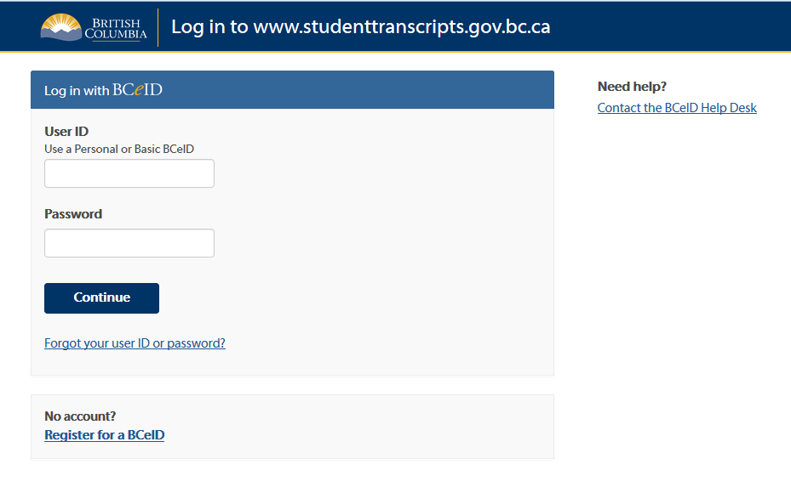
8. The email link will Prompt you to enter your user ID and Password
11

Slide 12
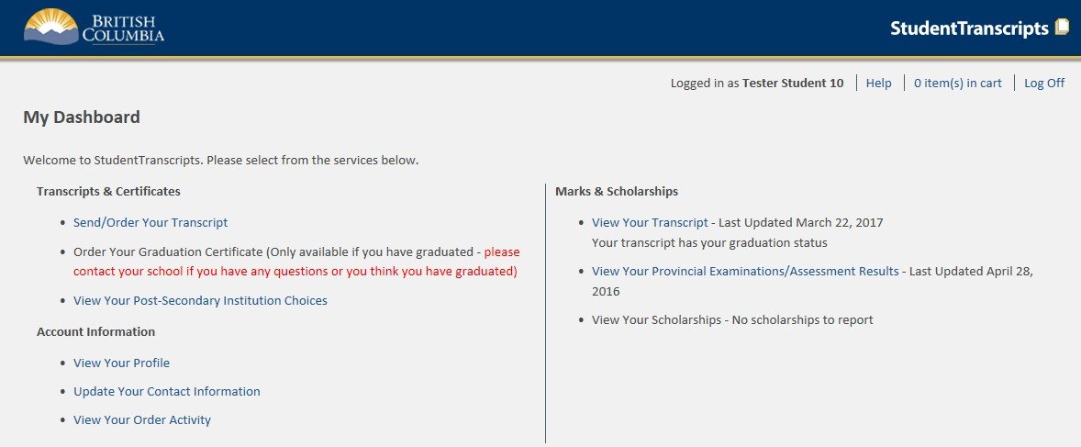

9. It will open to “my dashboard”
Click SEND/ORDER YOUR TRANSCRIPT

Slide 13
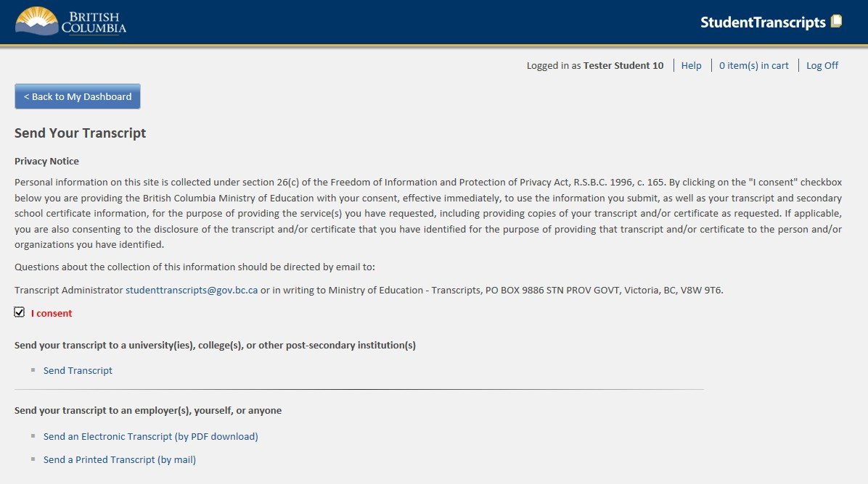
10. Must click “I Consent”
SEND YOUR TRANSCRIPT
Send Transcript to PSI

Slide 14
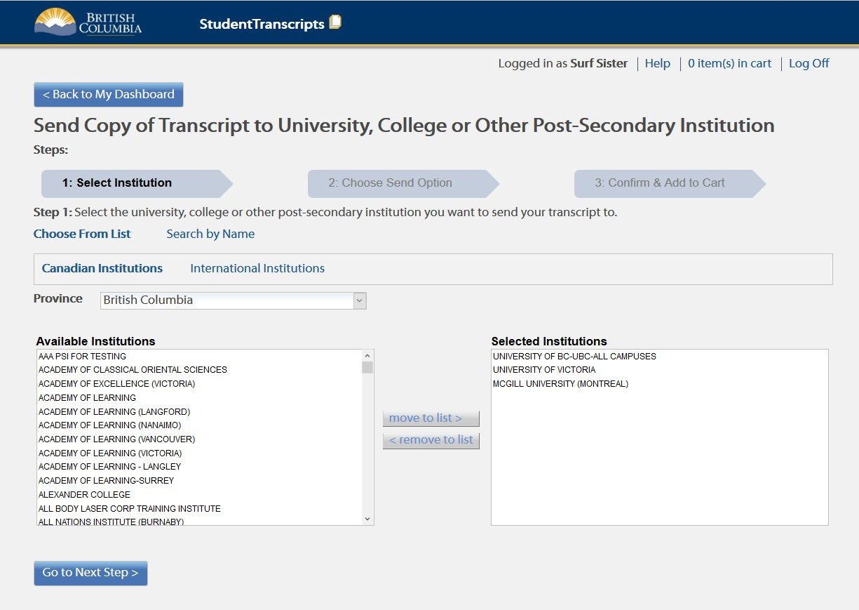
11. Choose your Post Secondary Institutions
1. Select Institution
2. Move to list
3. Go to next step

Slide 15
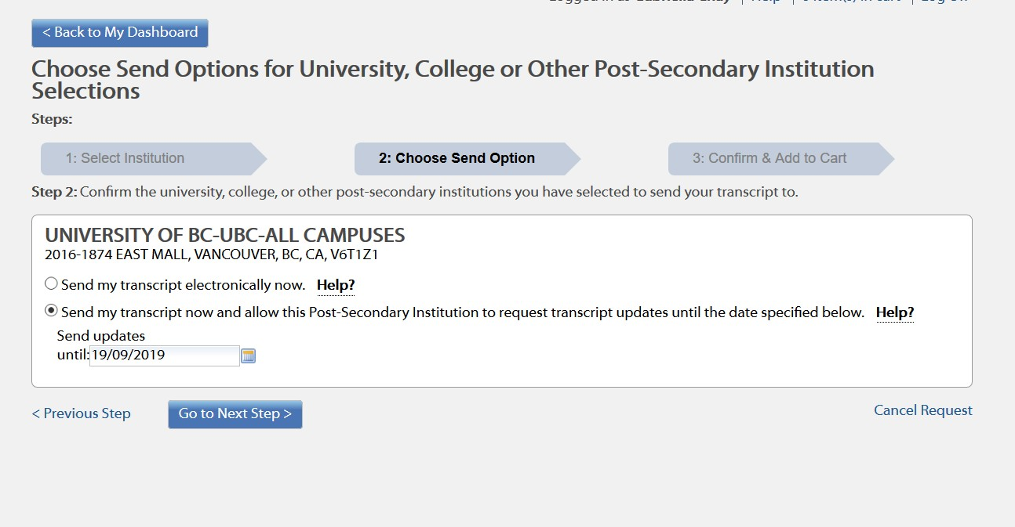
12. Send OPTION 1
For Post- Secondary schools that use XML function (e.g. UBC, SFU)
*LEAVE THE OPTION AS THE DEFAULT* You do not need to change anything!

Slide 16
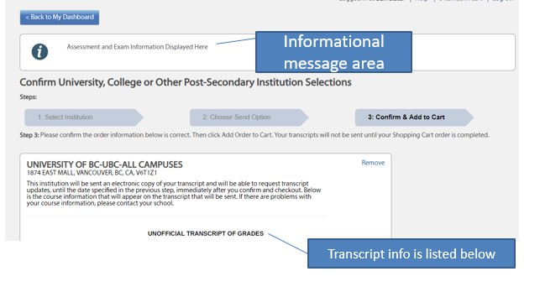
12. Send OPTION 1, continued
For Post- Secondary schools that use XML function(E.g. UBC, SFU, etc)
*Check grades on transcript and check off “I have reviewed my order and course info” at the bottom, then “add to cart”
20

Slide 17
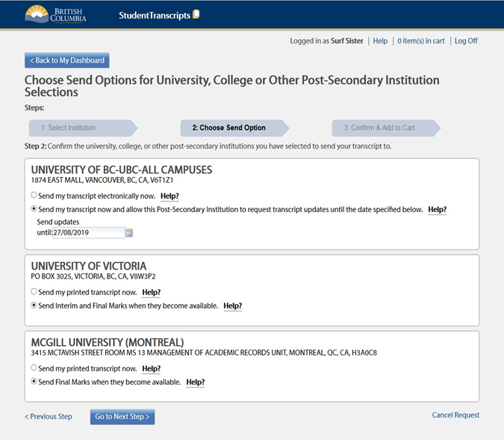
13. Send OPTION 2
For PSI that receives final transcript- *LEAVE OPTION AS DEFAULT*
Go to Next Step
20

Slide 18
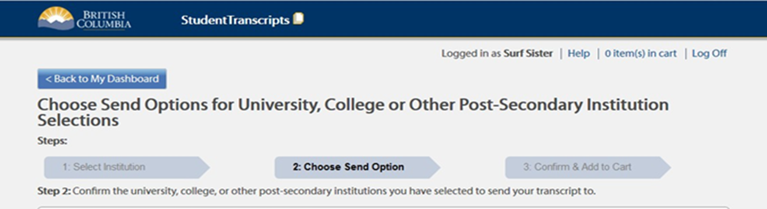

14. Send OPTION 3
For PSI that uses batch process- *LEAVE OPTION AS DEFAULT* (E.g. UVIC) – PSI will receive interim (May) and final marks (July)
Go to next step

Slide 19
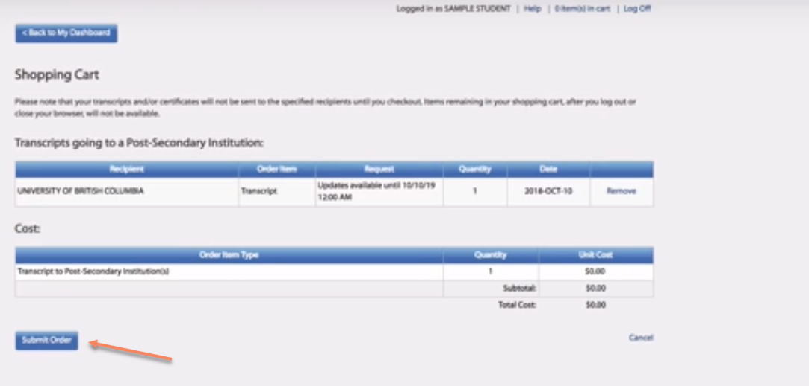
15. Review your order in your Shopping Cart
Click, SUBMIT ORDER

Slide 20
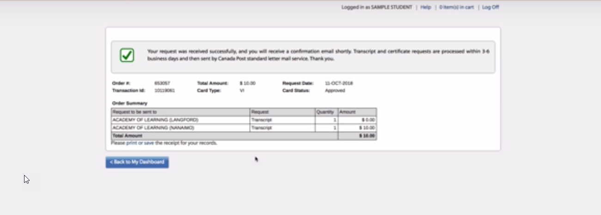
16. Confirm your order
Confirmation of order will be sent to email

Slide 21
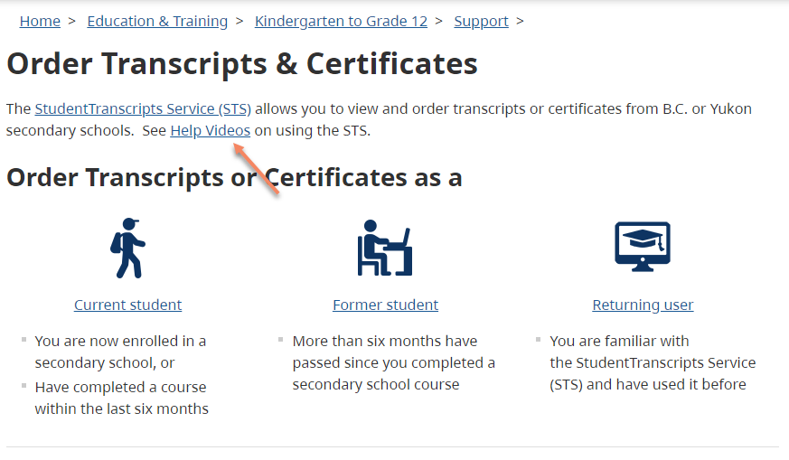
HELP VIDEOS- step by step instructions
(studenttranscripts.gov.bc.ca/)

Slide 22
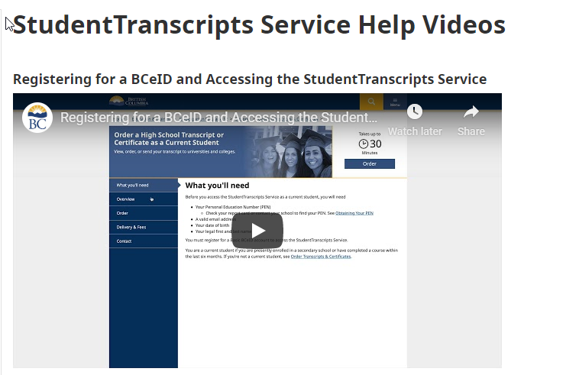
Notes:
https://www2.gov.bc.ca/gov/content/education-training/k-12/support/transcripts-and-certificates/order-a-high-school-transcript-or-certificate
Aprox. 3 minutes on Youtube

Slide 23
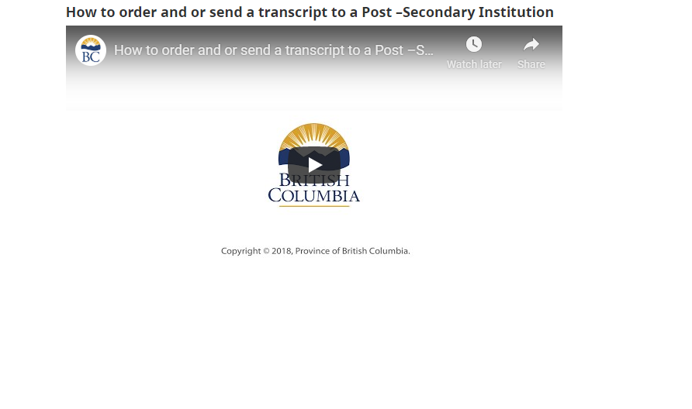
Notes:
Video 2: https://www2.gov.bc.ca/gov/content/education-training/k-12/support/transcripts-and-certificates/help
Aprox. 3 minutes

Slide 24
Counsellors available
Counsellor Student Transcript Services Support Sessions in the Library will be available Thursday and Friday this week.

Slide 25

Must begin the process NOW!
It is the one step that you can do EARLY and gain support from us if there are issues

