Slide 1


DR. CHARLES BEST SECONDARY
Grad 2026

Slide 2


GRADE 12 SURVIVAL GUIDE
Counsellors:
Ms. Rachel John Ms. Zafrin Alam Ms. Irina Birsan rjohn@sd43.bc.ca zalam@sd43.bc.ca ibirsan@sd43.bc.ca
(A-G) (H-O) (P-Z)
Post-Secondary and Career Advisor:
Mrs. Silke Kaufmann
skaufmann@sd43.bc.ca

Slide 3
80 CREDIT GRADUATION PROGRAM
Required Courses (48 credits – including 4 Indigenous course credits)
  English 10 4 Credits
  An English 11 4 Credits
  English 12 4 Credits
  Social Studies 10 4 Credits
  A Socials 11 or 12 4 Credits
  Science 10 4 Credits
  Biol., Chem., Phys., Earth Sc., Sc&Tech 11 4 Credits
  A Math 10 4 Credits
  A Math 11 4 Credits
  Physical Ed. 10 4 Credits
  CLE 10 4 Credits
  a F.A. or App. Sk.10/11/12 2 or 4 Credits
  Numeracy/ Literacy Assessments
  Elective Courses (28 credits – 7 Courses)
  ____________________________12 4 Credits
  ____________________________12 4 Credits
  ____________________________12 4 Credits
  Career Life Connections 4 Credits
  Total: 80 Credits

Slide 4

ASSESSMENTS
  Required to graduate:
  Numeracy 10
  Literacy 10 and 12
  If you have not written a grade 10 assessment, please see your counsellor so that you can be placed on the next assessment date
  French Immersion students:
  Français 12 Assessment

Slide 5



INDIGENOUS COURSE CREDITS
One of the following is required
​​
    EFP English 11
    Contp. Indigenous Studies 12
    Peuples Autochtones 12

Slide 6


CAREER LIFE CONNECTIONS CLC12
  Purpose: Capstone, 30 Hours (grad requirements) and a successful transition out of high school.
  Delivery Model: Blended/Hybrid through MS Teams & monthly in-person workshops. Support is available in every block of every day: Room 309.
  KEY! CLC12 is 4-credit, graded course that will appear on your January report card, June report card, and your high school transcript.
Notes:
7 assignments:
4 of which should have been completed in Grade 11
3 others which include finding a mentor and meeting with them 3 times, 30 hours of volunteer/work experience and a financial plan
Capstone Project (worth 40% of your mark)
<number>

Slide 7
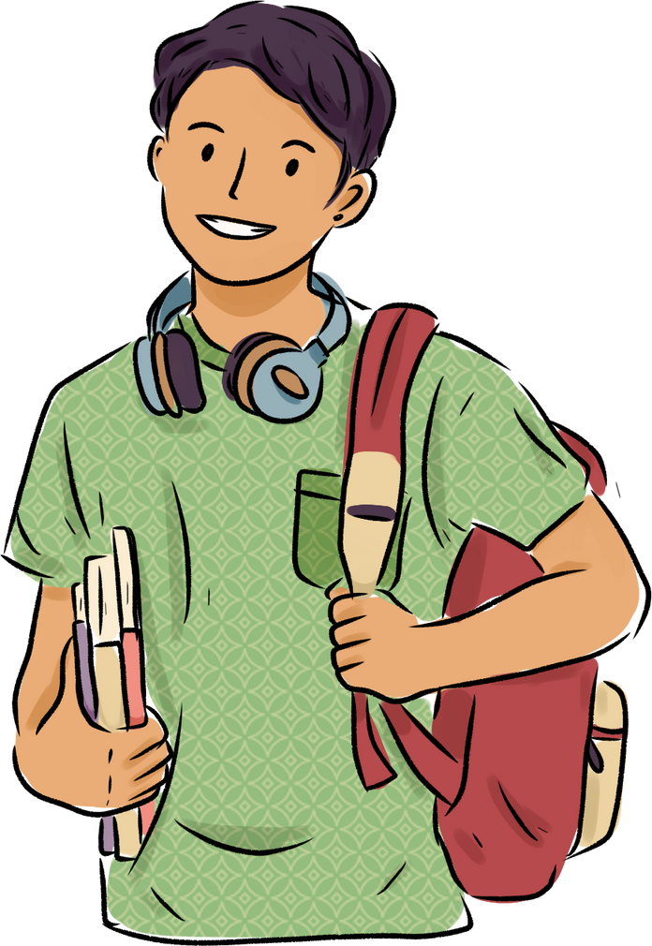
CAREER LIFE CONNECTIONS CLC12
  Part 1: Capstone (50%)
      Showcase project including proposal, two check-in meetings, presentation
      (Jan. 22).
  Part 2: Coursework (50%)
      4 workshops + assignments completed within the workshop
      Evidence of 30-hours (work or volunteer experience)
Notes:
7 assignments:
4 of which should have been completed in Grade 11
3 others which include finding a mentor and meeting with them 3 times, 30 hours of volunteer/work experience and a financial plan
Capstone Project (worth 40% of your mark)
<number>

Slide 8

CAREER LIFE CONNECTIONS CLC12
Upcoming Dates
  Sept. 26 – Capstone Proposal DRAFT 1 is DUE
  Oct. 7 to 23 – Capstone Check-In Meeting #1.
  You must sign-up NOW in room 309.
  Attend during your off block.
  Make sure you’re attached to a Team.
  Visit Room 309 with questions.
  For students who are graduating early or off site in Sem II, make arrangements with your CLC teacher
Notes:
7 assignments:
4 of which should have been completed in Grade 11
3 others which include finding a mentor and meeting with them 3 times, 30 hours of volunteer/work experience and a financial plan
Capstone Project (worth 40% of your mark)
<number>

Slide 9

LANGUAGE CHALLENGE EXAMS
  French
  Japanese
  Korean
  Mandarin
  Punjabi
  Spanish
  Farsi
  ASL 11 (American Sign Language) (NEW)
Application deadline: 23ʳᵈ October 2025
Exam Dates: Jan 31ˢᵗ & Feb 1ˢᵗ, 2026
https://www.deltasd.bc.ca/schools/secondary/challenge-exams/

Slide 10

EXTERNAL COURSE CREDIT
  Credit may be given for coursework taken outside of the school system.
  Examples: Music, Languages, First Aid, Sports (provincial/national level), Cadets, Driver Education, Dance, Scouts, Guides

Slide 11




WHAT ARE YOU GOING TO DO….

Slide 12



POST SECONDARY
The requirements for each institution varies
Please do your research!!

Slide 13
POST SECONDARY PLANNING AND APPLICATIONS
  Douglas College
  BCIT
  SFU
  UBC
  UVic
  Langara
  VCC
  Kwantlen
  Trinity Western
  Capilano University
  Thompson Rivers University
  Univ. of the Fraser Valley
  UNBC
  Corpus Christi
  Farleigh Dickinson
  Canadian Armed Forces
  Selkirk College
  NVIT
  ViU
Ontario Universities are now accepting applications

Slide 14
The pros and cons of
Univeristy
and
College
Which is a better fit for you?

Slide 15
UBC and SFU
  -Applications start early Oct
  -Highly competitive
  -Check program requirements (do your research)
  -Gr11 +12 grades count
  -Transcripts sent through STS after application is in

Slide 16
Polytech and trades schools
  More practical
  BCIT/Kwantlen/VCC
  varying application
  waitlist for some trades
  high job possibilities
  Hands-on learning

Slide 17
  All Grade 11 and 12 students.
  Go to Period 1 class. Attendance will be taken then you will be escorted to the gym. If you do not have a Period 1 class, please report to the small gym at 8:40am.
  Schedule
  8:40 – 8:50 am: Scope of the Day Presentation (Small gym)
  9:00 – 9:25 am: Session 1
  9:30 – 9:55 am: Session 2
  10:05 – 11 am: Mini Fair (large gym)
  Fairleigh Dickinson University University of Victoria
  University of Northern British Columbia Simon Fraser University
  Douglas College Trinity Western University
  Kwantlen Polytechnic University Capilano University
  Vancouver Island University Langara College
  Corpus Christi & St. Mark's Colleges Thompson Rivers University
  British Columbia Institute of Technology University of the Fraser Valley
  Canadian Armed Forces - Royal Military College
POST SECONDARY INSTITUTION DAY
NOVEMBER 26TH

Slide 18
POST SECONDARY APPLICATION
  For B.C schools www.educationplannerbc.ca
Applications for most schools open in early October
  For Ontario schools www.ouac.on.ca
Out of province students should apply as early as possible.
  Many College programs work on a first-come-first-served basis. Apply Now!!

Slide 19
APPLYING TO POST SECONDARY WORKSHOP
OCTOBER 15ᵗʰ AND 16ᵗʰ
AFTER SCHOOL
Room 214

Slide 20
STUDENT TRANSCRIPTS SERVICE (STS)
  An on-line document located under the student secure link at: www.studenttranscripts.gov.bc.ca
  This form gives the B.C. Ministry of Education permission to release marks to the selected post-secondary institutions
  This link is now available
  Form must be submitted before April 30 if you would like your interim grades sent to a post –secondary institution
  October 21ˢᵗ – 23ʳᵈ Block 3 Presentation

Slide 21


SAT
For students going to school in the United States
Some schools need Subject Exams (Check)
Get done by December

Slide 22

B.C. ACHIEVEMENT SCHOLARSHIPS:
$1250
  The Ministry of Education determines recipients
  Based on students’ achievement in Grade 10, 11, and 12 courses that satisfy graduation program requirements.
  Includes elective courses.
  Based on a cumulative average percentage
  Recipients must receive a “B” or greater in English 12.
  Rank among the top 8000 students in B.C.
  Scholarship meeting after school Oct. 8-Wed

Slide 24

District/Authority Scholarships: $1250
  Fine Arts
  Applied Skills
  Physical Activity
  International Languages
  Community Service
  Trades/Apprenticeship
  Indigenous Languages and Culture
SUPERIOR
ACHIEVEMENT
IN ONE OF:

Slide 25

REFERENCE LETTERS
  Attach a Brag Sheet
  Give at least 2 weeks notice to teachers if you require one
  Give also terms of reference for the scholarship

Slide 26


GRADUATION PHOTOS
Novemeber 20– December 4 , 2025
  If you missed these sittings you will need to go to artona.com(follow Links) to arrange for a make-up sitting
  Students must be photographed to appear in the yearbook and on the graduation composite

Slide 27
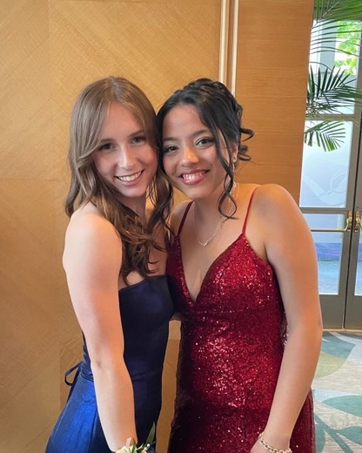
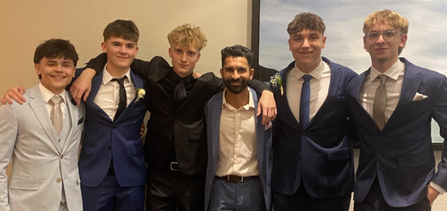
GRAD DINNER DANCE
  Saturday, May 30ᵗʰ
  Fairmont Waterfront
  6 pm

Slide 28



  Following the Dinner/Dance
  Dr. Charles Best Secondary

Slide 29
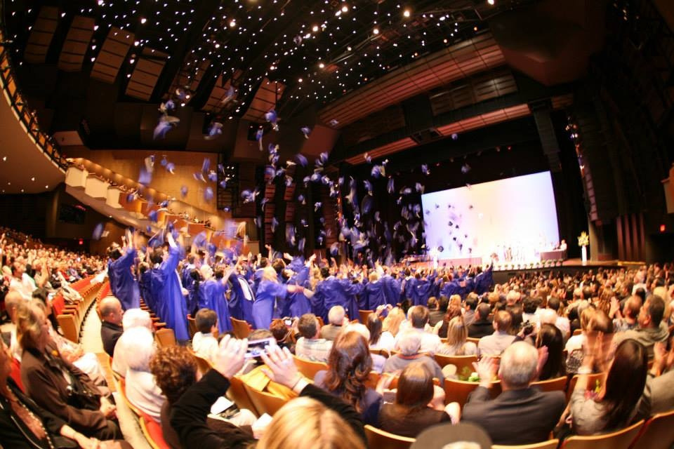
COMMENCEMENT
June 23ᵗʰ 2026
SFU

Slide 30

CONGRATULATIONS TO THE BEST CLASS OF 2026!

Slide 31

SWAG

